Slide 1

Transfusion Medicine
Rowena Punzalan, MD

Slide 2
Outline
Blood products: collection and storage, indications, dosage and administration
Pre-transfusion testing
Transfusion complications and prevention of complications
  Transfusion reactions and prevention (special attributes)
  Transfusion-transmitted disease
  Directed donation
  Refractoriness to platelet transfusion
Therapeutic apheresis
Copyright © 2019 by ASPHO

Slide 3
Blood Components from Whole Blood Donation
WHOLE BLOOD
“Soft” Centrifugation
RBCs
PLT-RICH PLASMA
“Heavy” Centrifugation
PLATELETS
FROZEN PLASMA
Leukoreduction
Washing
Irradiation
Freezing
Thawing at 0C and centrifugation
CRYOPRECIPITATE
PLASMA DERIVATIVES
Copyright © 2019 by ASPHO

Slide 4
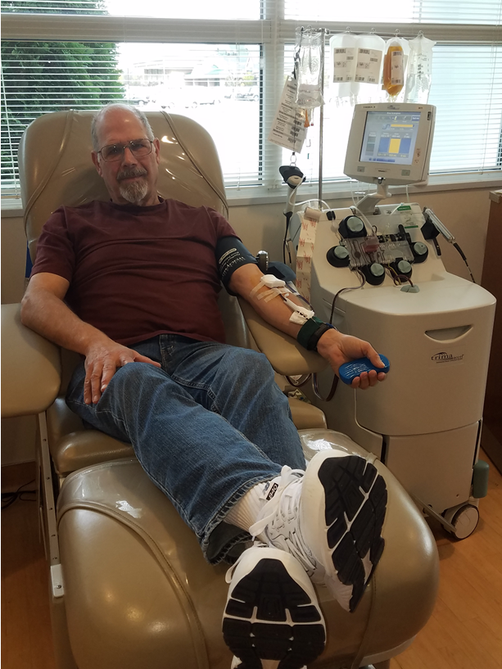
Blood components from apheresis donation
RBCs
Platelets
Plasma
Already leukocyte-reduced
Copyright © 2019 by ASPHO

Slide 5
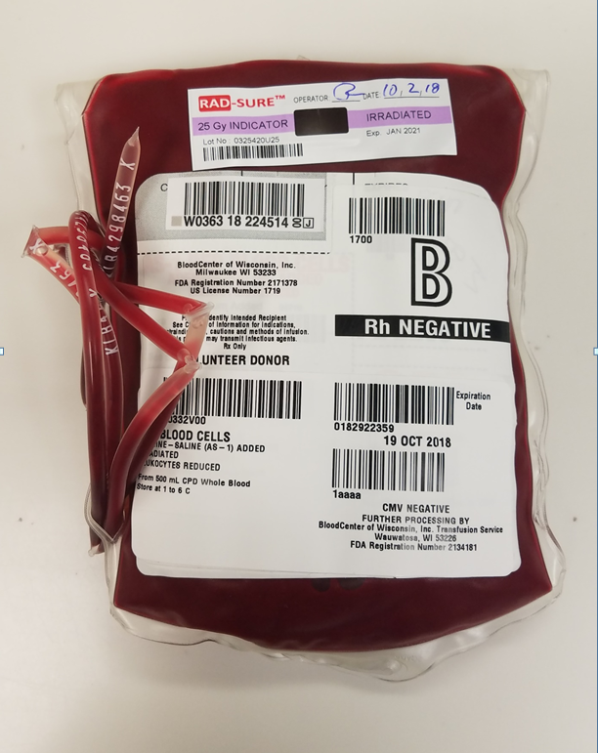
RBCs
Volume: 250-350 ml
  200 ml RBCs (Hct=55-60%)
  50 ml plasma
  100 ml anticoagulant and additive
Stored at 1-6°C
Irradiation decreases storage time to at most 28 days
Copyright © 2019 by ASPHO

Slide 6
The RBC storage lesion
Membrane shape change and microvesiculation
Decreased:
  pH (7.55 at collection to 6.60 after 42d of storage)
  2,3-DPG (to <5% after 42d)
  ATP
Increased:
  K⁺ (from 5 mmol/li at collection to 50 [w/adsol] to 80 [w/o adsol] mmol/li at expiration) *do not give large volumes to those who cannot tolerate K⁺ load
    Irradiation hastens K⁺ leak from stored RBCs
    Hyperkalemic cardiac arrest has been reported in infants (very rare)
  Free Hb
  Lysophospholipids
Copyright © 2019 by ASPHO

Slide 7
Indications for RBC transfusion
Increase O₂-carrying capacity by increasing RBC mass, in symptomatic anemia
Factors that affect the need for transfusion
  Rate of fall of Hb
  Ability to increase cardiac output (heart rate, stroke volume)
  Ability to adequately oxygenate RBCs
    Respiratory failure, cyanotic heart disease
  Ability of RBCs to deliver oxygen to tissues
    Hemoglobinopathies
  Ability of bone marrow to produce more RBCs
    BM failure (disease, iatrogenic, transient v chronic)
  Consequences of poor tissue oxygen delivery (apnea, poor growth, organ dysfunction, coronary artery disease, stroke)
Copyright © 2019 by ASPHO

Slide 8
Transfusion trigger in PICU
 | Restrictive (Keep Hb >7 g/dl) | Liberal (Keep Hb >9.5 g/dl)
Multi-organ dysfunction (#pts/total) | 38/320 (12%) | 39/317 (12%)
# dysfunctional organs | 1.6 ± 1.4 | 1.5 ± 1.2
Death (#pts/total) | 25/230 (7%) | 22/317 (7%)
Nosocomial infection | 65/320 (20%) | 79/317 (25%)
ICU stay after randomization (days) | 9.5 ± 7.9 | 9.9 ± 7.4
# patients that were not transfused* | 174 (54) | 7 (2)
Lowest Hb level during study (g/dl)* | 8.7±0.4 | 10.8±0.5
*p<0.001
Copyright © 2019 by ASPHO

Slide 9
RBC transfusion
Dose:
  Children: 10-15 ml/kg increases Hb by 2-3 gm/dl
  Adults: 1 unit increases Hb by 1 gm/dl
Administered over 2-4 hours (routine) to as fast as possible
Large volume transfusion >20-25 ml/kg over <4 hours
Survival of transfused RBCs: ~ 90 days
RBC aliquots
  Pediatric units, “mini-peds”, syringe
Copyright © 2019 by ASPHO

Slide 10
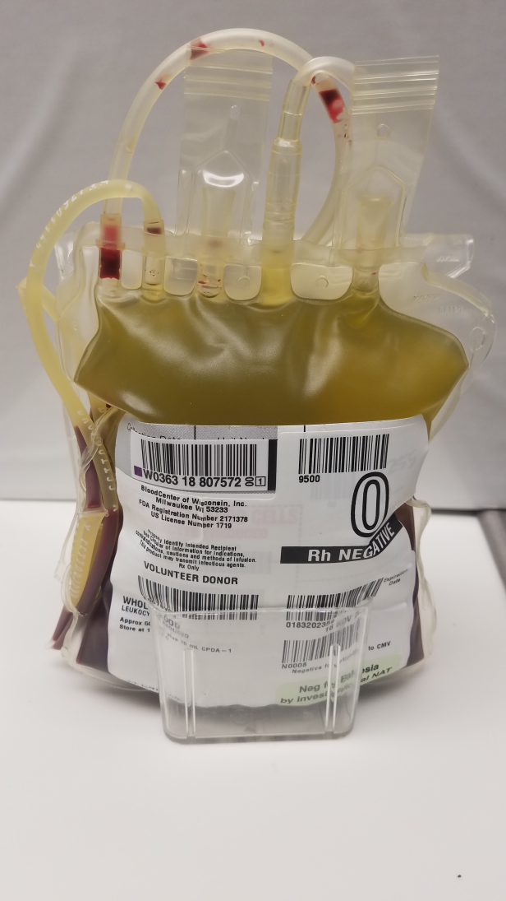
Whole Blood
450-500 ml
  200 ml RBCs
  250 ml liquid plasma
  Platelets not viable after 48h
Stored at 1-6°C, in CPD, for 21 days
Indications:
  ↓ O₂-carrying capacity with need for plasma
  Limit hemodilution (massive blood loss)
  Exchange transfusion in neonates
  Priming CPB circuit
Copyright © 2019 by ASPHO

Slide 11
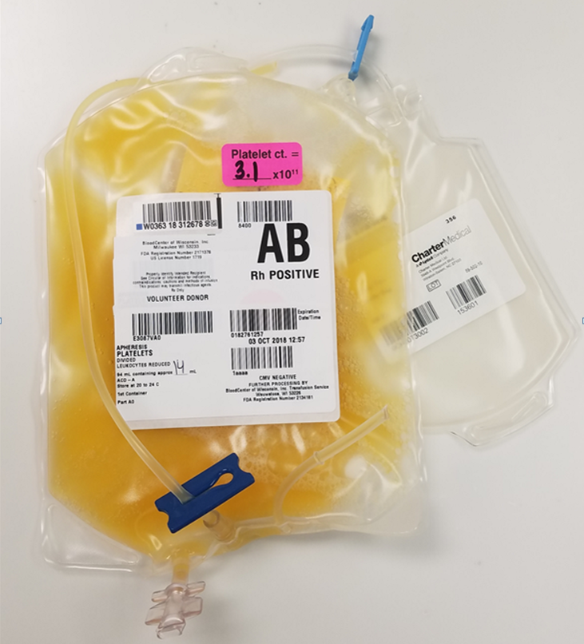
Platelets
Need to be Rh compatible
 | WB-derived | Apheresis
Volume (mostly plasma) | 50-70 ml | 200-300 ml
# platelets | ≥ 5.5 x 10¹⁰ | ≥ 3.0 x 10¹¹
# RBCs | 0.2-0.6 ml | 0.005-0.0002 ml
Storage | 20-24°C w/ gentle agitation x 5d (up to 7d) → risk of bacterial contamination
Dose | Pooled (1 unit/10 kg) | 5-10ml/kg; 10-15ml/kg (infant)
Administration | As volume tolerated
1h plt ct. increment | ~10,000 /μl per unit | 30,000-50,000 /μl per unit (10ml/kg)
Copyright © 2019 by ASPHO

Slide 12
Indications for platelet transfusion
Platelet count | Trigger for transfusion
<10,000 /ml | Thrombocytopenia from malignancy, chemotherapy
<20,000 /ml | Sepsis Mucositis DIC Bleeding Hx Non-tunneled CVL placement/removal BMA/Bx Anticoagulation
<40,000 /ml | Lumbar puncture
<50,000 /ml | Moderate hemorrhage (GI bleeding) Surgery Sick neonate
<75,000-100,000 /ml | Major hemorrhage Significant postoperative bleeding CNS/eye surgery
Any platelet count | Platelet function defect and significant bleeding or surgery
Exceptions: ITP, TTP/HUS, heparin-induced thrombocytopenia
Based on UK National Health Service Pediatric 2017 and ASCO 2018 Guidelines
Copyright © 2019 by ASPHO

Slide 13
Platelet transfusion
Dose: 5-10 ml/kg should raise platelet count by 30-50K/ul
  Up to 15 ml/kg in neonates
  Aliquots: ¼, ½ apheresis platelets, etc
Suspended in plasma, so needs to be ABO-compatible or have low titer of anti-A or –B
Platelets do not have Rh, but contaminating RBCs do: if not Rh-compatible, may need anti-Rh IgG (Rhogam) within 72 h of transfusion
  Most needed in females who have or may have childbearing potential, to prevent hemolytic disease of the fetus and newborn
  Usually not in low risk situations (risk of anti-D forming in Rh- person who gets Rh+ transfusion is 1.4%)
Survival of transfused platelets:
  ~ 3-5 days
  Decreased with thrombocytopenia, fever, infection, splenomegaly, DIC, bleeding, antibodies
Copyright © 2019 by ASPHO

Slide 14
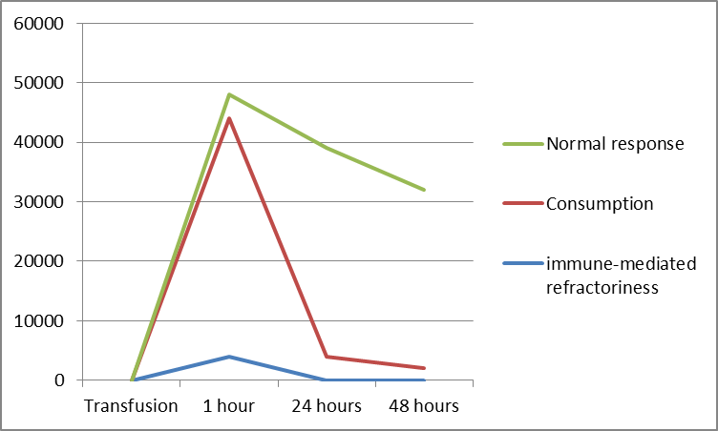
Response to platelet transfusion
Platelet count increase/ul
Corrected count increment = [(post plt count-pre plt count) x BSA (m2) x 10¹¹]/# of platelets transfused
Copyright © 2019 by ASPHO

Slide 15
Platelet refractoriness
Failure to achieve expected platelet count rise after 2 transfusions
Antigens on platelets
  HLA class I
  ABO are not inherent on platelets, but can acquire
  Platelet glycoproteins
  Drug-induced
Approach to platelet refractoriness
  Is it immune-mediated?: get 1-hour post-transfusion count
  HLA-matching
    HLA Ab screen and identification
    HLA class 1 typing
  Platelet crossmatch
  ABO matching
  Increase platelet dose
  Decrease manipulation (washing, VR)
Copyright © 2019 by ASPHO

Slide 16
Approach to platelet refractoriness
Is it immune-mediated?
  Get 1-hour post-transfusion count
  HLA-matching
  HLA Ab screen and type (PRA)
  HLA class 1 typing
  Must be irradiated
Platelet crossmatch
ABO matching
Increase platelet dose
Decrease manipulation (washing, plasma reduction)
Copyright © 2019 by ASPHO

Slide 17
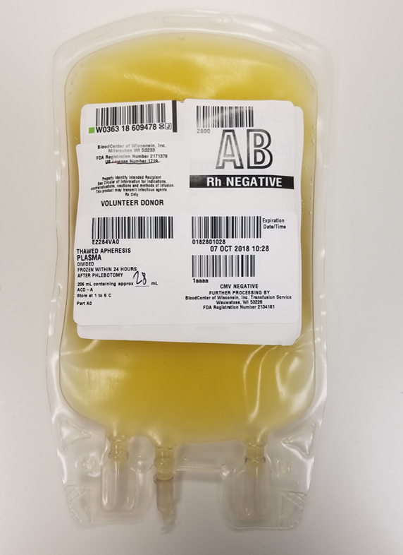
Plasma
200-300 ml
  Procoagulant factors: 1 IU/ml each
  400 mg/dl fibrinogen
  Anticoagulant factors
  Complement, immunoglobulins
Plasma product | Definition | Storage | Expiration
Fresh frozen plasma | Plasma frozen within 8h of collection | -18°C | 12 months
 |  | 1-6°C | 24 hours
PF24 | Plasma frozen within 24h of collection | -18°C | 12 months
 |  | 1-6°C | 24 hours
Thawed plasma | FFP or PF24 that has been thawed between 24h and 5 days | 1-6°C | 5 days
Cryporecipitate-reduced plasma | FFP from which cryoprecipitate was manufactured | 1-6°C | 24 hours
Copyright © 2019 by ASPHO

Slide 18
Indications for plasma transfusion
Replacement of coagulation factors:
  Bleeding with documented coagulopathy
  Replacement or prophylaxis (surgery /procedure) in multiple factor deficiency for which there is no factor concentrate:
    Liver Disease
    Emergent treatment for vitamin K deficiency/reversal of warfarin effect – evidence that prothrombin complex concentrate accomplishes this faster and safer
    DIC (plasma will have anticoagulant factors, which are also consumed in DIC)
    Isolated factor deficiency if no factor concentrate available (factor XI, V)
    TTP
Replacement of anticoagulant and other plasma proteins for which there is no factor concentrate, when clinically indicated (ie, uncontrolled thrombosis, angioedema)
Plasma is not indicated for:
  Volume expansion
  Correction of coagulopathy in the absence of bleeding or thrombosis, or increased risk of both
  Wound healing
  Hypogammaglobulinemia
Copyright © 2019 by ASPHO

Slide 19
Plasma transfusion
Dose: 10-20 ml/kg should raise factor levels to hemostatic levels
Administration: limited by volume
Should be ABO-compatible
Copyright © 2019 by ASPHO

Slide 20
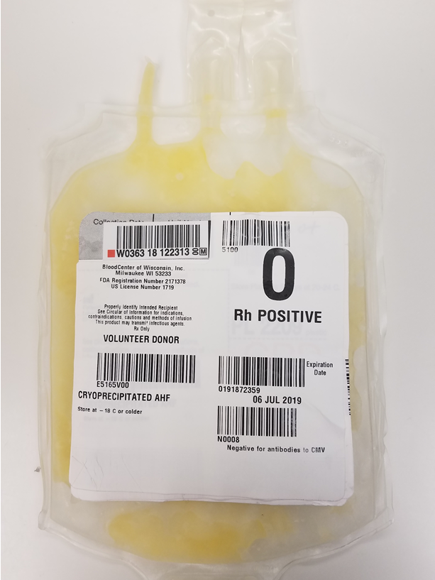
Cryoprecipitate
Aka Cryoprecipitate antihemophilic factor
10-25 ml
  150-250 mg fibrinogen
  ≥ 80 IU factor 8
  80-120 IU vWF
  40-60 IU factor 13
  Fibronectin
  5-20 ml plasma
Frozen within 1 hour of centrifugation; stored at ≤-18○C for 12 months; after thawing, stored at 20-24 ○C for 6 hours
Copyright © 2019 by ASPHO

Slide 21
Indications for and transfusion of cryoprecipitate
Fibrinogen deficiency
  100 mg/dl fibrinogen needed for adequate hemostasis
  Congenital: deficiency or dysfunction
  Acquired (most common): consumption from trauma, ECMO, DIC
Dose: 1 unit per 5-10 kg body weight
Usually pooled into 3, 5, 10 units
Effect: fibrinogen ↑ by 5-10 mg/dl per unit
If getting large volume, or if recipient is small, should be ABO-compatible
Copyright © 2019 by ASPHO

Slide 22
Granulocytes
  Pheresed from G-CSF-stimulated donor
200-250 ml
  ≥ 1.0 x 10¹⁰ granulocytes
  ≥ 3 x 10¹¹ platelets
  ~20-25 ml RBCs (ABO Rh-compatible; crossmatch needed)
  Plasma
  Anticoagulant
Indication: Reversible neutropenia w/ severe bacterial infection unresponsive to appropriate antibiotics
  RING RCT (Blood 2015)
    No difference in survival+microbial response between antimicrobial with and without granulocytes in patients with neutropenia,
    Closed early because of poor accrual
Transfuse ASAP (WBC half-life is hours)
Course of therapy: 1 unit/day x 5 infused slowly
Complications are not uncommon:
  Fever/Chills/Allergy: premedicate (Tylenol, Benadryl)
  Respiratory Distress; Pulmonary Reaction
    Especially w/concurrent Ampho-B; 2-4 hrs between
  Transfusion-associated GVHD: Irradiate product always
Copyright © 2019 by ASPHO

Slide 23
Dosing of blood components for children
Component | Dose (ml/Kg BW) | Expected response
RBC | 10-15 | ⁭ Hb by 2-3 g/dl
Platelet | 5-10 (round to nearest ¼ dose SDP) | ⁭ platelet count by 30-50K/ul
FFP | 10-20 | Clotting factors to 40-50% (hemostatic)
Cryoprecipitate | 1 unit/5-10 kg BW | ⁭ fibrinogen by ≥50 mg/dl
*If BW >50 kg, dose like an adult
Copyright © 2019 by ASPHO

Slide 24
Outline
Blood products: collection and storage, indications, dosage and administration
Pre-transfusion testing
Transfusion complications and prevention of complications
  Transfusion reactions and prevention (special attributes)
  Transfusion-transmitted disease
  Directed donation
  Refractoriness to platelet transfusion
Therapeutic apheresis
Copyright © 2019 by ASPHO

Slide 25
Pre-transfusion testing
ABO and Rh type of recipient
  WB, RBCs, platelets, FFP (ABO)
Antibody Screen
  Antibodies in recipient’s serum v various RBC antigens
Crossmatch
  Detects if patient serum reacts with donor RBCs
Uncross-matched Blood
  Group “O” RBCs issued when time does not allow for completion of pre-transfusion testing
  Safe > 99% of time
Copyright © 2019 by ASPHO

Slide 26
Indirect antiglobulin test: looks for antibodies in serum
Panel or donor RBCs
Recipient serum
Anti-human globulin
(Coomb’s)
Positive
Negative
Direct antiglobulin test: looks for antibodies on RBC
Patient RBCs and serum
Positive
Negative
Copyright © 2019 by ASPHO

Slide 27
The ABO System
Antigen on Red Cells | Blood Group | Antibody in Serum
A | A | Anti-B
B | B | Anti-A
A & B | AB | Neither Anti-A or Anti-B
Neither A or B | O | Anti-A and Anti-B
Copyright © 2019 by ASPHO

Slide 28
Compatibility
Recipient’s ABO group | RBCs and WB | Plasma-containing products (WB, platelets FFP)
O | O | O, A, B, AB
A | A, O | A, AB
B | B, O | B, AB
AB | AB, A, B, O | AB
Copyright © 2019 by ASPHO

Slide 29
Selecting RBC unit for transfusion
Order for transfusion received
History of RBC Ab
Check patient BB record
ABO Rh type
Antibody screen (IAT)
Positive IAT
Negative IAT
Identify RBC Ab (check
against RBC panel of
known Ag type)
Select RBC unit that Ag-negative
Select ABO Rh-compatible unit
IAT crossmatch
Compatible
“Simple” crossmatch
(checks if ABO on label is correct)
Incompatible
(RBC agglutination present)
Transfuse!
Incompatible
Copyright © 2019 by ASPHO

Slide 30
Administration of Blood Products
Positive identification: component and recipient, at bedside
150-280 micron filter
Blood warming (should be slow) to 37°C max
  Adults getting >50 ml/kg/h; kids >15 ml/kg/h; via CVL
  Water bath, in-line warmers, radiant warmer, NOT μwave
Direct observation during first 15 min, then q30 min
Duration of infusion, as clinically appropriate
  RBCs: 2-4 hrs; platelets and FFP: 1-2 hrs
  Maximum: 4 hrs
Documentation: donor unit # or pool #; date, time, amount of infusion; ID of transfusionist; pre- and post-transfusion vitals; any adverse reactions
Copyright © 2019 by ASPHO

Slide 31
Outline
Blood products: collection and storage, indications, dosage and administration
Pre-transfusion testing
Transfusion complications and prevention of complications
  Transfusion reactions and prevention (special attributes)
  Transfusion-transmitted disease
  Directed donation
  Refractoriness to platelet transfusion
Therapeutic apheresis
Copyright © 2019 by ASPHO

Slide 32
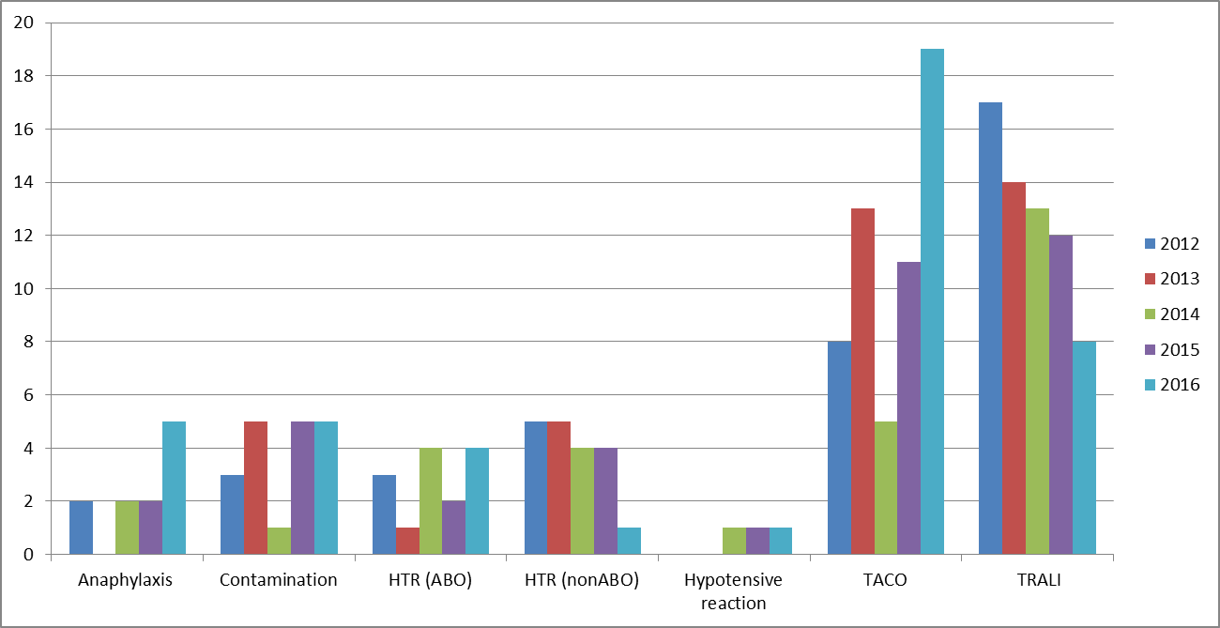
Transfusion-Associated Fatalities reported to the FDA
Number of deaths
Data from https://www.fda.gov/downloads/BiologicsBloodVaccines/SafetyAvailability/ReportaProblem/TransfusionDonationFatalities/UCM598243.pdf
Copyright © 2019 by ASPHO

Slide 33
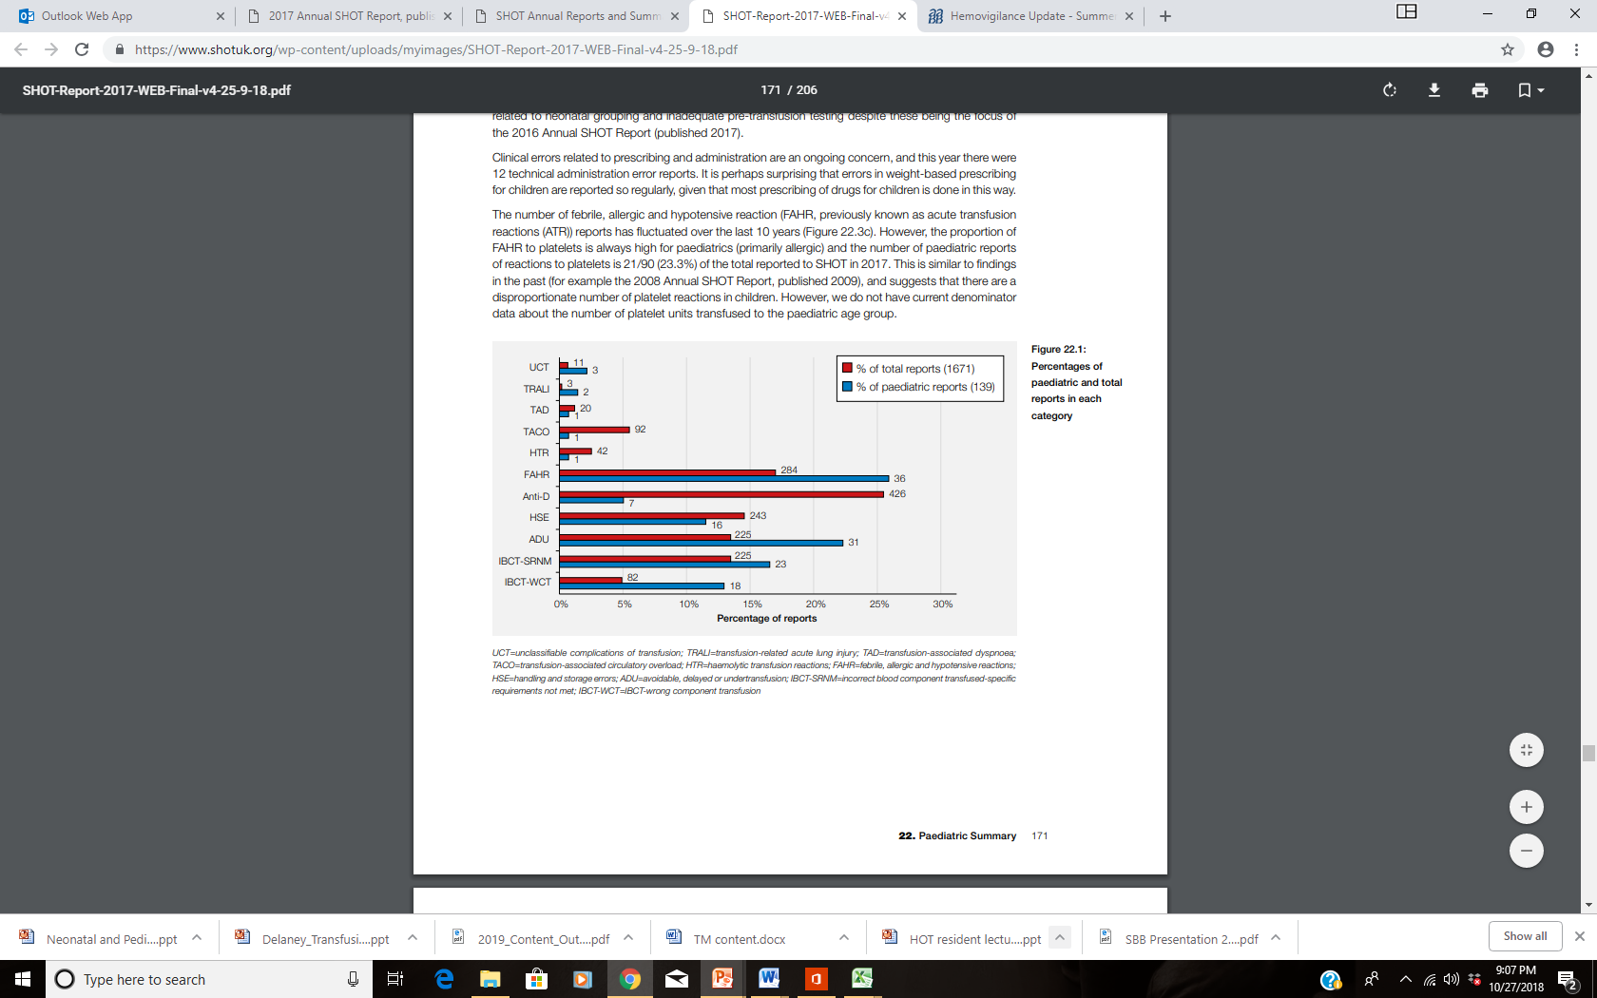
Transfusion-related morbidity in children in the UK 2017
PHB Bolton-Maggs (Ed) D Poles et al. on behalf of the Serious Hazards of Transfusion (SHOT) Steering Group. The 2017
Annual SHOT Report (2018). https://www.shotuk.org/wp-content/uploads/myimages/SHOT-Report-2017-WEB-Final-v4-25-9-18.pdf
Copyright © 2019 by ASPHO

Slide 34
Acute Transfusion Reaction: during or within 6 hours of transfusion
Fever (↑ 1ºC) and/or chills/rigors
  Febrile non-hemolytic reaction
  Hemolytic reaction: pain at infusion site, chest, or back/flank, gross hematuria
  If prolonged or very high, consider bacterial infection
Itching, flushing, rash, and/or hives
Respiratory distress (dyspnea, ↑RR, wheeze, ↓sats)
  Volume overload, anaphylaxis, lung injury, hemolytic
Hypotension
  Hemolytic, bacterial, anaphylaxis, lung injury
Numbness, tingling, nausea, vomiting, arrythmia
ANY acute change in recipient’s condition, assume transfusion reaction until proven otherwise
Copyright © 2019 by ASPHO

Slide 35
When Transfusion Reaction is Suspected
Stop the transfusion!
  It can always be re-started if symptoms mild and promptly relieved
Keep IV line open with 0.9% NS
Monitor vital signs, change in clinical condition
Check all labels, forms, recipient ID
Notify MD
Report reaction to the Blood Bank
Copyright © 2019 by ASPHO

Slide 36
Transfusion Reaction Work-up
Transfusion Reaction form
  Pre- and Post-transfusion vital signs
  Symptom(s) at time of reaction
  Date and Time of suspected reaction
  Unit number and type of blood product(s) transfused at or near time of reaction
Send to Blood Bank:
  Post-transfusion blood samples
    Visual check for hemolysis
    Repeat ABO type
    Serologic check for incompatibility: DAT
  Blood bag, administration set, IV fluid attached
  Post-transfusion urine sample: check for hemoglobinuria
Copyright © 2019 by ASPHO

Slide 37
Acute Transfusion Reactions
Immune
  Hemolytic
  Febrile non-hemolytic
  Allergic/Anaphylactic
  Transfusion-related acute lung injury
Non-Immune
  Sepsis
  Transfusion-associated circulatory overload
  Metabolic complications
Copyright © 2019 by ASPHO

Slide 38
Acute hemolytic transfusion reaction
Lysis or accelerated clearance of RBCs in a transfusion recipient due to immunologic incompatibility between the blood donor and the recipient
From transfusion of Ag-positive RBCs to recipient with pre-existing Ab
  Wrong blood transfused (most common cause)
  Missed antibody on screening/crossmatch
Usually intravascular, dramatic: fever, chills, nausea, vomiting dyspnea, hypotension, pain (back, infusion site, chest), feeling of impending doom, occasionally DIC
Labs: hemoglobinuria, elevated LDH, positive DAT
Treatment: aggressive hydration (NaCl is only compatible fluid), monitor kidneys
Copyright © 2019 by ASPHO

Slide 39
Transfusion Related Fever
Febrile non-hemolytic transfusion reaction
Hemolytic Transfusion Reaction
Bacterial Contamination
TRALI
Related to underlying Disease in Patient
Copyright © 2019 by ASPHO

Slide 40
Febrile non-hemolytic transfusion reaction
Increase of body temp by 1 degree C unrelated to other cause of fever, within few hours of transfusion
Chills, rigors, headache, nausea, vomiting
Causes:
  Systemic inflammatory response to foreign cells or to inflammatory mediators released by leukocytes in transfused product: most common
  Bacterial contamination of product: less common
Management: antipyretics, meperidine if needed
Prevention: premedication, slower infusion, leukoreduction
Copyright © 2019 by ASPHO

Slide 41
Leukocyte reduction
Filtration of blood products, usually at collection, to remove WBC
  Leukocyte reduction filter
  Apheresis collection
Decreases risk for:
  Febrile transfusion rections
  HLA allosensitization to platelets
  Transfusion-transmitted CMV
Copyright © 2019 by ASPHO
Notes:
Image made by M Delaney

Slide 42
Allergic transfusion reaction
Type I immediate hypersensitivity reaction: IgE
Against proteins or other allergens in donor plasma: more common against products with more plasma
Transient localized or generalized urticaria, erythema, pruritus, ± hypotension, angioedema
Mild: cutaneous only or responds readily to antihistamine
Management:
  Stop the transfusion
  H1 blocker
  May re-start transfusion if symptoms resolved and mild
Prevention: pre-treatment with H1 blocker if recurrent, consider plasma reduction or saline washing
Copyright © 2019 by ASPHO

Slide 43
Anaphylactic/anaphylactoid reactions
Type I IgE-mediated reaction involving organ systems (other than skin) and needing added treatment
  Bronchospasm, hypotension, nausea, vomiting, abdominal pain
From infusion of allergen in donor plasma
  For example: IgA into IgA-deficient recipient (1 in 800 people) with anti-IgA
Treatment: epinephrine, bronchodilators, IV fluids, H1 blockers, sometimes H2 blockers, steroids
Prevention
  Documented plasma protein deficiency: saline washing, plasma donor deficient in same plasma protein (family)
  Premedication (steroids, antihistamines) and careful observation
  Saline washing (to remove all plasma proteins)
Copyright © 2019 by ASPHO

Slide 44
Saline washing
Replacement of all plasma in cellular units by centrifugation and removal of supernatant
  Avoids passive transfer of plasma proteins, electrolytes, or antibodies
Indications:
  Prevention of severe allergic transfusion reaction
  Avoid hyperkalemia in vulnerable recipients of older RBC units
  Prevent transfer of significant antibodies (ie, neonatal alloimmune thrombocytopenia)
Effects:
  Platelet loss and activation
  Unit expires within 24 hours of washing
Copyright © 2019 by ASPHO

Slide 45
Plasma reduction
Removes most of the plasma after centrifugation
Usually, only platelets need this (RBCs have very little plasma already)
Uses:
  Decrease transfer of passive antibodies (ABO incompatibility)
  Decrease transfer of plasma proteins or allergens (persistent allergic reactions that are not anaphylactic)
  Decreases volume (for recipients at risk for volume overload)
Some platelet loss
Copyright © 2019 by ASPHO

Slide 46
Sepsis
Suspect when very high new fever during or soon after transfusion
Most commonly from bacterial contamination of platelets (stored in room temp): ~1 in 3000
  In US, all platelets cultured before release
Uncommon from RBCs but some bacteria like the cold (4*C)
  Pseudomonas species, Citrobacter freundii, E. coli, Yersinia enterocolitica
Bacterial contamination from:
  Donor skin flora (inadequate cleaning)
  Occult bacteremia in donor
  Contamination during handling
Copyright © 2019 by ASPHO

Slide 47
Transfusion-associated acute lung injury (TRALI)
Non-cardiogenic pulmonary edema within 6h of transfusion
  DDx: transfusion-associated circulatory overload (TACO)
Proposed mechanisms
  Recipient-directed anti-neutrophil or anti-HLA antibodies from previously sensitized donor incite inflammatory reaction in the lungs, causing vascular leak
  Biologic response modifiers in unit during storage incite same inflammation
Clinical diagnosis: Hypoxemia, cyanosis, tachycardia, hypotension, fever
Testing only to determine if donor needs to be deferred
Management
  Supportive, 72% require mechanical ventilation
  Future transfusions are not contraindicated
5 - 10% mortality
Copyright © 2019 by ASPHO

Slide 48
Metabolic complications of transfusion: neonates
  Hypoglycemia
    Glucose-containing infusions stopped during transfusions
    Exchange transfusion: high glucose load in reconstituted RBCs → ↑ insulin secretion → rebound hypoglycemia (nadir 2h post)
  Hyperglycemia: intolerance to exogenous glucose
  Hypocalcemia
    High citrate load and liver metabolism
    10% Ca gluconate (1ml/kg IV over 10 min)
  Hyperkalemia: leak of intracellular K⁺ from stored RBCs, hemolysis (heat, needle/tubing gauge)
  Know that these can happen, and check levels
Copyright © 2019 by ASPHO

Slide 49
Delayed Transfusion Reactions
Immune-Mediated
  Hemolytic
  Transfusion-associated GVHD
  Posttransfusion Purpura
Non-Immune-Mediated
  Infectious Disease
  Transfusion Hemosiderosis
Copyright © 2019 by ASPHO

Slide 50
Delayed Hemolytic Transfusion Reaction
Accelerated clearance of red blood cells in a transfusion recipient due to de novo antibody production or stimulation recipient memory B cells upon re-stimulation with antigen
Delayed onset: 5-10 days after transfusion
Antibodies not detected at Ab screen
Usually causes extravascular hemolysis
Low Hgb, jaundice, indirect hyperbilirubinemia, increased LDH, spherocytosis, reticulocytosis, positive Ab screen, positive DAT
Copyright © 2019 by ASPHO

Slide 51
Transfusion-associated Graft Vs Host Disease (GVHD)
Cause: Immunocompetent lymphocytes in donor blood recognize the recipient as "foreign” → engraftment and proliferation in recipient
Recipients at risk
  Immunocompetent but cannot recognize donor cells as foreign because of similar HLA antigen: close relative, HLA-matched donor
  T-cell immunosuppressed recipient: bone marrow transplant, heavily treated with chemotherapy, SCID, premature neonate
Donor cells mount immune reaction against recipient cells:
  Refractory pancytopenia
  Fever, enterocolitis, rash, hepatitis
>90% fatal
Management: supportive
Prevention by irradiation
Copyright © 2019 by ASPHO

Slide 52
Gamma irradiation
2500 cGy to the center prevents T-cell proliferation by damaging nucleic DNA
Components that need irradiation: WB, RBC, platelets, fresh plasma, granulocytes
  T-cells don’t survive freezing and thawing so previously frozen products do not need irradiation: FFP, cryo
Effects on RBCs:
  Decreases lifespan of stored RBCs
  Increases K⁺ release into supernatant
Platelet function is not impaired
Neutrophil chemotaxis and superoxide generation not impaired at current doses
Irradiate products to recipients at risk
  Immunocompetent but cannot recognize donor cells as foreign because of similar HLA antigen: close relative, HLA-matched donor
  T-cell immunosuppressed recipient: bone marrow transplant, heavily treated with chemotherapy, SCID, premature neonate
Copyright © 2019 by ASPHO

Slide 53
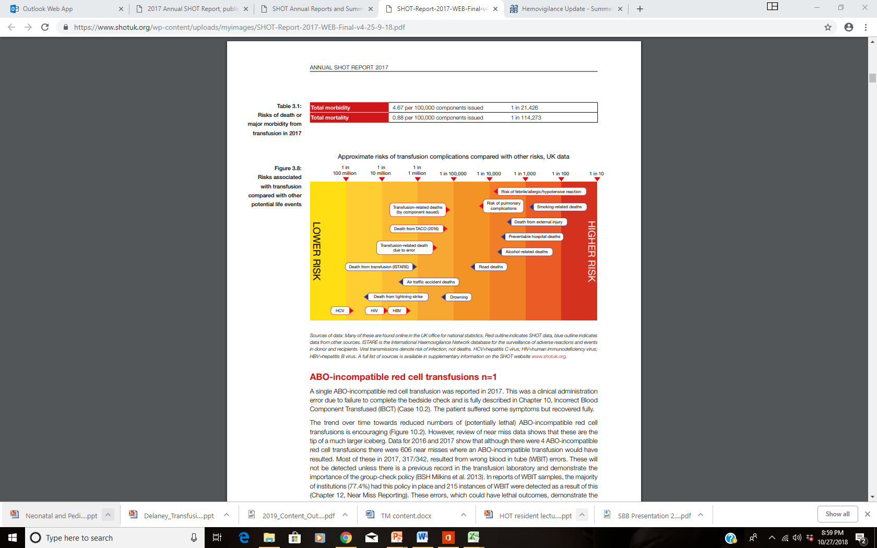
Relative risks of transfusion (UK data 2017)
PHB Bolton-Maggs (Ed) D Poles et al. on behalf of the Serious Hazards of Transfusion (SHOT) Steering Group. The 2017
Annual SHOT Report (2018). https://www.shotuk.org/wp-content/uploads/myimages/SHOT-Report-2017-WEB-Final-v4-25-9-18.pdf
Copyright © 2019 by ASPHO

Slide 54
Donor screening for infectious disease in US
HIV Ab, RNA
Hepatitis C Ab, RNA
Hepatitis B surface Ag, core Ab, RNA
HTLV I/II
Syphilis
West nile virus RNA
Zika
T. cruzi
Babesia: not all states
CMV: required for all leukocyte-rich hematopoietic cells
Not screened:
  Creutzfeld-Jakob disease
  Variant Creutzfeld-Jakob disease
  Malaria
  Hepatitis E
  Unknown pathogens
Copyright © 2019 by ASPHO

Slide 55
Residual risk of transfusion-transmitted infection in US
Hepatitis B | 1:250,000-1.5 mil
Hepatitis C | 1:1,500,000
HIV | 1:2.9 – 4.7 million
HTLV I & II | 1:2,000,000
Bacterial Contamination | Platelets 1:12,000 RBC’s 1:500,000
Copyright © 2019 by ASPHO

Slide 56
Cytomegalovirus
Member of herpes family of viruses
Can cause serious morbidity and mortality in immunosupressed patients: transplant patients, low birth weight neonates
Infection benign in non-risk recipients
Seroprevalence~50%
Highly white cell-associated (monocytes)
Transmission of CMV can be prevented by:
  Providing cellular products from CMV-seronegative donor
  Leukocyte reduction of cellular products
Copyright © 2019 by ASPHO

Slide 57
Directed donation
Belief that donation from someone patient/family knows
  Is safer than the community blood supply
  Decreases number of donor exposures
DD had higher:
  Deferral rates for positive infectious disease screens
  True-positive rates of transmissible disease
  High-risk (for infectious disease) activity
In children who received blood from DD for surgery, no decrease in number of blood donor exposure compared to those who received blood from volunteers
Not available emergently
For closely biologically related donors, risk of HLA sensitization against that relative, who will then not be eligible to be transplant donor
All units must be irradiated
Copyright © 2019 by ASPHO
Wales, Journal of Pediatric Surgery, 2001
Notes:
Image is personal image of M Delaney
Historically, transfusion medicine specialty physicians worried that directed donors would be less safe than community donors because they are under considerable pressure to donate and might not be candid about their medical and risk-behavior history.

Slide 58
Outline
Blood products: collection and storage, indications, dosage and administration
Pre-transfusion testing
Transfusion complications and prevention of complications
  Transfusion reactions and prevention (special attributes)
  Transfusion-transmitted disease
  Directed donation
  Refractoriness to platelet transfusion
Therapeutic apheresis
Copyright © 2019 by ASPHO

Slide 59
Therapeutic apheresis (TA)
Removal and discarding or manipulation of blood constituents, and return to patients, to treat various conditions, using pheresis machine
Goals
  Remove pathologic cells or plasma components from patients blood
  Replace deficient elements
  Alter function of cells
  Collect cells to manipulate for further treatment
Methods
  Centrifugation
  Adsorption
  Extracorporeal photopheresis
  Filtration
Copyright © 2019 by ASPHO

Slide 60
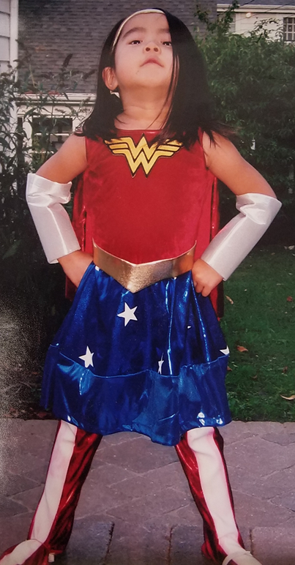
Continuous flow centrifugation apheresis
Return: plasma,
albumin
Anticoagulant
Discard
Blood in
Component
removed out
Rest of blood out
Copyright © 2019 by ASPHO

Slide 61
TA modalities
Therapeutic plasma exchange (TPE)
Red cell exchange
Erythrocytapheresis
Leukocytapheresis
Thrombocytapheresis
Extracorporeal photopheresis
Selective adsorption (lipids)
Rheopheresis
Hematopoietic stem cell collection
Whole blood exchange
Copyright © 2019 by ASPHO

Slide 62
Evaluation for TA
Indication for TA and correct modality: American Society for Apheresis Guidelines
Vascular access: how many procedures?
  Peripheral access preferred
  CVCs with rigid walls to accommodate negative pressure of withdrawal
Replacement fluid for TPE
  Need blood warmer?
Anticoagulant: platelet count
  Acid-citrate-dextrose
  Heparin
  Monitor and replace calcium
Can child tolerate sitting still for at least 90 min (1 blood volume processed)? Sedation?
If <25 kg, does child need priming of machine with RBCs?
  Machine volume 200-300 ml
Medications that may be removed: highly protein-bound
Copyright © 2019 by ASPHO

Slide 63
Risks of TA
CVC
  Line malfunction
  Infection
  Thrombosis
Transfusion-associated events
  Fever, allergic reaction
Other adverse events are mild and not uncommon, but transient and does not preclude finishing or repeating treatment
  Hypotension, paresthesia, urticaria, nausea, chills, flushing, abdominal pain
  Tiredness
Copyright © 2019 by ASPHO

Slide 64
Therapeutic plasma exchange
Remove plasma to:
  Remove unwanted component
  Replacement of needed component
  Both
Common indications:
  Thrombotic thrombocytopenic purpura
  Antibody-mediated transplant rejection
  Antibody-mediated neurologic disease
Replacement fluid:
  Albumin +/- normosaline
  Plasma: if plasma component needed, or bleeding risk
  Mixture of both
Copyright © 2019 by ASPHO

Slide 65
Red cell exchange
Remove abnormal RBCs and replace with normal donor RBCs
Sickle cell disease complications, to decrease HbS% to as low as possible (simple transfusion would get HbS ~60% at most)
  Stroke
  Sepsis with organ dysfunction
  Cardiorespiratory failure
  Acute chest syndrome unresponsive to other therapy
Copyright © 2019 by ASPHO

Slide 66
Extracorporeal photopheresis
Leukapheresis-based immunotherapy
3 steps:
  Leukapheresis
  Photoactivation of psoralen-treated MNCs by UV light, causing apoptosis
  Reinfusion
Treatment of cutaneous T-cell lymphoma and transplant-associated GVHD
Possible mechanism of action: Increases tolerogenic semi-mature dendritic cells and T-regulatory cells that can induce tolerance of donor T cells to host antigens (Lamioni et al, 2005; Goussetis et al, 2012)
Copyright © 2019 by ASPHO

