Slide 1

Myeloproliferative, Myelodysplastic and Histiocytic Disorders
Kenneth McClain M.D. Ph.D.
klmcclai@txch.org

Slide 2
DISCLOSURES
No financial disclosures
No drugs are approved for Pediatric Oncology
THIS TALK/SLIDEDECK IS ORGANIZED TO ABP Guidelines (Updated from Carl Allen’s 2017 Lecture)
RED or Green = PAY ATTENTION
Copyright © 2019 by ASPHO

Slide 3

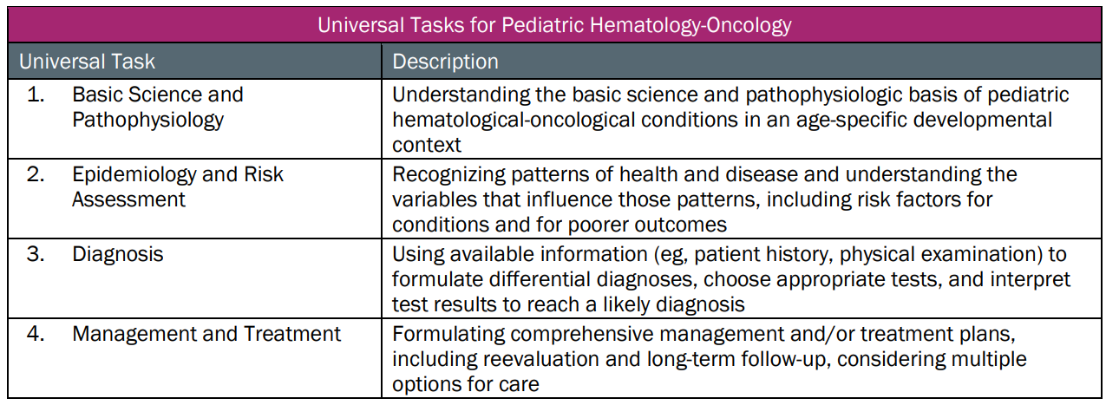
This talk will follow the topical structure suggested by the ABP:
Copyright © 2019 by ASPHO

Slide 4
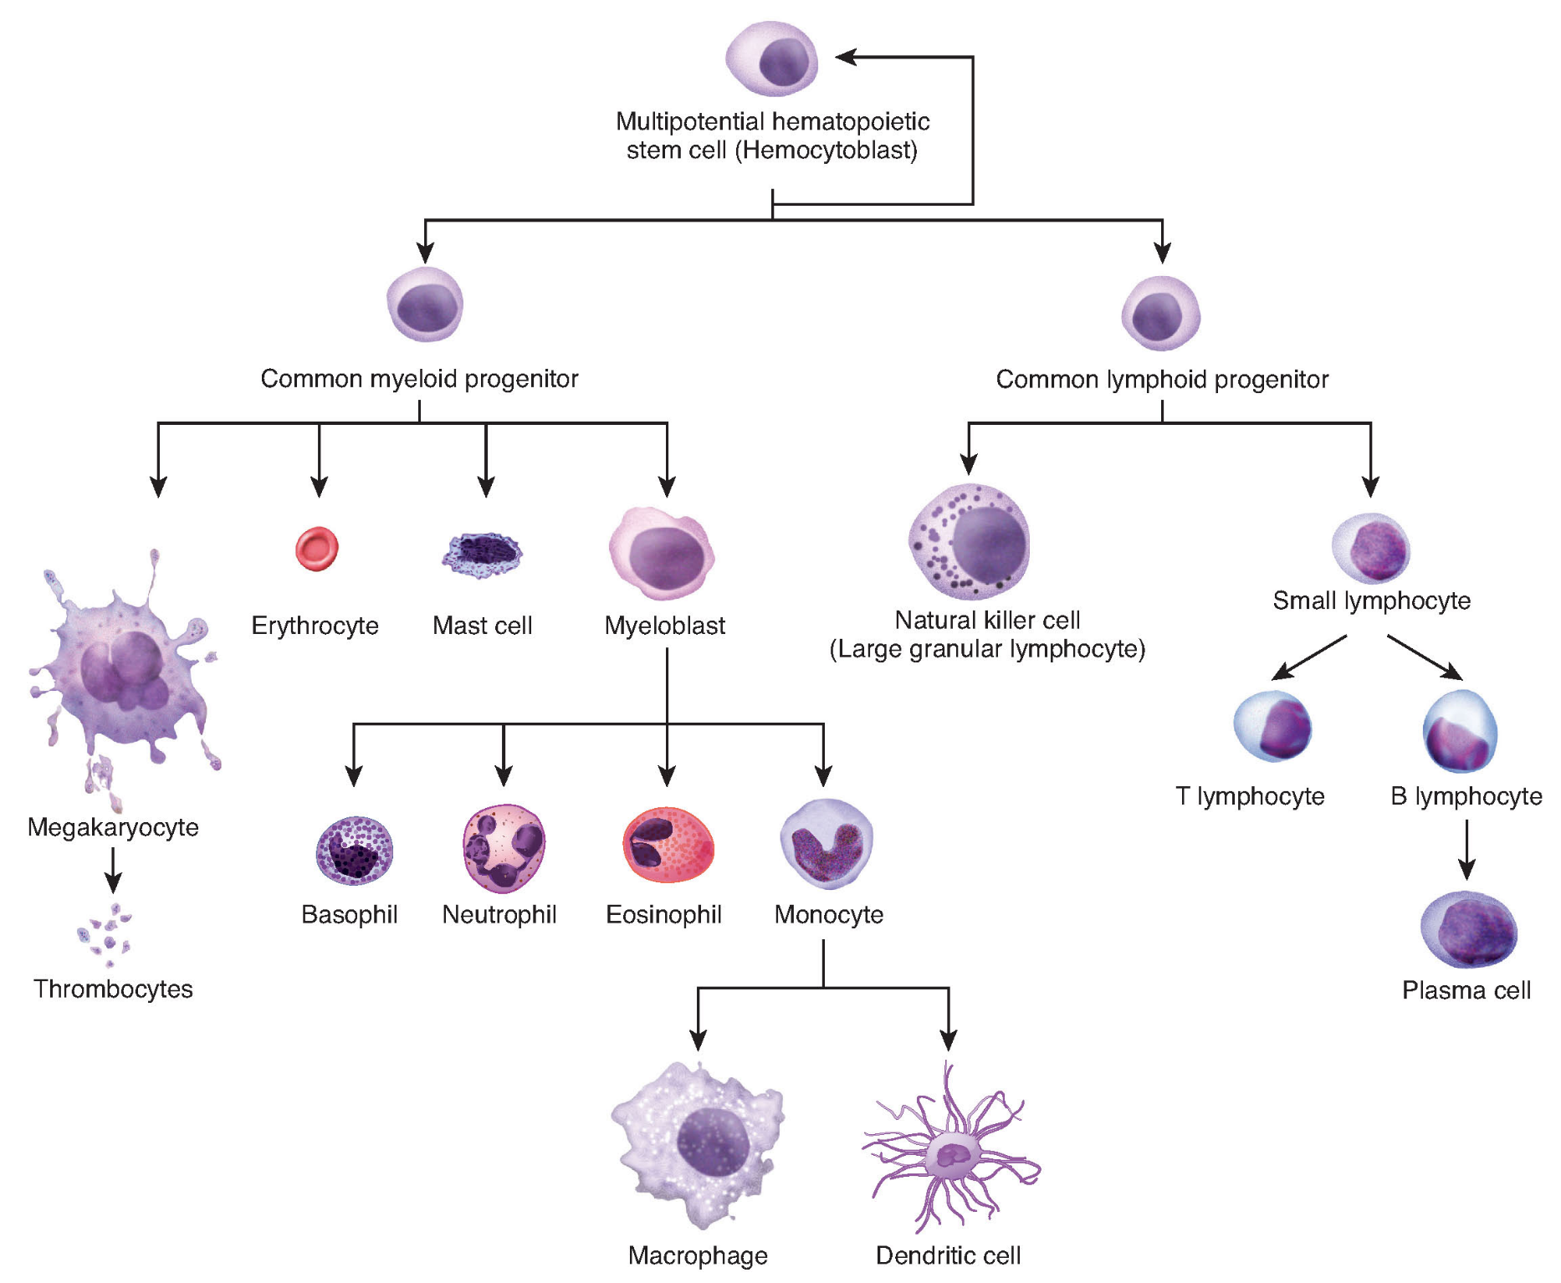
Copyright © 2019 by ASPHO
© 1999-2016, Rice University. Except where otherwise noted, content created on this site is licensed under a Creative Commons Attribution License 4.0 License.; partners@openstaxcollege.org.

Slide 5
Part I: Myeloproliferative, Myelodysplastic Syndromes
Basic Science and Pathophysiology
Epidemiology and Risk Assessment
Diagnosis
Management and Treatment
Copyright © 2019 by ASPHO

Slide 6
Myelodysplastic Syndromes
Cytogenetics
  Monosomy 7 most common
  Trisomy 8, Trisomy 21 also common
    differentiate from germline mosaicism
  3 or more chromosomal aberrations (at least 1 structural) is strongest predictor of poor outcome
Secondary MDS
  After chemotherapy or radiation therapy
  Inherited BMF disorders and familial diseases
Copyright © 2019 by ASPHO

Slide 7
Myelodysplastic Syndromes
Idiopathic Bone Marrow Failure (IBMF) vs
Refractory Cytopenia of Childhood (RCC)
  RCC can arise in setting of IBMF (Fanconi A, dyskeratosis, etc)
  Important to consider and evaluate
Emerging Inherited Risk (Germline Mutations)
  RUNX1, CEBPA:
    AML predisposition
  GATA2 – MonoMAC syndrome
    immune deficiency - absent/decreased monos or macs
    Susceptibility to mycobacterial infections, HPV
    Pulmonary alveolar proteinosis
    Lymphedema + MDS/AML = Emberger Syndrome
Copyright © 2019 by ASPHO

Slide 8
Myelodysplatic syndromes
Basic Science and Pathophysiology
Epidemiology and Risk Assessment
Diagnosis
Management and Treatment
Copyright © 2019 by ASPHO

Slide 9
Myelodysplastic Syndromes
MDS=myeloid lineage is broken and not working normally
  1-4 cases/million
  Median age 6.8 years; equal boys and girls
WHO classification (2008):
  Refractory cytopenia of childhood (RCC)
    Peripheral blood blasts <2% and/or BM blasts<5%
  Refractory anemia with excess blasts (RAEB)
    PB blasts 2-19% and/or BM blasts 5-19%
  RAEB in transformation (RAEB-T)
    PB and/or BM blasts 20-29%
  MDS/MPN
    JMML, CML, BCR-ABL-neg CML
  Down Syndrome-related
    TAM, MDS/AML
Copyright © 2019 by ASPHO

Slide 10
Myelodysplatic Syndromes
Basic Science and Pathophysiology
Epidemiology and Risk Assessment
Diagnosis
Management and Treatment
Copyright © 2019 by ASPHO

Slide 11
Myelodysplastic Syndromes-Many flavors
Non-heme disorders
  Infection (e.g. parvovirus)
  Vitamin deficiency (e.g. vitamin B12, folate, vitamin E deficiency)
  Metabolic disorders (e.g. Mevalonate kinase deficiency)
  Rheumatologic disease (e.g. JIA with MAS)
  Mitochondrial disorders (e.g. Persons)
Hematologic disorders
  Inherited bone marrow failure syndromes
  Severe apastic anemia
  Refractory cytopenias of childhood
  Paroxysmal nocturnal hemoglobinuria with BM failure
  B-cell ALL pre-phase
  Hemophagocytic lymphohistiocytosis
  Autoimmune lymphoproliferative syndrome(s)
Copyright © 2019 by ASPHO

Slide 12
Myelodysplastic Syndromes
Refractory Anemia with Excess Blasts (RAEB) in children
  Histologically similar to adults
  Unlike adults, counts may be stable for months
  AML-type chemotherapy prior to BMT may not be necessary for RAEB-T
Copyright © 2019 by ASPHO

Slide 13
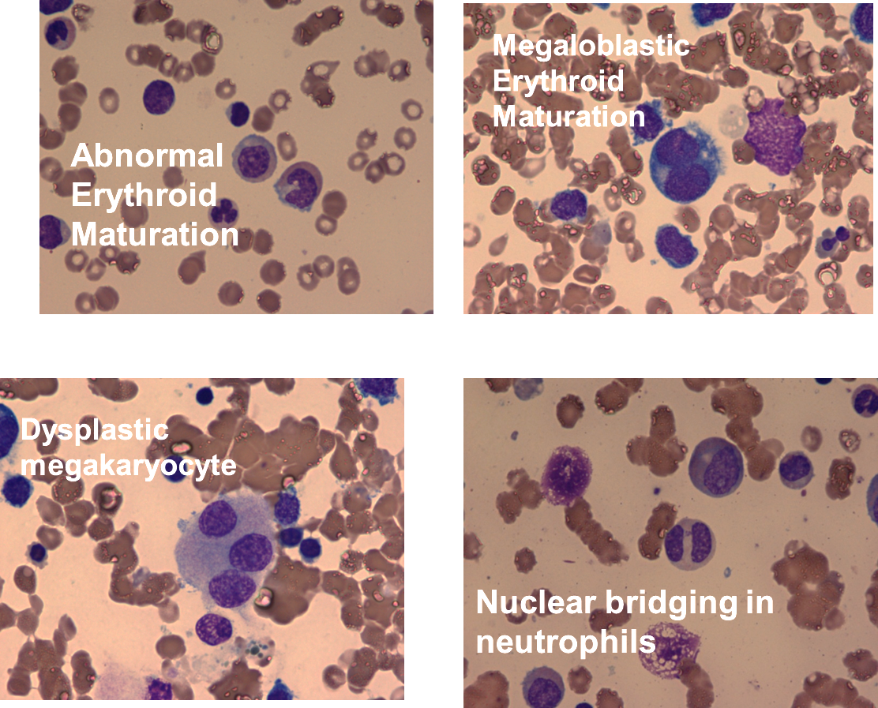
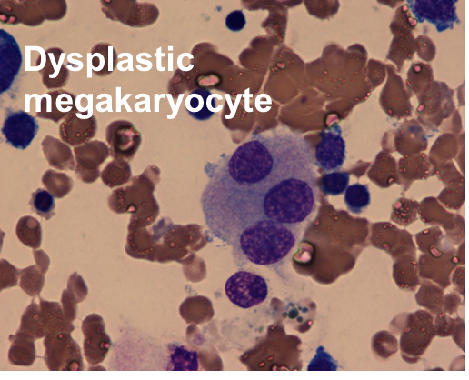
Myelodysplastic Syndromes-Bone Marrow Findings
Copyright © 2019 by ASPHO
Image courtesy of Don Mahoney

Slide 14
Myelodysplastic Syndromes
Basic Science and Pathophysiology
Epidemiology and Risk Assessment
Diagnosis
Management and Treatment
Copyright © 2019 by ASPHO

Slide 15
Myelodysplastic Syndromes
Treatment
  Observe if appropriate
  Evaluate for inherited DNA repair defect
  Immune suppression is sometimes used to stabilize
  Transfuse as needed
  AML therapy
  Allo HCT-only curative therapy
    Avoid transplanting sib’s MDS/AML-susceptibility syndrome
Copyright © 2019 by ASPHO

Slide 16
Myeloproliferative Syndromes
Basic Science and Pathophysiology
Epidemiology and Risk Assessment
Diagnosis
Management and Treatment
Copyright © 2019 by ASPHO

Slide 17
Copyright © 2019 by ASPHO
© 1999-2016, Rice University. Except where otherwise noted, content created on this site is licensed under a Creative Commons Attribution License 4.0 License.; partners@openstaxcollege.org.

Slide 18
Myeloproliferative Disorders
Down syndrome-associated
  Compare/contrast with AML, M7
Juvenile myelomonocytic leukemia
  MAPK pathway mutations, diagnostic criteria
  Diagnosis and therapy
Chronic myeloid leukemia (Dr. Brown’s Lecture)
  Philadelphia chromosome, blast crisis, priapism
  Compare/contrast CML and Ph+ ALL
Copyright © 2019 by ASPHO

Slide 19
Down Syndrome TAM
Fetal Liver
Germline: Trisomy 21
Somatic: GATA-1, exon 2
Copyright © 2019 by ASPHO
© 1999-2016, Rice University. Except where otherwise noted, content created on this site is licensed under a Creative Commons Attribution License 4.0 License.; partners@openstaxcollege.org.

Slide 20
Down Syndrome – Transient Abnormal Myeloid Proliferation
(TAM)
TAM vs DS-AM(K)L
  Blasts can be indistinguishable
  GATA-1, exon 2 mutations arise in fetal liver
    GATA-1 exon 2 mutations in both
  Additional mutations in DS-AML (including GATA2)
  DS-AML clonal
  DS-AML with later onset
Copyright © 2019 by ASPHO

Slide 21
Down Syndrome TAM
Basic Science and Pathophysiology
Epidemiology and Risk Assessment
Diagnosis
Management and Treatment
Copyright © 2019 by ASPHO

Slide 22
Down Syndrome TAM
Incidence:
  10% of all children with DS
    Up to 30% with screening and sequencing
  10-20-fold increased risk of AML-M7
Clinical characteristics:
  Median onset: 1.6 mo (range 1-30)
  Spontaneous resolution in >85%, usually by 3 mo
  20-30% with TAM -> AML (90% M7) by 2-4 years
Copyright © 2019 by ASPHO

Slide 23
Down Syndrome - TAM
Clinical Course
  Mortality - 20% (Overall survival 80%)
    Event-free survival – 60%
    20-30% develop AML (0.5-2% of all DS)
  Risk factors for death in children with TAM:
    Pre-term delivery
    Congestive heart/liver failure
    Hyperviscosity/hyperleukocytosis
    DIC
    Pleural and cardiac effusions
    Organomegaly
Copyright © 2019 by ASPHO

Slide 24
Down Syndrome - TAM
TAM Risk Categories
  Factors: (COGA2971)
    Hepatomegaly and adverse features (previous slide)
  Low risk:
    38% of TAM patients
    92% survival
  Intermediate risk:
    40% of TAM patients
    77% survival
  High risk:
    22% of TAM patients
    51% survival
Copyright © 2019 by ASPHO

Slide 25
Down Syndrome-TAM
Basic Science and Pathophysiology
Epidemiology and Risk Assessment
Diagnosis
Management and Treatment
Copyright © 2019 by ASPHO

Slide 26
Down Syndrome - TAM
TAM vs DS-AM(K)L
  Blasts can be indistinguishable
  GATA-1, exon 2 mutations arise in fetal liver
    GATA-1 exon 2 mutations in both
  Additional mutations in DS-AML (including GATA2)
  DS-AML clonal
  DS-AML with later onset
Copyright © 2019 by ASPHO

Slide 27
Down Syndrome - TAM
Bone Marrow in TAM
  Hypo- to hypercellular
  Fibrosis common
  Blasts ~30% (range 7-80%)
  Immunophenotype: In general, more mature than AML
    CD33 (myeloid)
    CD45, CD52 (pan leukocyte)
    (+/-) CD34, CD117 (HSC)
    (+/-) CD41, CD42b, CD61 (platelets)
Copyright © 2019 by ASPHO

Slide 28
Down Syndrome-TAM
Basic Science and Pathophysiology
Epidemiology and Risk Assessment
Diagnosis
Management and Treatment
Copyright © 2019 by ASPHO

Slide 29
Down Syndrome - TAM
Who/How to Treat TAM?
  For most, observe
  For hydrops, organ failure, hyperleukocytosis
    Exchange transfusion
    Leukapheresis
    Cytosine arabinoside ~ 1 mg/kg q 12 h x 7 days
Copyright © 2019 by ASPHO

Slide 30
Down Syndrome - AML
Features
M7 (AMKL)
Outcomes
  DS AML – 89% DFS
    Older than 4 years old is a risk factor (EFS 33% vs 81% for <4)
    If >4 and no GATA1, likely “regular” AML
  Normal karyotype AML – 42% DFS
DS ALL:DS AML = 1.7 (for under 15 years)
ALL:AML (non-DS) = 6.5
Copyright © 2019 by ASPHO

Slide 31
Juvenile Myelomonocytic Leukemia (JMML)
Basic Science and Pathophysiology
Epidemiology and Risk Assessment
Diagnosis
Management and Treatment
Copyright © 2019 by ASPHO

Slide 32
Copyright © 2019 by ASPHO
© 1999-2016, Rice University. Except where otherwise noted, content created on this site is licensed under a Creative Commons Attribution License 4.0 License.; partners@openstaxcollege.org.

Slide 33
JMML
NF1: Neurofibromatosis
PTPN11/SHP-2: Noonan Syndrome**
PTPN11/SHP-2: LEOPARD Syndrome
GM-CSF
C-CBL: Cbl germline syndrome
RAS
NRAS: Ras-Assoc LPD
KRAS: CFC Syndrome
KRAS: Noonan Syndrome
PI3K/AKT
Pathway
RAF
MEK
ERK
Copyright © 2019 by ASPHO
Proliferate, etc

Slide 34
JMML
Somatic or germline activating mutations in Ras pathway
  NF1, NRAS, KRAS, PTPN11, CBL = 90%
  Genotype/phenotype correlations controversial
    JMML with Noonan Syndrome (PTPN11, KRAS) associated with:
      younger age at diagnosis vs somatic mutations
      better survival vs somatic (BMT may not be necessary)
      occasional spontaneous resolution
      polyclonal myelopoiesis
      normal cytogenetics
    Spontaneous resolution in some with germline CBL mutations-risk of vasculitis
Copyright © 2019 by ASPHO
Image courtesy of Rikhia Chakraborty

Slide 35
JMML
Basic Science and Pathophysiology
Epidemiology and Risk Assessment
Diagnosis
Management and Treatment
Copyright © 2019 by ASPHO

Slide 36
JMML
Incidence
  1% of all pediatric leukemias (1.2 per million)
  Median age of diagnosis: 2 years
Clinical presentation
  Too many wbcs
    Pallor, fever, rash, lymphadenopathy, hepatomegaly, splenomegaly
    Anemia, elevated wbc, decreased platelets
    Monocytosis, increased fetal hemoglobin
Outcomes
  EFS 52% (rare spontaneous resolution)
Copyright © 2019 by ASPHO

Slide 37
JMML
Risk Factors
  Spontaneous resolution observed in SOME with:
    Germline PTPN11, K-RAS, N-RAS, CBL (Noonan Syndrome)
  Favorable:
    Male
    <3 years
    Platelets >33 x 10⁹/L
    Low age-adjusted fetal hemoglobin
Copyright © 2019 by ASPHO

Slide 38
JMML
Basic Science and Pathophysiology
Epidemiology and Risk Assessment
Diagnosis
Management and Treatment
Copyright © 2019 by ASPHO

Slide 39
JMML
Peripheral blood: Increased immature myeloid cells
Homework: Look up JMML peripheral blood and bone marrow.
Copyright © 2019 by ASPHO

Slide 40
JMML
Diagnostic Criteria
  Clinical (need 4)
    Absence of BCR-ABL fusion gene
    Monocytosis (>1 x 10⁹/L (1000/ul))
    Blast percentage in peripheral blood and bone marrow <20%
    Splenomegaly
    Age younger than 13 years
  Mutation analysis (need 1)
    Somatic/germline mutation in PTPN11, K/N-RAS
    Germline mutation in CBL or NF1 (with clinical NF)
    Monosomy 7
  In no mutation (need 2)
    WBC>>1 x 10¹⁰/L (10000/ul)
    GM-CSF hypersensitivty in growth colony assay
    Increased fetal hemoglobin
    Increased circulating myeloid precursors
Copyright © 2019 by ASPHO

Slide 41
JMML
Basic Science and Pathophysiology
Epidemiology and Risk Assessment
Diagnosis
Management and Treatment
Copyright © 2019 by ASPHO

Slide 42
JMML
Therapy
  Watch for spontaneous resolution with Noonan
  Pre-transplant
    6-mercaptopurine (mild)
    Low-dose cytarabine (moderate)
    High-dose cytarabine + fludarabine (severe)
  Hematopoietic stem cell transplant (allogeneic)
    55% survival with MRD
    49% with MUD
    44% with cord
    RELAPSE WITH 30-40%
    Not on the test: RAS and PI3K/AKT pathway inhibitors under investigation.
Copyright © 2019 by ASPHO

Slide 43
JMML
From the ABP outline: Be sure to know…
JMML (aka juvenile CML) vs CML
  RAS activation vs BCR-ABL (aka Philadelphia Chromosome)
    t(9;22) = Philadelphia
  Ph+ CML associated with priapism as a presenting symptom
  Alpha interferon was/is used for CML
  Imatinib (or similar TK inhibitor) for CML
Copyright © 2019 by ASPHO

Slide 44
Part II:
Histiocytic Disorders
Copyright © 2019 by ASPHO

Slide 45
Histiocytoses
Histiocyte = “Tissue Cell”
  “Classification” is dynamic with changing understanding of biology.
  **The data in this lecture will give you the correct answers for your test, but some concepts are a bit outdated.
  Historic classification based on presumed cell of origin.
Histiocytosis = Abnormal proliferation or function of a “histiocyte”
Copyright © 2019 by ASPHO

Slide 46
Histiocytoses
Dendritic Cell Proliferation
  Langerhans Cell Histiocytosis
Macrophage Proliferation
  Juvenile Xanthogranuloma
  Erdheim-Chester Disease
  Rosai-Dorfman Disease
    Sinus histiocytosis with massive lymphadenopathy
  Hemophagocytic Lymphohistiocytosis
“Histiocytic” Malignancies
  Malignant Histiocytosis
  Histiocytic Sarcoma
  AML (M7)
Copyright © 2019 by ASPHO

Slide 47
Langerhans Cell Histiocytosis (LCH)
Basic Science and Pathophysiology
Epidemiology and Risk Assessment
Diagnosis
Management and Treatment
Copyright © 2019 by ASPHO

Slide 48
LCH
Tissue or Blood
Copyright © 2019 by ASPHO
© 1999-2016, Rice University. Except where otherwise noted, content created on this site is licensed under a Creative Commons Attribution License 4.0 License.; partners@openstaxcollege.org.

Slide 49
Boards 2019
Tissue or Blood
Fetal Liver
Yolk Sac
Copyright © 2019 by ASPHO
© 1999-2016, Rice University. Except where otherwise noted, content created on this site is licensed under a Creative Commons Attribution License 4.0 License.; partners@openstaxcollege.org.

Slide 50
LCH
Molecular Pathogenesis: BRAF-V600E
*ERBB3
RAS
65% BRAFV600E
6% BRAF indel
*BRAF Fusion
*ARAF
RAF
15% Unknown
MEK
15% MAP2K1
ERK
LCH
Copyright © 2019 by ASPHO
Image courtesy of Rikhia Chakraborty

Slide 51
LCH
Molecular Pathogenesis: BRAF-V600E
*ERBB3
RAS
65% BRAFV600E
6% BRAF indel
*BRAF Fusion
*ARAF
RAF
15% Unknown
MEK
15% MAP2K1
ERK
LCH
Copyright © 2019 by ASPHO
Image courtesy of Rikhia Chakraborty

Slide 52
LCH
Basic Science and Pathophysiology
Epidemiology and Risk Assessment
Diagnosis
Management and Treatment
Copyright © 2019 by ASPHO

Slide 53
LCH
Incidence: 5-8/million children
Male/female: 1.3/1
Median age at presentation: 2.4 yrs
Epidemiologic associations:
  Rare in Africans and African-Americans
  Some families with multiple children reported (?)
  Increased incidence of thyroid/autoimmune disease in family (?)
Copyright © 2019 by ASPHO

Slide 54
LCH
Disease categories:
  Risk based on organ involvement
    “Risk” = risk of death
    High Risk (liver, bone marrow, spleen)
    Multisystem Low Risk
    Single system Low Risk
  CNS risk
    “Risk” = risk of developing neurodegeneration
    Lesions in skull (front of face, skull base) and pituitary
Copyright © 2019 by ASPHO

Slide 55
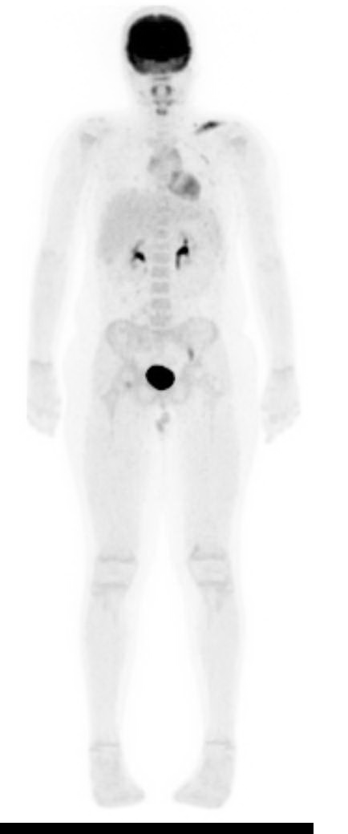
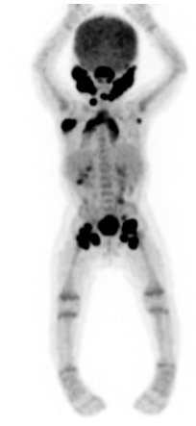
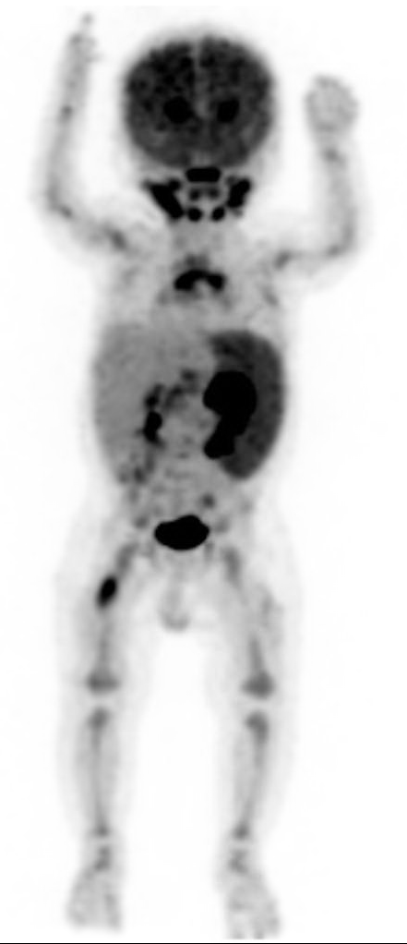
LCH
Single low-risk
Multifocal low-risk
High-risk
Copyright © 2019 by ASPHO

Slide 56
LCH
Basic Science and Pathophysiology
Epidemiology and Risk Assessment
Diagnosis
Management and Treatment
Copyright © 2019 by ASPHO

Slide 57
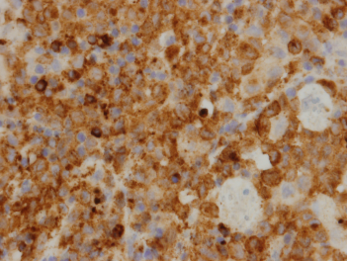
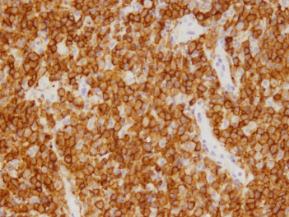
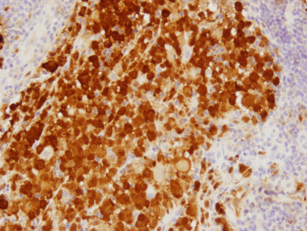
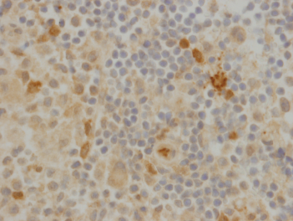
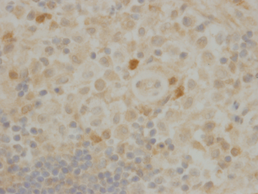
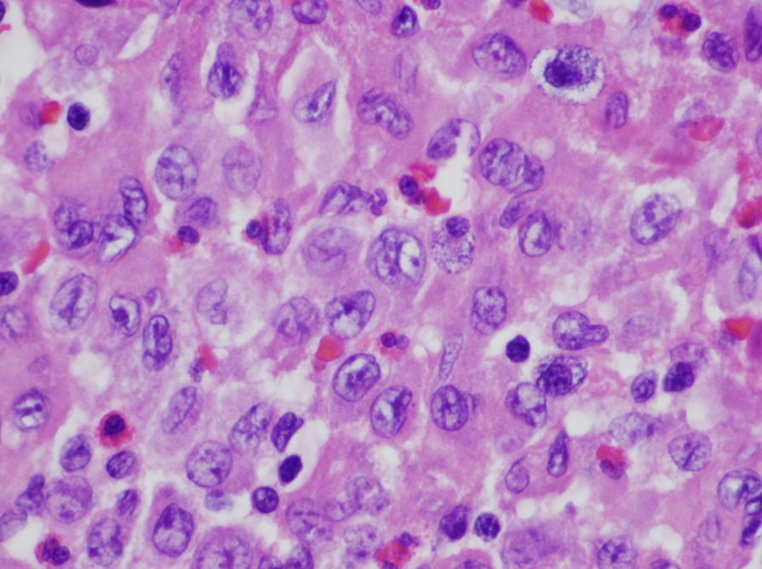
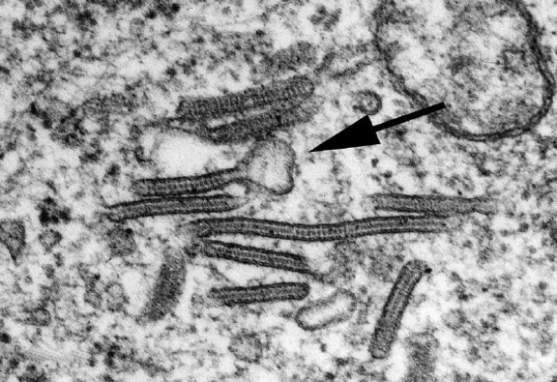
LCH
Histology
  CD207+, CD1a+ histiocytes among inflammatory infiltrate
  Birbeck granules on electron microscopy
CD207
CD1A
S100A
Fascin
Factor XII
Copyright © 2019 by ASPHO
Images courtesy of Dr. John Hicks

Slide 58
LCH
Presenting symptoms are highly variable
Bone marrow:
  Cytopenias, hemophagocytosis
Spleen:
  Splenomegaly, abdominal pain, throbocytopenia
Liver:
  Hepatomegaly, abdominal pain, jaundice, ascites
Copyright © 2019 by ASPHO

Slide 59
LCH
Presenting symptoms are highly variable
  Skin:
    Can look like anything
    Pruritic, scaly, erythematous
    Otitis externa with purulent drainage
  Bones:
    painful swelling, mastoiditis
  Jaw:
    “floating” teeth and early tooth eruption
  Lymph nodes:
    lymphadenopathy
Copyright © 2019 by ASPHO

Slide 60
LCH
Presenting symptoms are highly variable
Pulmonary:
  interstitial pattern with cysts and nodules
  spontaneous pneumothorax
Gastrointestinal:
  diarrhea, fevers, edema (hypoalbuminemia)
Endocrine
  diabetes insipidus, growth hormone deficiency, hypothyroidism, hypoadrenalism
  hypogonadism
Copyright © 2019 by ASPHO

Slide 61
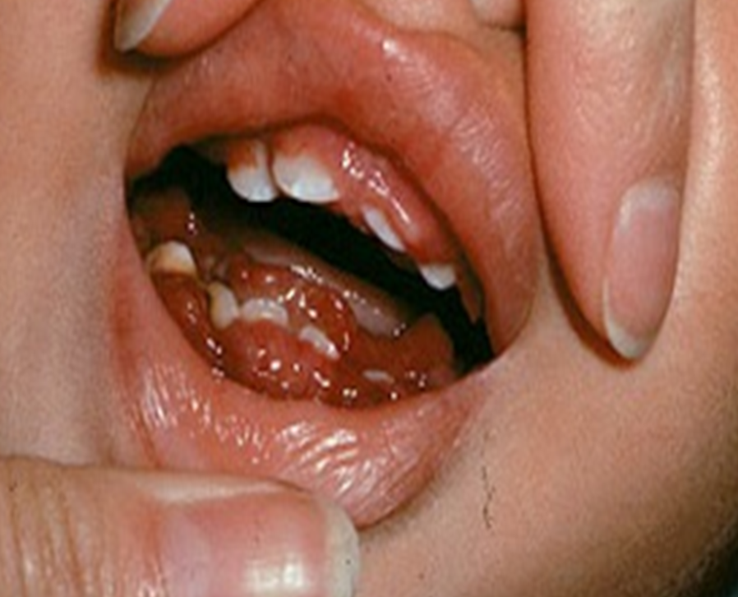
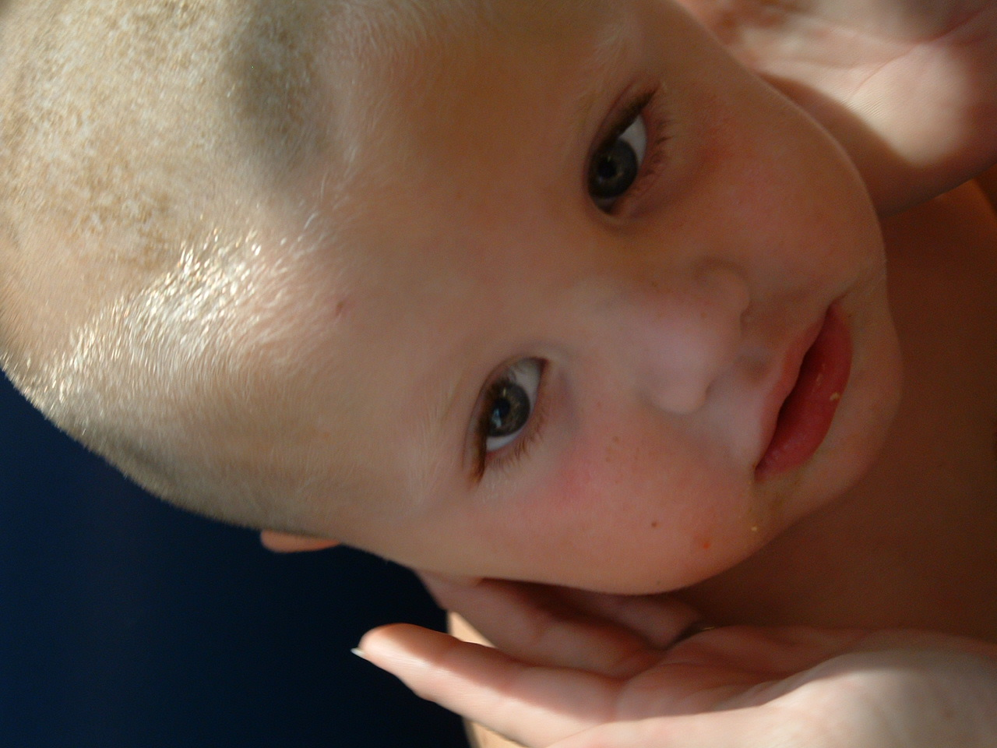
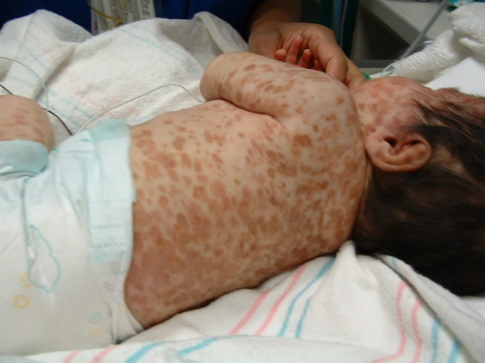
LCH
Copyright © 2019 by ASPHO

Slide 62
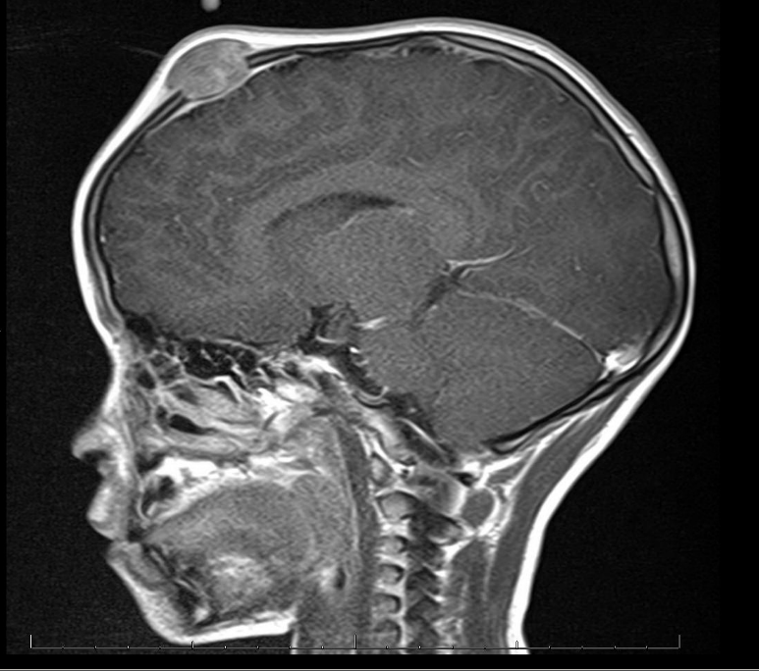
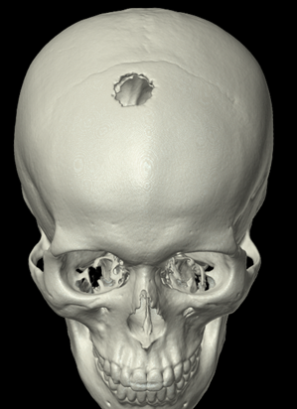
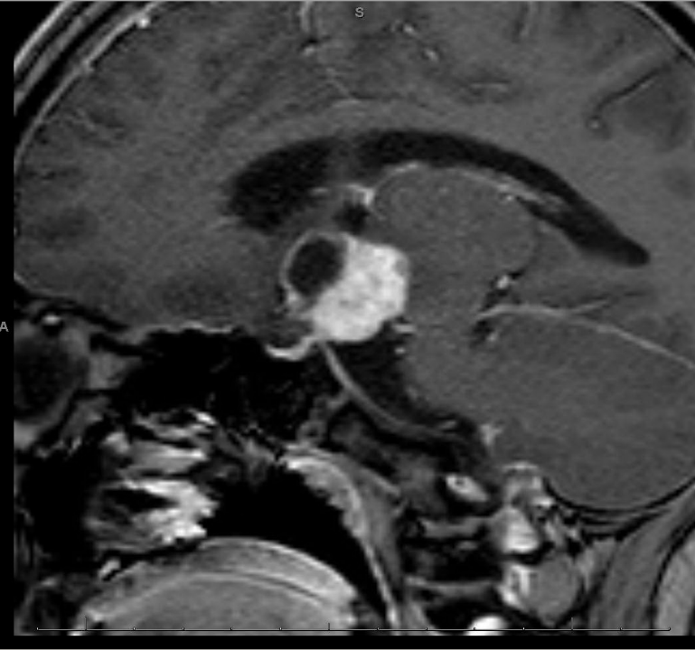
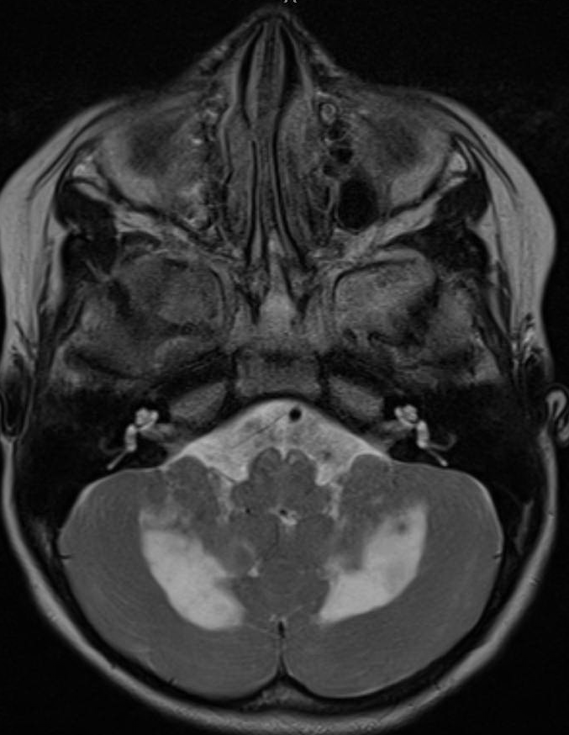
LCH
Copyright © 2019 by ASPHO

Slide 63
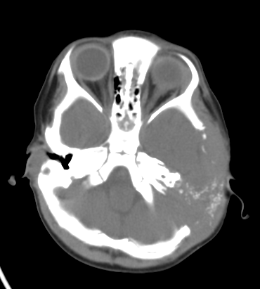
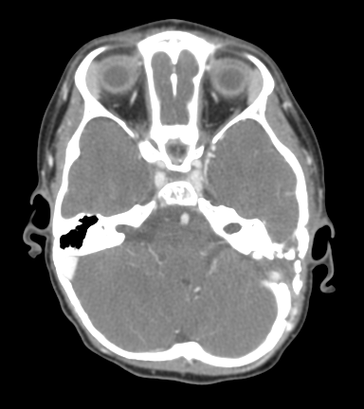
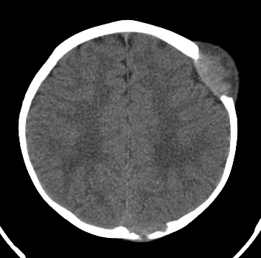
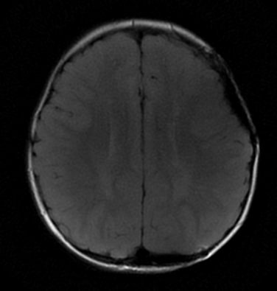
Classic LCH Scenarios:
“Clean margins” impair remodeling
A
B
Copyright © 2019 by ASPHO

Slide 64
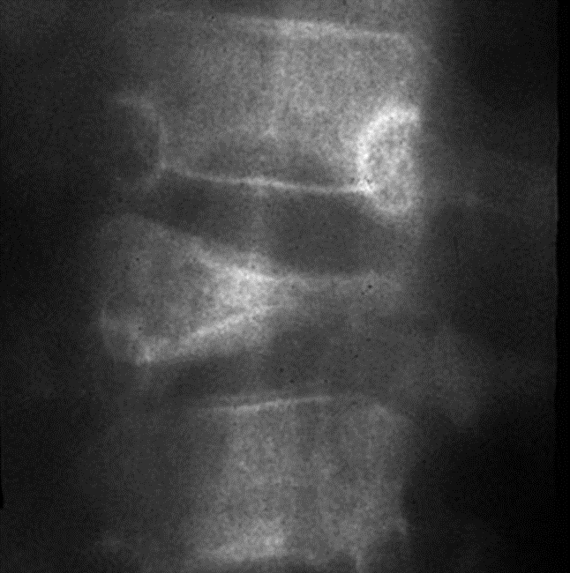
Classic LCH Scenarios:
Back pain with vertebra plana
Copyright © 2019 by ASPHO

Slide 65
LCH
Lab Evaluations
CBC
Bone marrow aspirate & biopsy if cytopenias
  usually infants
  Isolated anemia is common and does not require bone marrow
  Note that 50% of bone marrow with BRAF-V600E+ CD34+ cells were reported as histologically normal
Liver function
  AST, ALT, GGT, Bili, Albumin/TP, PT/PTT
Sodium homeostasis
  Serum sodium, urine/serum osmols if D.I. symptoms
BRAFV600E qPCR of peripheral blood
  (+) suggests High Risk (if lesion (+)
Copyright © 2019 by ASPHO

Slide 66
LCH
Imaging Evaluations
Skeletal survey and chest xray
CT of chest if chest xray abnormal
Ultrasound (CT/MRI of abdomen if hepatomegaly or abnormal liver functions)
PET/CT scan
CT of skull if orbit or mastoid involved
MRI of brain if pituitary involved and F/U for neurodegenerative disease
MRI of spine when vertebra plana or neurologic symptoms
Copyright © 2019 by ASPHO

Slide 67
LCH
Basic Science and Pathophysiology
Epidemiology and Risk Assessment
Diagnosis
Management and Treatment
Copyright © 2019 by ASPHO

Slide 68
LCH
Front Line Therapy
Skin alone:
  oral methotrexate, vinblastine/prednisone, hydroxyurea
“Low Risk” (bone +/-skin,lymph nodes or CNS Risk)
  vinblastine/prednisone 12 mo.
“High Risk” (liver, spleen, bone marrow)
  vinblastine/prednisone/6MP
Radiotherapy or intra-lesion steroids:
  only for spine, femur, or non-CNS Risk isolated bone lesions
Copyright © 2019 by ASPHO

Slide 69
LCH
Outcomes
Low Risk:
  “0%” Mortality
  ~50% Event free survival (frequent relapse)
High Risk
  10% Mortality
    Highest risk in patients who fail to respond to initial induction therapy
  ~50% event free survival (frequent relapse)
Copyright © 2019 by ASPHO

Slide 70
LCH
Complications of LCH: Neurodegeneration
“Risk” Sites:
  Mastoid, orbital sphenoid, temporal bone lesions:
Impact of therapy:
  If single agent or no treatment: 40% incidence of diabetes insipidus
  Velban/prednisone: still 20% D.I.
Timing:
  May be acute or present 20 yrs after initial diagnosis
Copyright © 2019 by ASPHO

Slide 71
LCH
Complications of LCH: Neurodegeneration
Symptoms
  ataxia, dysarthria, dysmetria, behavior changes
MRI:
  Masses or T2 hyper-intense signal in cerebellar white matter, pons, or basal ganglia may be long before symptoms appear
Cause:
  ???Textbooks suggest autoimmune/inflammation
Copyright © 2019 by ASPHO

Slide 72
LCH
2nd/3rd/4th –Line Therapy
High-risk:
  Cytarabine, Clofarabine
  2-CdA/ARA-C
  BRAF/MEK inhibitors
Low-risk:
  Cytarabine, Clofarabine
  BRAF/MEK inhibitors
LCH-ND
  Observation, Cytarabine, IVIG
Copyright © 2019 by ASPHO

Slide 73
LCH
Complications
Long-term sequelae
  >50%
  More common and more severe in patients with poorly controlled disease
Diabetes Insipidus:
  15% of all patients
  50% of patients with DI have other pituitary deficiencies
  50% with MRI signs of LCH-ND
  12% with clinical symptoms of LCH-ND
Copyright © 2019 by ASPHO

Slide 74
Rosai Dorfman Disease (RDD)
Basic Science and Pathophysiology
Epidemiology and Risk Assessment
Diagnosis
Management and Treatment
Copyright © 2019 by ASPHO

Slide 75
RDD
Tissue or Blood
Copyright © 2019 by ASPHO
© 1999-2016, Rice University. Except where otherwise noted, content created on this site is licensed under a Creative Commons Attribution License 4.0 License.; partners@openstaxcollege.org.

Slide 76
RDD
Basic Science and Pathophysiology
Epidemiology and Risk Assessment
Diagnosis
Management and Treatment
Copyright © 2019 by ASPHO

Slide 77
Rosai-Dorfman Disease
Site Frequency (%)
Lymph nodes 87
Skin and soft tissue 16
Nasal cavity 16
Eye 11
Bone 11
Central Nervous System 7
Salivary gland 7
Kidney 3
Respiratory tract 3
Liver 1
Breast, GI, Heart <1
Copyright © 2019 by ASPHO

Slide 78
RDD
Basic Science and Pathophysiology
Epidemiology and Risk Assessment
Diagnosis
Management and Treatment
Copyright © 2019 by ASPHO

Slide 79
Rosai-Dorfman Disease
EMPERIPOLESIS
VIABLE LYMPHOCYTES TRAFFICKING THROUGH HISTIOCYTES
CD163+
S100A+
Images courtesy of Dr. John Hicks
Copyright © 2019 by ASPHO

Slide 80
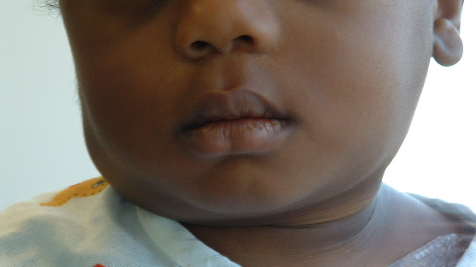
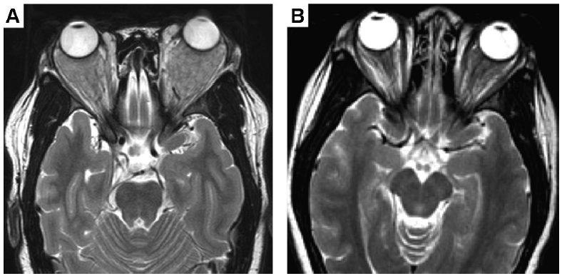
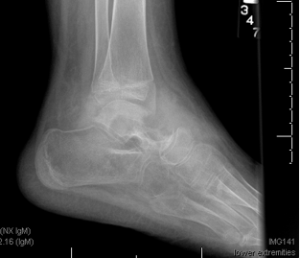
Rosai-Dorfman Disease
Sinus Histiocytosis with Massive Lymphadenopathy
CLASSIC
EXTRANODAL
Copyright © 2019 by ASPHO

Slide 81
RDD: Differential Dx
Reactive hyperplasia
Autoimmune Lymphoproliferative Syndrome (ALPS)
Hemato-lymphoid malignancy
Metastasis
Storage disorders
Histiocytoses: LCH or JXG
Copyright © 2019 by ASPHO

Slide 82
RDD
Basic Science and Pathophysiology
Epidemiology and Risk Assessment
Diagnosis
Management and Treatment
Copyright © 2019 by ASPHO

Slide 83
RDD
Therapeutic Approach
Randomized clinical trials unavailable; no real prognostic/prospective data
  Response to steroids is transient
  Reports of cure with clofarabine
Most patients with CLASSIC do not require treatment for lymph node enlargement alone
Treatment necessary in minority with organ or life-threatening complications
Copyright © 2019 by ASPHO

Slide 84
JXG
Tissue or Blood
Copyright © 2019 by ASPHO
© 1999-2016, Rice University. Except where otherwise noted, content created on this site is licensed under a Creative Commons Attribution License 4.0 License.; partners@openstaxcollege.org.

Slide 85
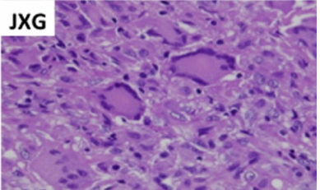
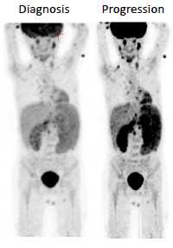
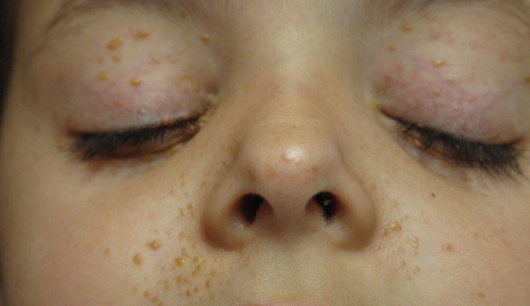
Juvenile Xanthogranuloma
JXG QUICK FACTS
CD163+ Histiocytes
Usually skin-limited
Can have tumors anywhere
Can have disseminated AML-like disease
Association with NF1
Mutations in MAPK genes
Copyright © 2019 by ASPHO

Slide 86
Hemophagocytic Lymphohistiocytosis
(HLH)
TOO MUCH INFLAMMATION
Copyright © 2019 by ASPHO

Slide 87
Hemophagocytic Lymphohistiocytosis (HLH)
Basic Science and Pathophysiology
Epidemiology and Risk Assessment
Diagnosis
Management and Treatment
Copyright © 2019 by ASPHO

Slide 88
HLH
Tissue or Blood
Copyright © 2019 by ASPHO
© 1999-2016, Rice University. Except where otherwise noted, content created on this site is licensed under a Creative Commons Attribution License 4.0 License.; partners@openstaxcollege.org.

Slide 89
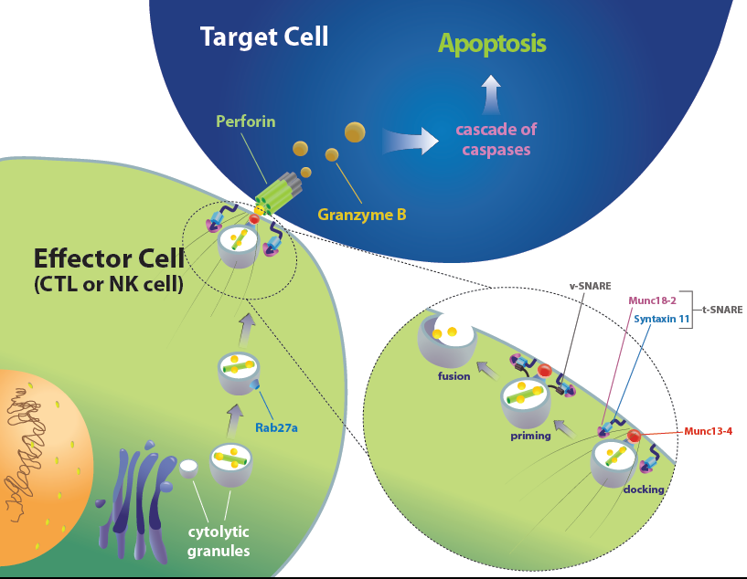
HLH-Associated Gene Function
Jordan, M, et al. How I treat hemohagocytic lymphohistiocytosis. Blood 2011;118(15):4041-4062.
Copyright © 2019 by ASPHO

Slide 90
HLH as Loss of Inflammatory Homeostasis
Dysfunctional Cytotoxicity: Inability to prune DCs
-
IFNγ
ANTIGEN
DC
T
INFLAMMATION
+
+
PRF1 > Rab27a > STX11 >Lyst > HPS2
Copyright © 2019 by ASPHO
Image courtesy of Carl Allen

Slide 91
EBV and HLH
Model: Infected B cells as a T cell “irritant”
EBV infection most common infection associated with HLH
  Specific association with XLP (SH2D1A/XIAP)
  More recent association with XMEN Syndrome (MAGT1)
Model: Infected and functional T cells become activated
EBV infection of T cells induces HLH
  More common in Asia, but also in US
Early introduction of Etoposide associated with improved outcomes
Copyright © 2019 by ASPHO

Slide 92
HLH
Basic Science and Pathophysiology
Epidemiology and Risk Assessment
Diagnosis
Management and Treatment
Copyright © 2019 by ASPHO

Slide 93
“Familial” versus “Secondary”
Not a clinically helpful question in the acute setting
    Review of patients treated on HLH-94
      All “HLH”
        55% (3 yr overall survival)
      Familial HLH
        51% (3 yr overall survival)
    HLH-2004: All HLH is “HLH”
    For the test, these “Familial” and “Secondary” are considered as distinct entities
Copyright © 2019 by ASPHO

Slide 94
“Secondary” HLH
Infection
  EBV, CMV, Parvovirus, HHV8
  Virus, fungus, bacteria
Malignancy
  ALCL, NK/T cell malignancies
  T-CAEBV
Immune Deficiencies
  Intrinsic and acquired (chemotherapy, post-HCT)
“Synthetic” HLH
  Post-CAR/CTL
  Inhibition of inhibitors
Autoimmune Disease/”MAS”
  JIA, SLE
Copyright © 2019 by ASPHO

Slide 95
Macrophage Activation Syndrome (MAS)
HLH with underlying autoimmune dz:
  JIA and SLE are the most common
  Frequent hypomorphic mutations in PRF1, etc
  Induced in mice with repeated TLR9 stimulation
  Difficult to differentiate from HLH prospectively
      Most gene-proven HLH at TCH were first diagnosed with Kawasaki Disease
Copyright © 2019 by ASPHO

Slide 96
HLH
Basic Science and Pathophysiology
Epidemiology and Risk Assessment
Diagnosis
Management and Treatment
Copyright © 2019 by ASPHO

Slide 97
HLH: Lab Evaluations
Underlying Immune Dysfunction and/or Trigger
Evaluate cytotoxic function
  NK cell function
  CD107 mobilization assay
  Perforin, XLP protein (XIAP, SAP) expression
  Targeted sequencing or whole exome sequencing
Virus, bacterial, fungal search
  Focus on herpesviruses
Evaluate for malignancy
Evaluate for autoimmune disease
Copyright © 2019 by ASPHO

Slide 98
HLH: Lab Evaluations
NK/T/Mac activation
Ferritin (good screening test)
  >10k is unusual for conditions other than HLH
Unregulated cytokine production: elevated
  Interferon-γ
  sIL-2Rα
  TNFα
  sCD163 (macrophage)
Copyright © 2019 by ASPHO

Slide 99
HLH: Lab Evaluations
Damage from Pathologic Immune Activation
CBC, peripheral smear, bone marrow
  Hemophagocytosis (not sensitive or specific)
Liver function studies
Renal function studies
Abdominal ultrasound
Brain MRI and/or LP
DIC panel
Copyright © 2019 by ASPHO

Slide 100
HLH
Basic Science and Pathophysiology
Epidemiology and Risk Assessment
Diagnosis
Management and Treatment
Copyright © 2019 by ASPHO

Slide 101


HLH: Treatment Philosophies
Consider HLH
Acute
  Actively observe and trend
  Supportive care
  Attack inflammation
Intermediate
  Minimize antigen “trigger”
  Minimize complications of immune suppression
Long-term
  Determine risk of recurrence, need for HSCT
    Gene studies, functional studies, trial wean immune suppression
Copyright © 2019 by ASPHO

Slide 102
HLH: “Standard of care”
“Gold Standard”: HLH-94
  etoposide/decadron 8 wks
HLH-2004:
  Added cyclosporine upfront
  No difference in outcomes
CNS HLH
  IT methotrexate/hydrocortisone for CNS+
  CNS+ = pleocytosis, ↑protein, MRI changes
Buy time, unsure or autoimmune:
  IVIG, plasmapheresis, cytokine neutralization
Salvage:
  Alemtuzumab for relapses before SCT
Stem cell transplant: (Reduced Intensity Conditioning = RIC)
  Genetic defect/familial, CNS+, relapsing patients
Investigational: IFN-g antibody
Copyright © 2019 by ASPHO

Slide 103
QUESTIONS?
GOOD LUCK!!
klmcclai@txch.org
Copyright © 2019 by ASPHO

