Slide 1

AYA Oncology & Survivorship
Karen E. Effinger, MD, MS
Assistant Professor, Emory University
Medical Director, Survivorship
Aflac Cancer & Blood Disorders Center, Children’s Healthcare of Atlanta

Slide 2
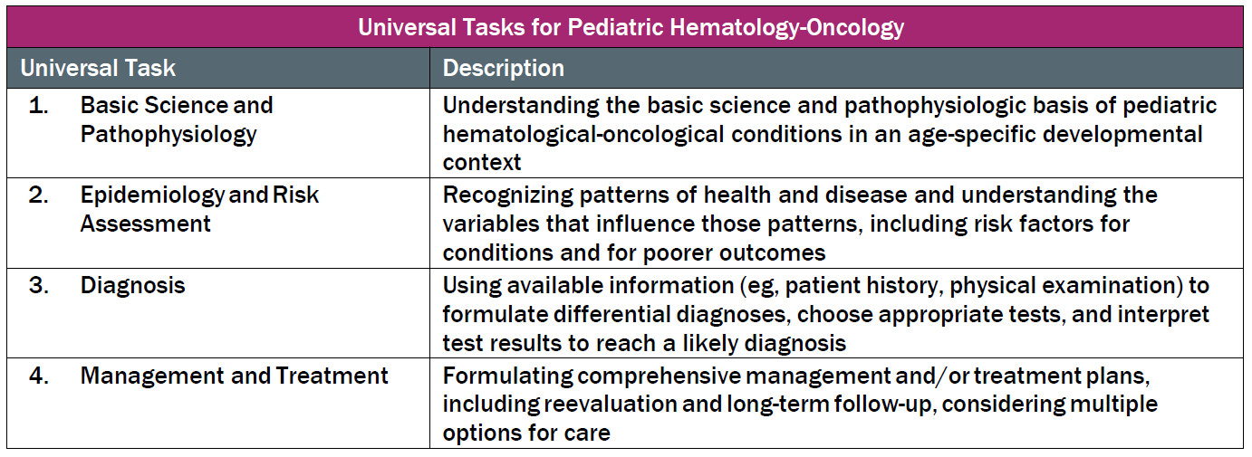
This talk will follow the topical structure suggested by the ABP (Sort of):
(
)

Slide 3
AYA Oncology & Survivorship
AYA Oncology
Late Effects
Fertility Preservation

Slide 4
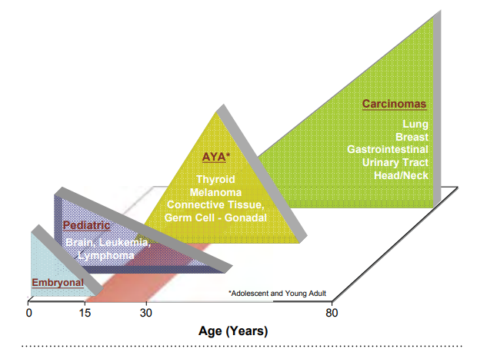
AYA Oncology
NCI definition: Cancer Diagnosis 15-39 years
~70,000 cases/yr vs. 11,050/yr ages 0-14y
5% cancer diagnoses in the United States from 2011-2015
Bleyer NCI SEER AYA Monograph 2006; https://seer.cancer.gov/publications/aya/aya_mono_complete.pdf
Notes:
Most frequent: 90% all invasive cancers are breast cancer, lymphomas, melanoma, female GU tumors (ovary/cervix), thyroid, sarcoma, testicular, colorectal, leukemia, CNS

Slide 5
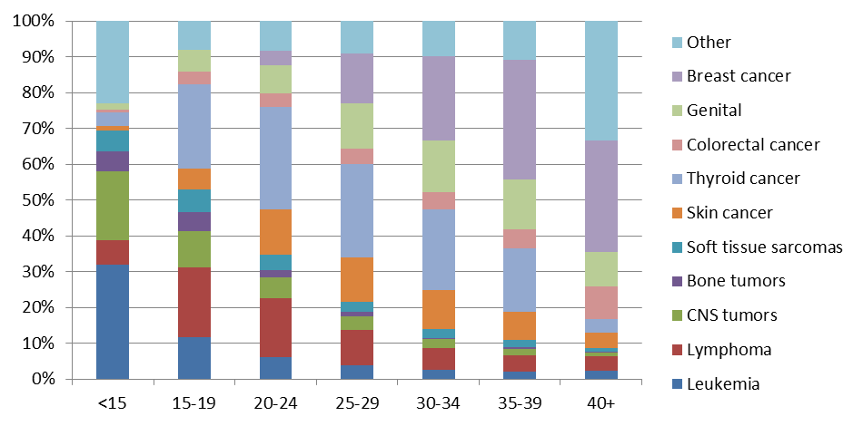
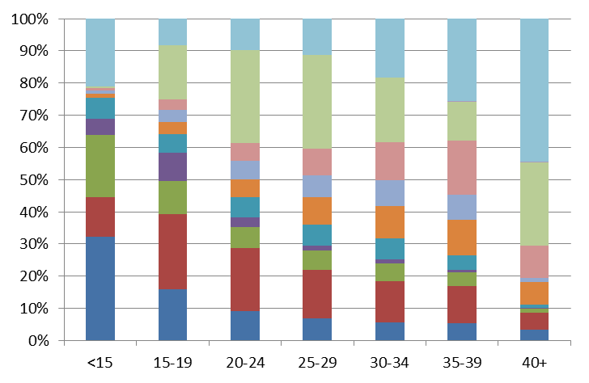

Cancer Site Distribution by Age, SEER 2011-15
FEMALES
MALES
Notes:
15-19: lymphoma (25%), followed by leukemia, sarcoma, CNS
20-29: Lymphoma (22%), melanoma, thyroid, testicular
HL most common

Slide 6
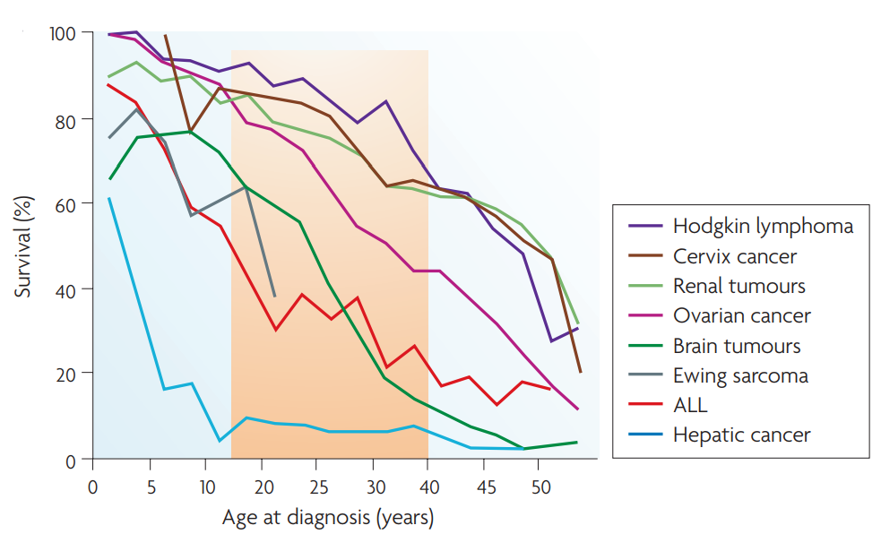
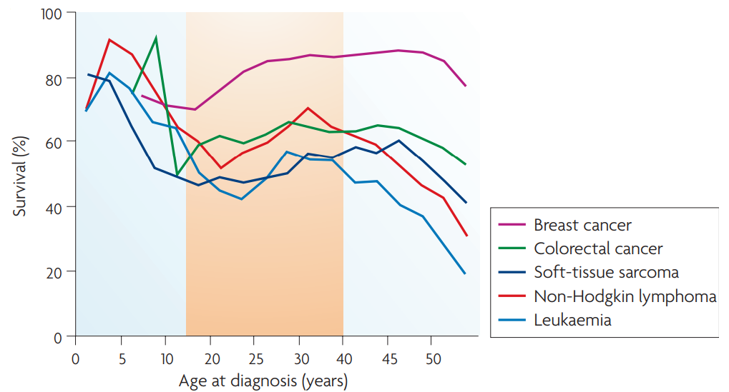
AYA Survival
Relative survival rates are lower in AYAs for some diseases
Compared to younger patients
Compared to younger & older patients
Reprinted by permission from Copyright Clearance Center: Springer Nature. Nature Reviews Cancer. The distinctive biology of cancer in adolescents and young adults, Archie Bleyer, Ronald Barr, Brandon Hayes-Lattin, David Thomas, Chad Ellis et al. Copyright © 2008
Notes:
Overall gains in survival have been less in AYA patients compared to other age groups
Also NB, rhabdomyosarcoma

Slide 7
AYA Survival
Similar prognosis across age groups for thyroid and testicular cancer
Better prognosis for melanoma

Slide 8
Causes for AYA Survival Differential
Cancer biology
Familial cancer syndromes or subsequent malignancies
Increased toxicity
Location of care/Clinical trial enrollment
Adherence
Access to healthcare
Psychosocial stressors

Slide 9
Cancer Biology- Poor Prognostic Findings
B-ALL: More likely to have PH+ t(9;22), PH+-like
B-ALL: Less likely to have ETV6-RUNX1, hyperdiploidy
T-ALL: HOX+
Rhabdomyosarcoma: More likely alveolar (chromosome 13 translocations)
Neuroblastoma: More likely stage IV disease
Breast cancer: More likely estrogen-, progesterone- and HER2 receptor (triple negative) disease
Colorectal cancer: More likely mucinosis adenocarcinoma
Notes:
T9;22: <3% children; 3-26% AYAs
PH+ like- 10% ages 1-9 and 27% ages 21-39
½ children have TEL-AML1 compared to 10% AYAs

Slide 10
Cancer Biology- Favorable Prognostic Findings
DLBCL: Less likely to have t(14;18)
Melanoma: More likely to have BRAF mutations
Notes:
DLBCL- 60% lymphoma in AYA population. More common to have primary mediastinal
BRAF: Lower mitotic rate, thinner tumors

Slide 11
Causes for Survival Differential
Cancer biology
Familial cancer syndromes or subsequent malignancies
Increased toxicity
Location of care/Clinical trial enrollment
Adherence
Access to healthcare
Psychosocial stressors
Notes:
Breast cancer at early age more likely to have increased familial risk: BRCA1, BRCA2, p53 (though most do not), survivors with chest radiation
Colon cancer: FAP. Herediatry non-polyposis colon cancer
3% thyroid cancer- second malignancy

Slide 12
Familial Cancer Syndromes/Subsequent Malignancies
Breast cancer: Early diagnosis more likely in those with increased familial risk: BRCA1, BRCA2, p53
Breast cancer: Survivors of childhood cancer treated with chest radiation
Colorectal cancer: Highest incidence of heritable CRC: FAP, hereditary non-polyposis colon cancer
Colorectal cancer: Survivors of childhood cancer treated with abdominal radiation
Thyroid cancer: 3% subsequent malignancy
Notes:
Breast cancer: most young dx do not have family cancer syndrome
Colon cancer: Familial adenomatous polyposis

Slide 13
Causes for Survival Differential
Cancer biology
Familial cancer syndromes or subsequent malignancies
Increased toxicity
Location of care/Clinical trial enrollment
Adherence
Access to healthcare
Psychosocial stressors

Slide 14
Different Toxicity Profile
Epigenetic factors
Changing volume of distribution
Protein binding
Hepatic/renal function
Obesity
Neuropathy
Osteonecrosis
Glucose intolerance
Pancreatitis
Nausea/emesis
Renal toxicity
Thrombosis
Pain
    Less Myelosuppression
Notes:
Need higher doses and don’t tolerate
Dose modification

Slide 15
Causes for Survival Differential
Cancer biology
Familial cancer syndromes or subsequent malignancies
Increased toxicity
Location of care/Clinical trial enrollment
Adherence
Access to healthcare
Psychosocial stressors

Slide 16
Location of Care/Clinical Trial Enrollment
Location of care
  Comprehensive centers vs. community-based
  Supportive care regimens
  Treatment compliance/intensity
Clinical trial enrollment
  Overall survival rate higher when on clinical trials
  Low enrollment (2% of patients aged 20-39 years)
  Improved enrollment with AYA programs (or pediatric center)
Pediatric treatment protocols
  Evidence for improved outcomes in ALL, AML, Ewing sarcoma, and Hodgkin lymphoma on pediatric regimens
Notes:
Children clinical trials >60%
Lack clinical trials- decreased bio samples
Location of Care: EWS- # of patients treated
ALL: Asparaginase and increased intensity (89% 5 year survival vs 38-46% for non-asparaginase regimens)
AML: 16-21yo: COG performed better but also had younger cohort. COG: Better anti-leukemic efficacy but increased toxicity. Though both age groups had less relapse on COG protocols but higher treatment-related mortality was seen
EWS: Thought to be due to Dose intensity/timing of local control (earlier)- also inferior outcomes based on age
HL: Differing findings. COG AOD0331 vs E2496 E2496 AYAs FFS worse that COG AYAs and older patients; however, trials were different-different criteria

Slide 17
Causes for Survival Differential
Cancer biology
Familial cancer syndromes or subsequent malignancies
Increased toxicity
Location of care/Clinical trial enrollment
Adherence
Access to healthcare
Psychosocial stressors
Notes:
Studies out there looking specifically at AYA Adherence and incorporating phone apps that improve this.

Slide 18
Adherence
Medication, symptom management, seeking medical help, appointment attendance
Poorer adherence compared with younger and older patients
Rates of nonadherence: 27-60%
Notes:
Not just pharmacoadherence also symptom management, seeking medical help, attendance at appointments

Slide 19
Causes for Survival Differential
Cancer biology
Familial cancer syndromes or subsequent malignancies
Increased toxicity
Location of care/Clinical trial enrollment
Adherence
Access to healthcare
Psychosocial stressors
Notes:
Insurance problems, delay in diagnosis, delay in treatment
Lack of PCP

Slide 20
Access to Healthcare
Highest percentage of uninsured Americans
  Uninsured rate: <18yo 5%, 19-25yo 14%, 26-34yo 16%, older Americans 9%
No or public insurance associated with increased mortality
  Present with higher stage disease
  Even with same stage, independent risk factor for mortality
Notes:
10% at age 18
>65 2%
Lower SES associated with increased risk of death in AYAs with private insurance and all AYAs aged 25-34 years

Slide 21
Causes for Survival Differential
Cancer biology
Familial cancer syndromes or subsequent malignancies
Increased toxicity
Location of care/Clinical trial enrollment
Adherence
Access to healthcare
Psychosocial stressors

Slide 22
Psychosocial Stressors
Financial Concerns
Educational/ Employment Concerns
Lack of Medical Home
Health Insurance
Desire for Autonomy
Emotional Challenges
Risky Behaviors
Self-Esteem/ Body Image
Fertility
Sexual Health
Peer Relations
Family Interactions
Notes:
Uncertainity about future
AYA patients maturing appropriately before cancer report decreased ability to hold job, complete education, maintain relationships- psychological development slow, stop, regress

Slide 23
AYA Oncology & Survivorship
AYA Oncology
Late Effects
Fertility Preservation

Slide 24
Pediatric Oncology Survivorship
Over 465,000 Americans are childhood cancer survivors
Top 3 cancers among survivors: ALL, brain tumors, Hodgkin lymphoma

Slide 25
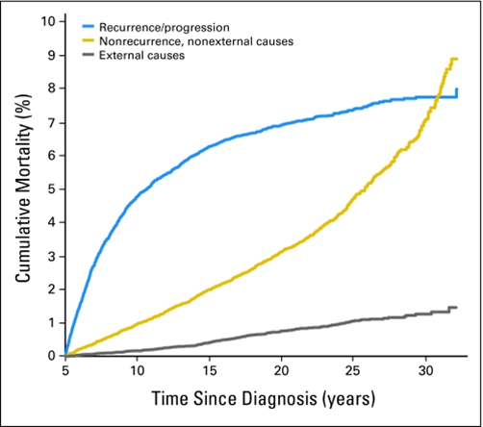
Late Effects
As time from treatment increases, risk of recurrence decreases and risk for late effects increases
Risk at 30 years from diagnosis:
  ≥1 chronic condition ~75%
  Severe/life-threatening/disabling/fatal ~40%
Recipients of HSCT have nearly fourfold
risk compared to those treated with
conventional therapy
Reprinted with permission. © 2009 American Society of Clinical Oncology. All rights reserved. Armstrong G et al: J Clin Oncol 27, no. 14 (May 2009)2328-2338.
Notes:
Late effects are broadly defined as consequences of cancer and its treatment that manifest either during or after cancer treatment and persist beyond the end of treatment.
Increased risk of late effects and death over time
Lifelong surveillanc

Slide 26
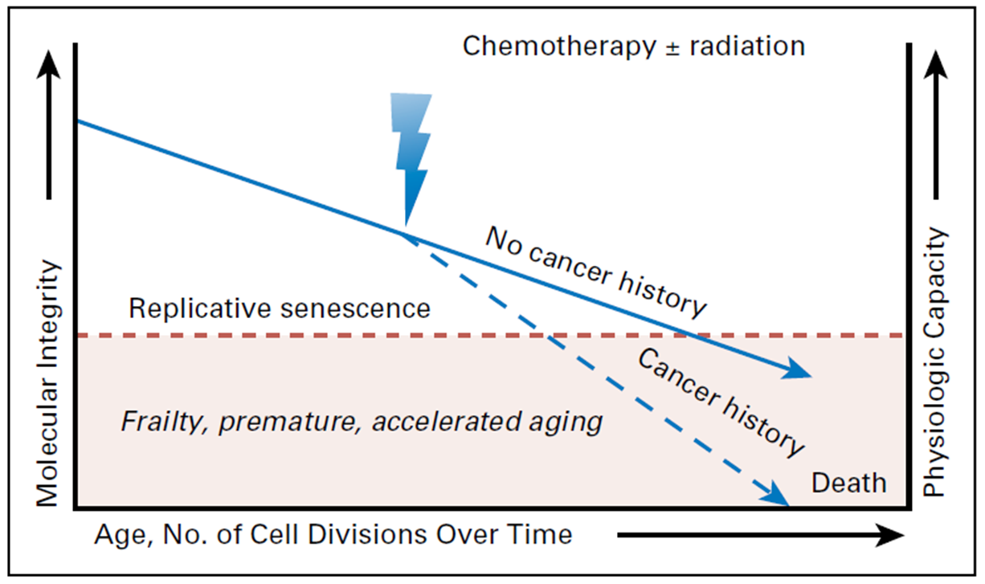
Accelerated Aging
Reprinted with permission. © 2018 American Society of Clinical Oncology. All rights reserved. Ness K et al: J Clin Oncol 36, no. 21 (July 2018)2206-2215.

Slide 27
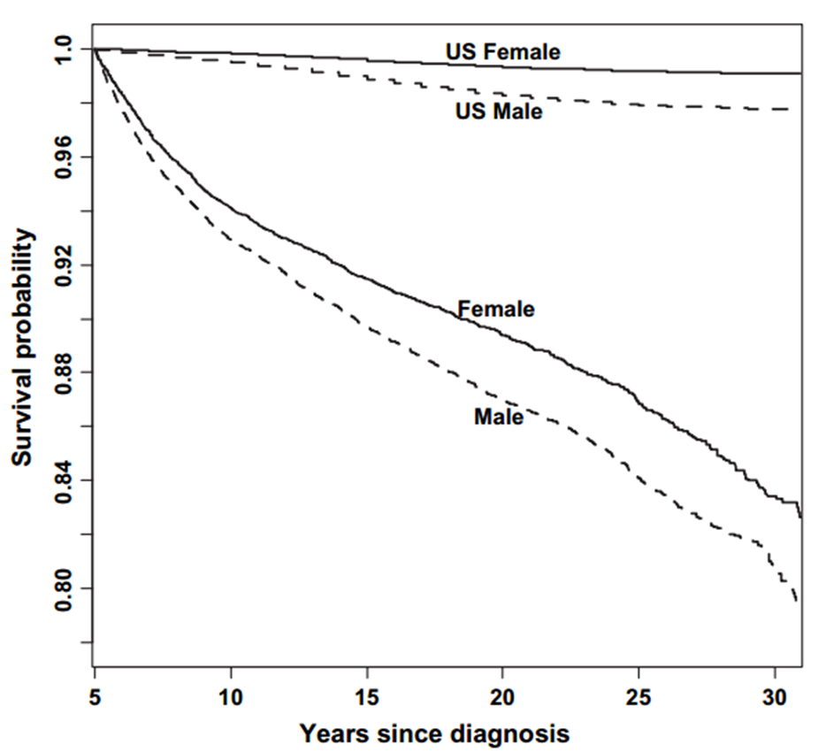
Early Mortality
18% of 5-year survivors had died by 30 years after their diagnosis
Mertens, et al, Cause-Specific Late Mortality Among 5-Year Survivors of Childhood Cancer: The Childhood Cancer Survivor Study, Journal of the National Cancer Institute, © 2008, 100, 19, 1368-1379, by permission of Oxford University Press

Slide 28
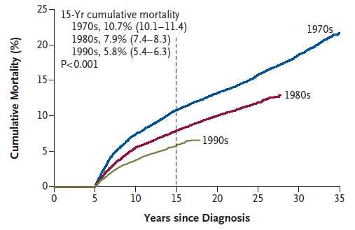
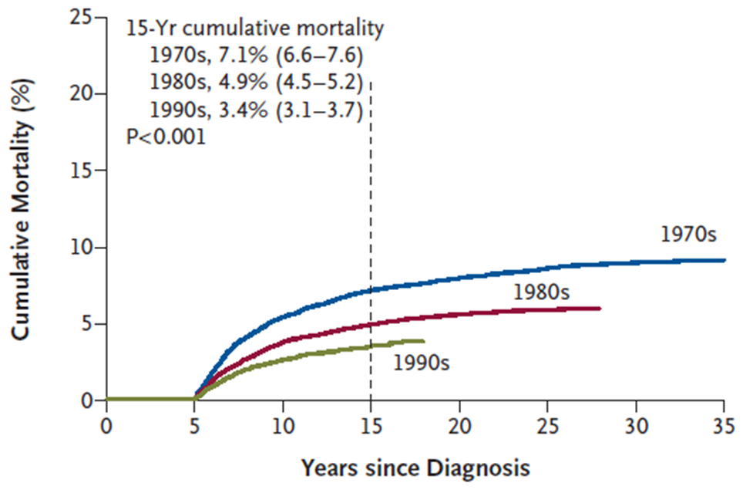
Changes in Mortality
All cause: 3,958 deaths
Primary cancer: 2,002 deaths
From The New England Journal of Medicine, Armstrong, et al, Reduction in Late Mortality among 5-Year Survivors of Childhood Cancer, 374, 833-842. Copyright © 2016 Massachusetts Medical Society. Reprinted with permission from Massachusetts Medical Society.
Notes:
50% decrease in 15-yr mortality between 1970s and 1990s
Largest cause of death primary cancer- also largest improvement between 1970s/1990s
Other cuases: SMN, cardiac pulmonary

Slide 29
Neurocognitive Sequelae
Attention, executive functioning, memory impairment, processing speed, visual spatial skills, learning difficulties (math/reading)
Screening: Neuropsychological evaluation
Radiation-associated (Cranial)
  Evident 1-2yr following XRT, progressive due to failure to slow rate of skill or information acquisition NOT progressive loss
  Risk factors: Young age, VP shunt, stroke, hearing/motor impairment
  May have drops in IQ over time
Anti-metabolite therapy (HD-/IT-MTX, HD-cytarabine)
  Risk factors: young age, females
  Global intellectual function relatively preserved
  Persists into adulthood
Notes:
Diseases: Cranial: brain tumor, head sarcomas, retinoblastoma, CNS relapsed ALL
Antimetabolite: Leukemia (ALL), osteosarcoma

Slide 30
Ocular Toxicity
Late effects: Cataracts
Exposures: Long-term corticosteroids, busulfan, cranial/orbital XRT (including TBI)
Higher risk: XRT >15 Gy, combination of exposures
Screening (if previously normal): Annual funduscopic exam, Evaluation by eye doctor after XRT
Other XRT-related: Xerophthalmia, glaucoma, retinopathy, orbital hypoplasia
  Higher risk: Higher doses
Notes:
Dry eye more common with

Slide 31
Ototoxicity
Exposures: Cisplatin, myeloablative carboplatin, XRT ≥30 Gy, loop diuretics, aminoglycoside antibiotics, surgery involving CN VIII
Higher risk: Combination of exposures, higher doses, younger age, genetics
Common diagnoses: CNS tumors, GCT tumors, neuroblastoma, hepatoblastoma, osteosarcoma
Screening (if previously normal): ≤5yo annually, 6-12yo q2y, ≥13yo q5y
Platinum related:
  Sensorineural loss due to destruction of cochlear hair cells
  High-frequency affected first (>2000 Hz)
  Sodium thiosulfate reduces risk of hearing loss through antioxidant properties and forming inactive complexes with cisplatin (esp low-risk disease)
Notes:
Radiation: SN, conductive, tympanosclerosis, otoslcerosis, Eustachian tube dysfunction
Low risk if <35Gy
Hair cells arranged tonotopically; therefore, high-frequency first
SIOPEL 6 (hepatoblastoma and COG)

Slide 32
Oral/Dental Complications
Late effects: Tooth/root agenesis or malformations, enamel dysplasia (increased caries)
Exposures: Chemotherapy, XRT
Higher risk: Younger age at treatment, high-dose alkylators, high-dose radiation, combination therapies
Common diagnoses: Rhabdomyosarcoma, neuroblastoma
Screening: Routine dental care
Other XRT-related: Xerostomia, TMJ dysfunction, osteoradionecrosis

Slide 33
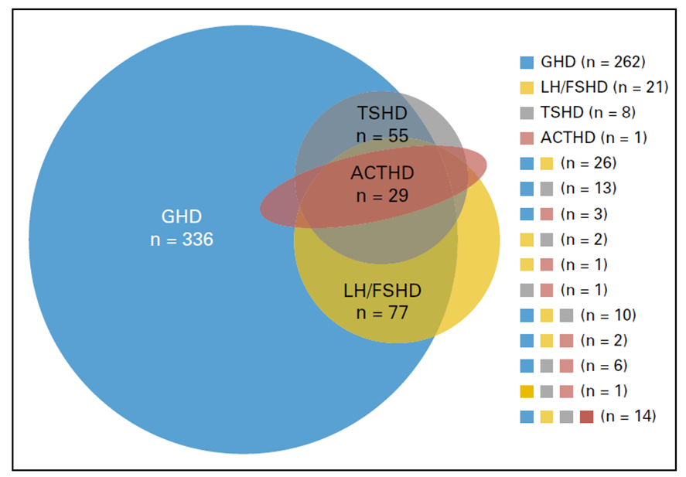
Anterior Pituitary Dysfunction
6 major hormones: GH, ACTH, FSH, LH, TSH, Prolactin
Dysfunction occurs months to decades after cranial radiation
51% of survivors developed at least 1 deficiency
11% had multiple deficiencies
GHD is the most common and first deficiency to develop
From Anterior hypopituitarism in adult survivors of childhood cancers treated cranial radiotherapy: a report from the St Jude Lifetime Cohort study. Chemaitilly W, Li Z, Huang S, et al. J Clin Oncol. 2015 Feb 10;33(5):492-500. doi: 10.1200/JCO.2014.56.7933.
© 2015, American Society of Clinical Oncology. Used with permission.
Notes:
Chemaitilly JCO 2015

Slide 34
Growth
Decreased linear growth
  Exposures
    Cranial XRT: GHD, hypothyroidism. Higher risk: Younger age, higher dose
    Spinal XRT: Vertebral growth plate toxicity
    Prolonged steroids: Growth plate damage, decreased endogenous GH release, decreased proliferation of chondrocytes
    Retinoids & Hedgehog pathway inhibitors: Premature fusion of growth plates
    TKIs: Unknown. GH vs. growth plate
Scoliosis/Hypoplasia
  Occurs after XRT, becomes more pronounced during adolescent growth spurt
  Higher risk: Younger age, higher dose

Slide 35
Thyroid Late Effects
Late effects: Hypothyroidism (most common), hyperthyroidism, thyroid nodules
Exposures: Radiation (cranial, nasopharyngeal, cervical, supraclavicular, mantle, TBI), systemic MIBG, I-131 therapy
Primary Hypothyroidism
  Prevalence: At 20 years: 30% after 35-45Gy, 50% after ≥45Gy
  Higher risk: Dose ≥10 Gy, female, older age
Central Hypothyroidism
  Higher risk: ≥30 Gy to pituitary
Hyperthyroidism
  Higher risk: ≥30 Gy to neck

Slide 36
Pulmonary Toxicity
Late effects: Pulmonary fibrosis, pneumonitis
Exposures: Lung XRT, bleomycin, busulfan, BCNU, CCNU, thoracic surgery
XRT-related:
  Higher risk: Higher dose, higher area of exposure, younger age
  Mechanism: Likely mediated by cytokines stimulating septal fibroblasts leading to collagen production, younger children- hypoplasia
Chemotherapy-related:
  Higher risk: Combination with radiation, higher dose, older age
  Bleomycin mechanism: Oxidative damage, inflammatory cytokines, genetics
Screening: PFTs, smoking cessation
Notes:
Chest wall and lung parachyma

Slide 37
Cardiovascular Disease
Leading cause of non-oncologic death in survivors
Cardiomyopathy/CHF:
  Anthracycline cardiotoxicity related to myocardial injury due to free radicals
  Dexrazoxane acts as an iron chelator to prevent cardiotoxicity
  Acute cardiotoxicity: Develops within 1 week, usually reversible
  Chronic cardiomyopathy: After completion of therapy, increase risk with longer time since treatment, progressive, often treated with β-blocker
  Higher risk: Increased anthracycline dose (≥250 mg/m2), chest XRT (≥15 Gy or with anthracyclines), younger age, comorbidities, genetics, Rare after XRT alone
Cumulative Anthracycline Dose
Agent | Doxorubicin | Daunorubicin | Mitoxantrone | Epirubicin | Idarubicin
Conversion Factor | 1 | 0.5 | 4 (new ~10) | 0.67 | 5
Notes:
Anthracyclines: free radicals. Complex with iron to induce damage through reactive oxygen species
Anthracycline: systolic dysfunction
XRT: diastolic dysfunction

Slide 38
Cardiovascular Disease
Coronary Artery Disease:
  Cumulative risk 21% at 20 years after XRT
  Ischemic heart disease most common cause of cardiac death after XRT
  Higher risk: Dyslipidemia, hypertension, obesity
Other XRT-related Heart Disease:
  Pericarditis, valvular heart disease, conduction abnormalities
Screening for Heart Disease
  EKG at baseline, ECHO based on anthracycline/XRT exposures
Every 2 years | Every 5 years | No screening
XRT ≥35 Gy | XRT ≥15 Gy - <35 Gy | XRT <15 Gy
Anthra Dose ≥250 mg/m2 | Anthra Dose <250 mg/m2 | No Anthracyclines
Anthra Dose <250 mg/m2 + XRT ≥15 Gy

Slide 39
Renal Toxicity
Exposures: Cisplatin, carboplatin, ifosfamide, radiation, nephrectomy
Cisplatin: Glomerular and distal tubular dysfunction, hypomagnesemia may be severe. Higher risk: Higher dose, concurrent exposures
Ifosfamide: Typically proximal tubular dysfunction, ~5% significant Fanconi syndrome. Higher risk: Higher dose, younger age, concurrent exposures
XRT: Usually develops month to years after exposure. Higher risk: Dose >20Gy
Screening (if previously normal): Creatinine and electrolytes at baseline, UA/Creatinine annually after nephrectomy

Slide 40
Gastrointestinal Toxicity
Hepatic
  Exposures: Thioguanine, mercaptopurine, methotrexate, radiation
  Usually acute toxicity
  Higher risk: XRT ≥20 Gy, thioguanine during maintenance, SOS during treatment
  Screening: LFTs
Gastrointestinal
  Esophageal stricture, fistulae, enterocolitis, obstruction, cholelithiasis due to radiation
  Constipation or fecal incontinence due to spinal cord dysfunction

Slide 41
Bone Toxicity
Osteopenia
  Exposures: Steroids, methotrexate
  Mechanism: Decreased osteoblast activity, increased osteoclastic bone resorption
  Higher risk: White race, gonadal failure, GH deficiency, hypothyroidism, decreased BMI, decreased calcium intake, decreased activity
  Radiation may damage bone marrow stroma, but mostly due to hormone deficiencies
Avascular necrosis
  95% weight-bearing joints, femoral head most common. Often multifocal
  Exposures: Steroids
  Mechanism: Multifactoral increased intramedullary pressure leading to blood stasis
  Higher risk: Dexamethasone (higher risk than prednisone), continuous exposure, older age, female gender, XRT exposure, high BMI, White race.
  Methotrexate and asparaginase may contribute
Notes:
ALL therapy for older patients, pred instead of dex
Suppression of osteoblasts, apoptosis of osteocytes, intramedullary lipocyte proliferation, fat embolization to subchondral arteries

Slide 42
Chronic GVHD
Dermatologic toxicity: Atrophy, hypo/hyperpigmentation, sclerosis, alopecia, nail dystrophy
Xerophthalmia
Oral problems: Xerostomia; dental caries; oral cancer
Pulmonary toxicity: Bronchiolitis obliterans, chronic bronchitis
Liver toxicity
Immunologic compromise: May have functional asplenia
Esophageal stricture: Dysphagia, heartburn
Vaginal fibrosis: Dryness, dyspareunia, amenorrhea
Joint contractures

Slide 43
Subsequent Malignant Neoplasms
Develop >2 months from completion of therapy
Leading cause of non-relapse death
At 30 years after diagnosis, cumulative incidence of a subsequent neoplasm >20%
Most common in 5 year survivors: Nonmelanoma skin cancer (9%), breast cancer (5% in females), meningioma (3%), thyroid cancer (1.4%)
Multiple SMNs are common
  Cumulative incidence of second SMN 47% at 20 years after first SMN

Slide 44
Subsequent Malignant Neoplasms
t-MDS/AML
  Usually presents <3 years from therapy completion with plateau at 10-15 years
  2% at 15 years after therapy
  Topoisomerase II-Inhibitor related:
    Epipodophyllotoxins and anthracyclines
    Associated with translocation 11q23
    Typically 6mo-3yr from therapy completion
  Alkylating-agent related:
    Dose dependent
    Often preceded by MDS
    Associated with chromosome 5-/7- mutations
    Typically 3-7yr from therapy completion
Notes:
Anthracyclines, epipodophyllotoxins topo-ii inh

Slide 45
Subsequent Malignant Neoplasms
Solid tumors
  80% of SMN
  Associated with radiation
  30-year cumulative incidence of SMN excluding NMSC
    3% surgery only/no treatment
    4% chemotherapy only
    9% chemotherapy+radiation
    11% radiation only
  Higher risk: Younger age, increased dose, increased time after radiation, genetic predisposition syndromes
  Chemo only: Higher doses of platinums, alkylating agents. Increased anthracycline dose associated with breast cancer risk
Notes:
Anthracyclines, epipodophyllotoxins topo-ii inh

Slide 46
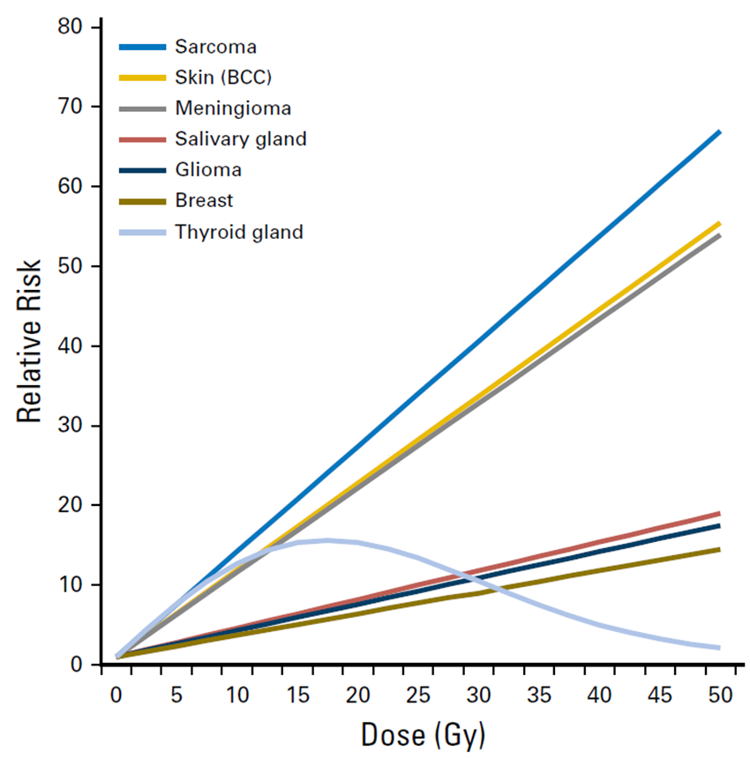
Solid Subsequent Malignant Neoplasms
Reprinted from International Journal of Radiation Oncology, Biology, Physics, 94, Inskip, et al, Radiation-Related New Primary Solid Cancers in the Childhood Cancer Survivor Study: Comparative Radiation Dose Response and Modification of Treatment Effects, 800-807, © 2016, with permission from Elsevier
Notes:
Dose relative
Thyroid dose-response until about 20 Gy then decrease risk

Slide 47
Subsequent Malignant Neoplasm Screening
Breast cancer: Clinical breast exam annually until 25yr, then q6mo. Mammogram & Breast MRI annually starting at age 25 or 8 yrs post-XRT (whichever is last)
Colorectal cancer: Multitarget stool DNA test q3yr or colonoscopy q5yr starting at age 30 or 5 yrs post-XRT (whichever is last)
Lung cancer: High-risk patients consider spiral CT
Skin cancer: Skin self-exam monthly, dermatology exam annually
Thyroid cancer: Counsel about risk and then decide
  Palpation of thyroid annually vs. US q3-5 yrs

Slide 48
AYA Oncology & Survivorship
AYA Oncology
Late Effects
Fertility Preservation

Slide 49
Reproductive Late Effects
Late Effects | Male | Female
Central Disorders | Precocious puberty Gonadotropin insufficiency | Precocious puberty Gonadotropin insufficiency
Primary Disorders | Hypoandrogenism Oligo-/Azoospermia | Acute ovarian failure Premature ovarian insufficiency
Sexual Dysfunction | Retrograde ejaculation Anejaculation Erectile dysfunction | Dyspareunia
Structural Disorders |  | Vaginal fibrosis/stenosis Uterine vascular insufficiency Uterine growth impairment
Notes:
Structural disorders lead to low birth weight, premature birth, malposition of fetus, fetal loss

Slide 50
Risk Factors for Reproductive Late Effects
Organs involved in cancer
Type, dose, combination of cytotoxic therapy
Sex (males more sensitive than females)
Age (in females, younger age protective)
Genetic factors (currently unknown)
Notes:
Infertility risk hard to determine- not everyone wants a child, in a relationship
Infertility is unsuccessful in becoming pregnant/fathering a child after trying for 1 year

Slide 51
Risk Factors: Reproductive Late Effects-Males
Late Effects | Exposures
Central disorders Precocious puberty Gonadotropin insufficiency | Brain surgery Hypothalamic-pituitary radiation
Primary Disorders Hypoandrogenism Oligo-/Azoospermia | Orchiectomy Pelvic/testicular radiation Alkylating agent chemotherapy
Sexual Dysfunction Retrograde ejaculation Anejaculation Erectile dysfunction | Pelvic surgery (RPLND, cystectomy, prostatectomy) Spinal surgery Pelvic, bladder, spine radiation

Slide 52
Risk Factors: Reproductive Late Effects-Females
Late Effects | Exposures
Central disorders Precocious puberty Gonadotropin insufficiency | Brain surgery Hypothalamic-pituitary radiation
Primary Disorders Acute ovarian failure Premature ovarian insufficiency | Oophorectomy Abdominal/pelvic/spinal radiation Alkylating agent chemotherapy
Sexual Dysfunction Dyspareunia | Spinal and pelvic surgery (hysterectomy) Uterine or vaginal radiation
Structural Disorders Vaginal stenosis/fibrosis Uterine vascular insufficiency Uterine growth impairment | Vaginal radiation Uterine radiation (abdomen, pelvis, lumbosacral spine)
Notes:
Structural disorders lead to low birth weight, premature birth, malposition of fetus, fetal loss

Slide 53
Gonadotoxic Chemotherapy
Traditional alkylators converted to Cyclophosphamide Equivalency Doses (CED)
Agents without conversion: Temozolomide, Dacarbazine, Bendamustine, Heavy Metals (Carboplatin, Cisplatin)
Cyclophosphamide
1mg/m²
BCNU
(Carmustine)
15
Nitrogen mustard
100
Ifosfamide
0.244
Busulfan
8.823
Thiotepa
50
Procarbazine
0.857
Chlorambucil
14.286
CCNU
(Lomustine)
16
Melphalan
40
Notes:
CED- usually tertile of studies; however, some studies have shown males may not be dose responsive
Highest risk: Males >7500, Females 15,000

Slide 54
Gonadotoxicity Males vs. Females
Males
Females
Compared to controls decreased likelihood of siring pregnancy: HR 0.63 (0.58-0.68)
Leydig cells (secrete testosterone): Fairly resistant
Sertoli cells/germ cells: Sensitive
Pubertal status does not provide protection from gonadal injury
After recovery from therapy, gonadal function is stable with aging
Compared to controls decreased likelihood of having pregnancy: HR 0.87 (0.81-0.94)
Stromal and germ cells equally affected by therapy
Pre-pubertal status protective from gonadal injury
After recovery from therapy, there may be a reproductive window followed by premature menopause
Notes:
Females can maintain gonadal function at higher cumulative doses
Females: Concurrent endocrine dysfunction and infertilty
Males: Endo ok, fertility not

Slide 55
Fertility Preservation: Males
Post-pubertal (Tanner III)
  SOC: Sperm cryopreservation (masturbation, electroejaculation or testicular sperm extraction)
  Experimental: Testicular tissue cryopreservation, reimplantation/grafting of testicular tissue
Pre-pubertal
  Experimental only: Testicular tissue cryopreservation
Gonadal shielding may reduce exposure to radiation
NO evidence for hormonal gonadoprotection
Notes:
Males with cancer may have an underlying impairment in semen parameters prior to treatment- stress, etc.
Electroejaculation (transrectal probe while under anesthesia)
Extraction: Epididymal sperm aspiration, aspiration of sperm from epididymal tubule or testicular sperm extraction: TESE: Low sperm counts or obstructive azoospermia
Reimplantation: not L/L, testiticular tumor- goal reimplantation

Slide 56
Fertility Preservation: Females
Post-pubertal (post-menarchal)
  SOC: Oocyte/Embryo cryopreservation
    Considerations: Delay of cancer treatment, cost
  SOC: Ovarian tissue cryopreservation
    New designation, best results with orthotopic transplantation
  Hormonal suppression with GnRHa for fertility preservation is controversial
Pre-pubertal
  SOC: Ovarian tissue cryopreservation
    New designation, limited success for future pregnancies thus far
Gonadal shielding or ovarian transposition (oophoropexy) may reduce exposure to radiation
Notes:
Old methods: 2-3 weeks, Newer methods- less delay but still a delay
Ovarian tissue cryopreservation- may become non-experimental in post-pubertal
GnRH analogues gonadotropin-releasing hormone agonists: off-label, reduce risk of POI but not fertility replacemtn
Oophoropexy: May need ovaries repositioned. May need IVF

Slide 57
Fertility Evaluations in Survivorship
Infertility definition: Unsuccessful in becoming pregnant/siring a child after having tried one year
Males: Semen analysis, FSH and inhibin for those unable to obtain
Females: Assess menstrual status, screen with FSH and estradiol, AMH to evaluate diminished ovarian reserve, consider REI evaluation for antral follicle count
Notes:
Resumed spermatogenesis 5-10 years post-therapy

Slide 58
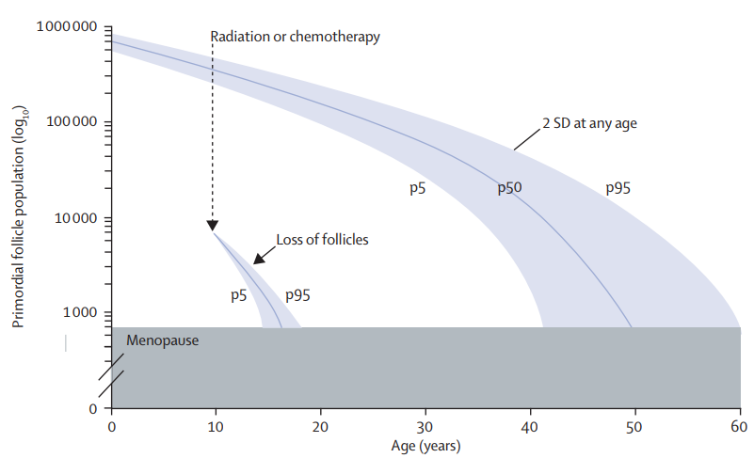
Considerations After Therapy
Reprinted from The Lancet, 376, De Vos, et al, Primary ovarian insufficiency, 911-921, © 2010, with permission from Elsevier.
Notes:
Faddy Gosden

