Slide 2
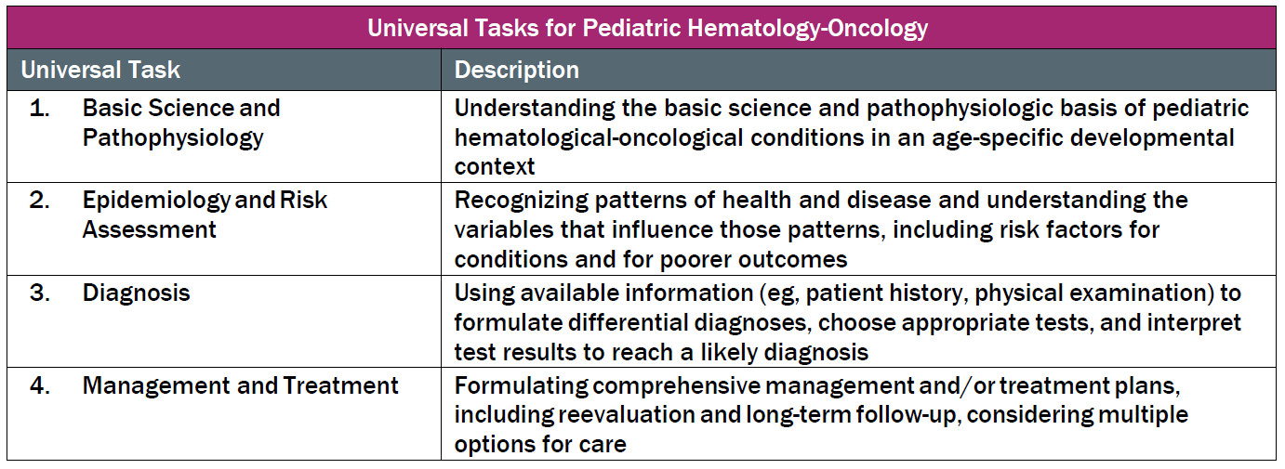
This talk will follow the topical structure suggested by the ABP:

Slide 3
Basic Science and Pathophysiology
Epidemiology and Risk Assessment
Diagnosis
Management and Treatment

Slide 4
Basic Science and Pathophysiology
Epidemiology and Risk Assessment
Diagnosis
Management and Treatment

Slide 6
Basic Science and Pathophysiology
Epidemiology and Risk Assessment
Diagnosis
Management and Treatment

Slide 8
Basic Science and Pathophysiology
Epidemiology and Risk Assessment
Diagnosis
Management and Treatment

Slide 10
Basic Science and Pathophysiology
Epidemiology and Risk Assessment
Diagnosis
Management and Treatment

