Slide 1
Retinoblastoma
Carlos Rodriguez-Galindo, MD
St. Jude Children’s Research Hospital

Slide 2
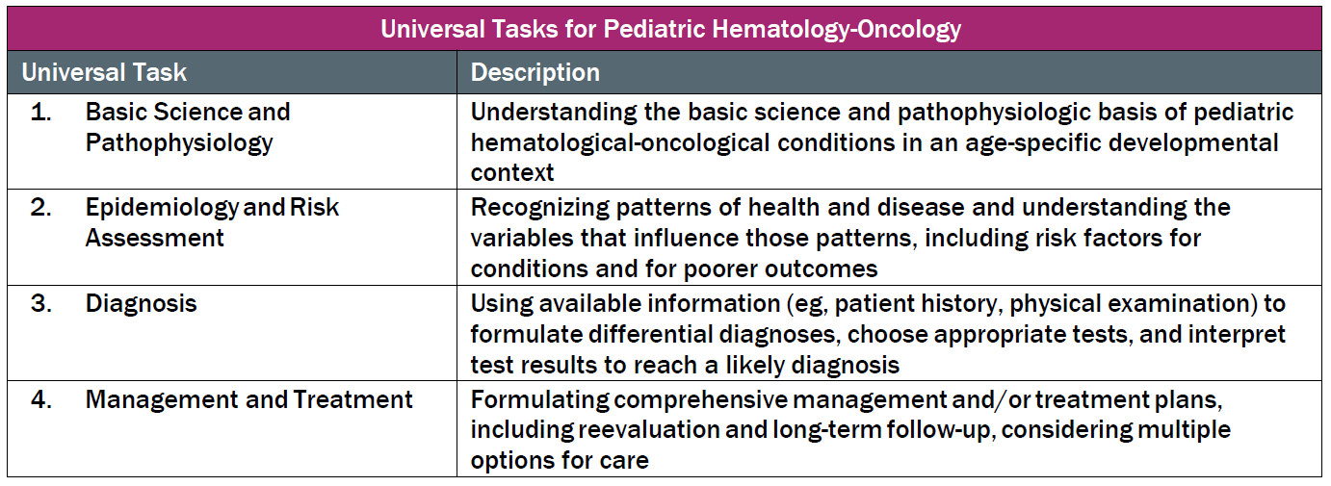
This talk will follow the topical structure suggested by the ABP:

Slide 3
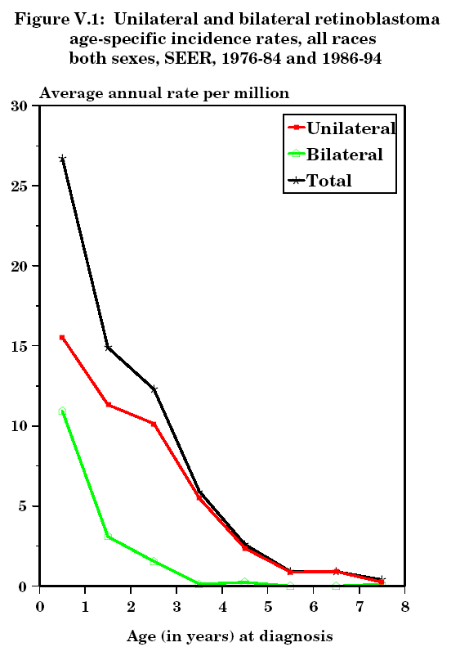
Retinoblastoma
Epidemiology and Risk Assessment
Annual Incidence
  3.7 cases per million children < 15 y
  US: 300 new cases/year
~3% of all pediatric cancers
  11% of cancers < 1 yr
Age at presentation
  63% < 2 years
  95% < 5 years
Laterality is age dependent
  < 1 yr: 42% BL – 58% UL
  1-2 yr: 21% BL – 79% UL
  > 2 yr: 9% BL – 91% UL
Ries LAG, Smith MA, Gurney JG, Linet M, Tamra T, Young JL, Bunin GR (eds).
Cancer Incidence and Survival among Children and Adolescents: United States SEER Program 1975-1995, National Cancer Institute, SEER Program. NIH Pub.No.99-4649. Bethesda,MD,1999.

Slide 4
Retinoblastoma
Two Clinical Forms
Basic Science and Pathophysiology
Non-heritable, unilateral or unifocal
  75% of patients
  Mutation of both alleles in a somatic cell
  Median time to diagnosis: 29-30 months
Heritable, bilateral, multifocal
  25% of patients
  Germline mutation of RB1
    25% cases: Inherited from a carrier parent
    75% cases: “de novo” mutation early in embryogenesis
  Median time to diagnosis: 14-16 months

Slide 5
Retinoblastoma
Biology
Basic Science and Pathophysiology
Biallelic inactivation of RB1 almost universal
  First hit is germline in heritable form and somatic in sporadic non-heritable form
    Germline RB1 mutations often occur in paternal allele (paternal environmental exposures)
    Germline RB1 deletions (3-5%) are associated with intellectual disability and dysmorphic features (13q- syndrome)
  Additional events required for transformation
    P53 pathway: MDM2 and MDM4 amplification
    Epigenetics
      BCOR mutations
      SYK upregulation
Wild type RB1 (1.5%): MYCN amplification
  Associated with worse outcome

Slide 6
Genetics and Genetic Counseling
Heritable Retinoblastoma
Epidemiology and Risk Assessment
Facts to remember
  RB1 germline mutation is associated with >90% penetrance to develop RB
    “Silent carriers” are very rare
  All patients with bilateral RB have a RB1 germline mutation
    25% inherited, 75% ‘de novo’
  BUT:
    15% of patients with unilateral RB carry a mutation
    15% of patients with germline mutation develop unilateral RB
    Mosaics for RB1 mutation exist
      Mutation occurs in late embryogenesis
      Variable tissue expression
      10% of patients with sporadic (‘de novo’) bilateral RB

Slide 7
Genetics and Genetic Counseling
Heritable Retinoblastoma
Epidemiology and Risk Assessment
Genetic counseling and proposal for genetic testing is indicated in all patients with retinoblastoma and their families, regardless of laterality
  Mutations are distributed throughout the 27 exons of the RB1 gene
  No single mutational “hotspot”
  A single genetic test is unlikely to detect all germline RB gene mutations
    Sequencing + FISH + QM-PCR + Methylation + MLPA
    Current methods: 90-95% sensitivity
  Specific mutation of the proband is needed to screen relatives
All offspring and newborn siblings MUST be screened at birth and every 4 weeks until genetic testing is complete
  Babies with positive testing (RB1 mutation) require dilated eye exams every 4 weeks due to high penetrance of mutation

Slide 8
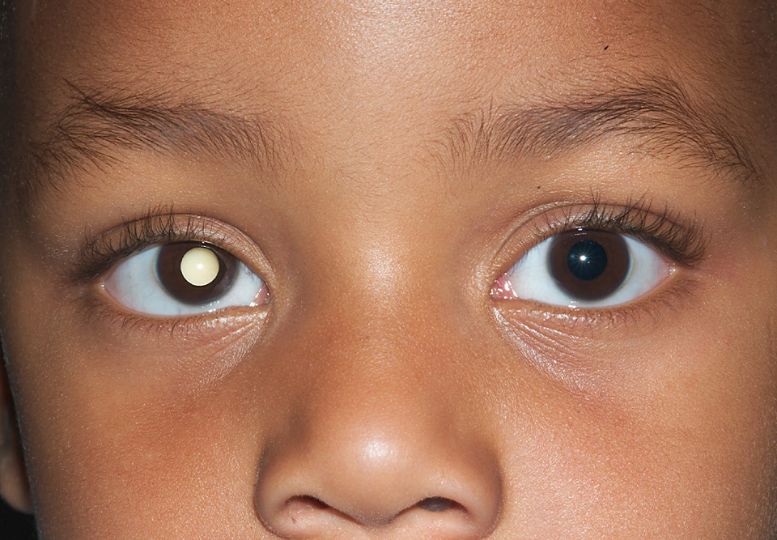
Retinoblastoma
Clinical Presentation
Diagnosis
Intraocular
Leukocoria 65-75%
Strabismus 10-15%
Nystagmus 5-10%
Advanced Intraocular
Buphthalmos
Glaucoma
Periorbital cellulitis
Extraocular
Proptosis + LN
Metastases

Slide 9
Retinoblastoma
Evaluation
Diagnosis
Examination under anesthesia (both eyes)
  Direct visualization of the tumor(s)
  Evaluation of corneal diameters and intraocular pressure
Imaging:
  Ocular US
  MRI orbits and brain
    Evaluation of optic nerve prior to enucleation
    Evaluation of CNS (Trilateral RB)
Bone scan, bone marrow aspirate/biopsy and CSF cytology
  Only if advanced disease: high-risk histology after enucleation, or extraocular retinoblastoma
Genetic counseling

Slide 10
Retinoblastoma
Differential Diagnosis
Diagnosis
Congenital Cataracts
Coats Disease
Persistent Fetal Vasculature (PFV)
Retinitis:
  Toxocara
  Toxoplasma
Medulloepithelioma
Astrocytic Hamartoma
Choroidal Osteoma

Slide 11
Diagnosis
Retinoblastoma “Staging”
Eye → Classification (groups)
Patient → Staging

Slide 12
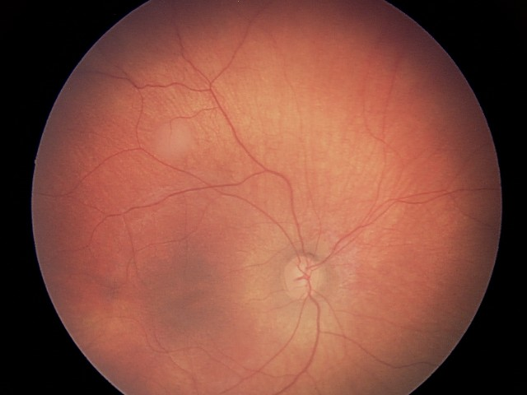
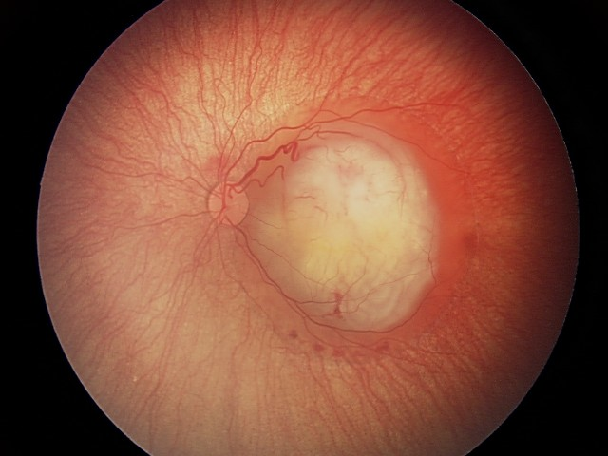
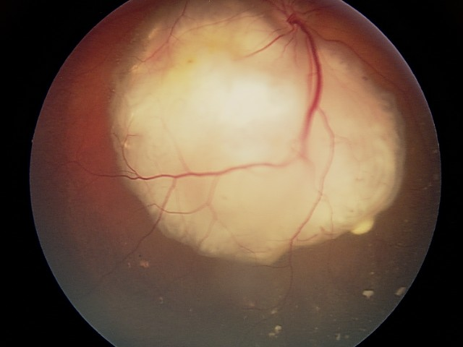
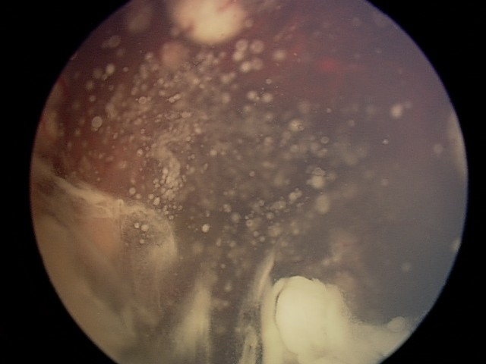
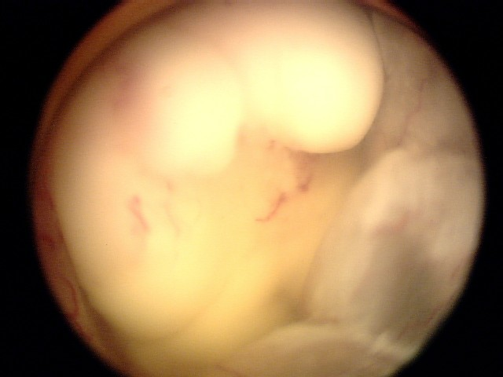
International Retinoblastoma Classification System
Diagnosis
Developed in the 2000’s
Based on ocular salvage using modern conservative approaches
Tumor size and tumor burden
Tumor location (in relationship to foveola and optic disc)
Subretinal fluid and seeding
Vitreous seeding
Group | Defining Features
Group A Small tumors away from foveola and disc | Tumors < 3 mm and Located at least 3 mm from foveola and 1.5 mm from the optic disc
Group B All remaining tumors confined to the retina | All other tumors confined to retina not in Group A Subretinal fluid < 3 mm from the base of tumor
Group C Local subretinal fluid or seeding | Local subretinal fluid alone > 3 to < 6 mm from tumor Vitreous seeding or subretinal seeding < 3 mm from the tumor
Group D Diffuse subretinal fluid or seeding | Subretinal fluid alone > 6 mm from tumor Vitreous seeding or subretinal seeding > 3 mm from tumor
Group E Presence of poor prognosis features | More than 2/3 globe filled with tumor Tumor in anterior segment or ciliary body Iris neovascularization, neovascular glaucoma Tumor necrosis, phthisis bulbi
A
B
C
D
E

Slide 13
International Retinoblastoma Staging System
Diagnosis
Stage | Definition
0 | Patients treated conservatively Refer to RB Group (Classification)
I | Eye enucleated, completely resected histologically
II | Eye enucleated, microscopic residual tumor Trans-scleral invasion Positive cut-end of o.n.
III | Regional extension a) Overt orbital disease b) Preauricular or cervical LNs
IV | Metastatic disease a) Hematogenous metastasis b) CNS extension 1. Pre-chiasmatic 2. CNS mass 3. Leptomeningeal and CSF disease
Key Concepts:
  Intraocular disease
    Without extraretinal extension
    With extraretinal extension
      Risk histological factors
  Extraocular disease
    Orbital
    Extraorbital
      CNS
      Extra-CNS

Slide 14
Retinoblastoma
Treatment
Management and Treatment
Multidisciplinary Team
Pediatric Oncologist
Ophthalmologist
Radiation Oncologist
Infrastructure
Supportive care
Priorities in Treatment
Cure
Eye Salvage
Vision Preservation
(+ Avoid or Delay RT)

Slide 15
Retinoblastoma
Treatment
Management and Treatment
Priorities in Treatment
Cure
Eye Salvage
Vision Preservation
(+ Avoid or Delay RT)
Must be individualized
  Stage, group
  Laterality
Major concepts
  Ocular preservation vs. enucleation
  Risk-adapted therapies
    Intraocular vs. orbital vs. extraorbital
  Two different scenarios: unilateral and bilateral
  Avoid or delay RT for ocular salvage
    Important impact on orbital growth
    Risk of second malignancies (heritable RB)

Slide 16
Retinoblastoma
Treatment
Management and Treatment
Treatment of intraocular retinoblastoma
  Ocular salvage vs. enucleation
  Treatment of unilateral retinoblastoma
  Treatment of bilateral retinoblastoma
Treatment of extraocular retinoblastoma
  Treatment of orbital disease
  Treatment of metastatic disease

Slide 17
Retinoblastoma
Treatment
Management and Treatment
Treatment of intraocular retinoblastoma
  Ocular salvage vs. enucleation
  Treatment of unilateral retinoblastoma
  Treatment of bilateral retinoblastoma
Treatment of extraocular retinoblastoma
  Treatment of orbital disease
  Treatment of metastatic disease

Slide 18
Retinoblastoma
Treatment
Management and Treatment
Treatment of intraocular retinoblastoma
  Ocular salvage vs. enucleation
  Treatment of unilateral retinoblastoma
  Treatment of bilateral retinoblastoma
Treatment of extraocular retinoblastoma
  Treatment of orbital disease
  Treatment of metastatic disease

Slide 19
Treatment of Retinoblastoma
Ocular Salvage vs. Enucleation
Management and Treatment
A
B
C
D
E
Factors influencing initial treatment decision: intraocular disease (group), potential for vision, and laterality
Decisions need to be made in this continuum of tumor progression
  Ocular salvage chances are very high in group A and very low in group E, and decisions are individualized
  Favorable visual outcomes decrease with increasing intraocular tumor burden
  Intensity of treatments required for ocular salvage increase across the continuum
  In general, ocular salvage options are not offered for group E eyes (and many group D eyes) and upfront enucleation is recommended
  Treatment for patients with bilateral retinoblastoma is more conservative, and decisions regarding enucleation are usually delayed

Slide 20
Treatment of Retinoblastoma
Ocular Salvage vs. Enucleation
Management and Treatment
Chemoreduction: Reduce tumor burden to facilitate focal treatments
  Systemic chemotherapy: vincristine, etoposide, and carboplatin (VCE)
  Intra-arterial chemotherapy: melphalan, others (carboplatin, topotecan)
  Intra-vitreal chemotherapy: melphalan
    Used for treatment of vitreous seeds
Focal treatments
  Used to consolidate responses after chemotherapy
  Small lesions (< 4 dd): cryotherapy (anterior pole), thermotherapy (posterior pole)
  Larger lesions (> 4 dd): brachytherapy (radiation plaque applied to the sclera)
External-beam radiation therapy
  Used when other measures have failed

Slide 21
Treatment of Retinoblastoma
Ocular Salvage vs. Enucleation
Management and Treatment
Upfront treatment of advanced disease
  Always indicated in Group E eyes
  Alternative to ocular salvage depending on laterality
    Unilateral > Bilateral
Treatment after failure of ocular salvage
Surgery: Expert surgeon
  Removal of long section of optic nerve (~ 10 mm)
  Placement of orbital implant
Histopathological exam

Slide 22
Treatment of Retinoblastoma
Ocular Salvage vs. Enucleation: Histopathological Examination
Management and Treatment
Look for High-Risk Histology (extra-retinal disease), which is present in about 20% to 25% of the cases:
  Massive choroidal replacement (> 3 mm)
  Ciliary body infiltration
  Iris infiltration
  Scleral invasion
  Anterior chamber seeding
  Optic nerve involvement
    Post-laminar involvement
    Pre-laminar involvement + choroidal involvement
Presence of High-Risk Histology is indication for additional staging studies and risk-adapted therapy
(Consensus Criteria from COG ARET0332 study)

Slide 23
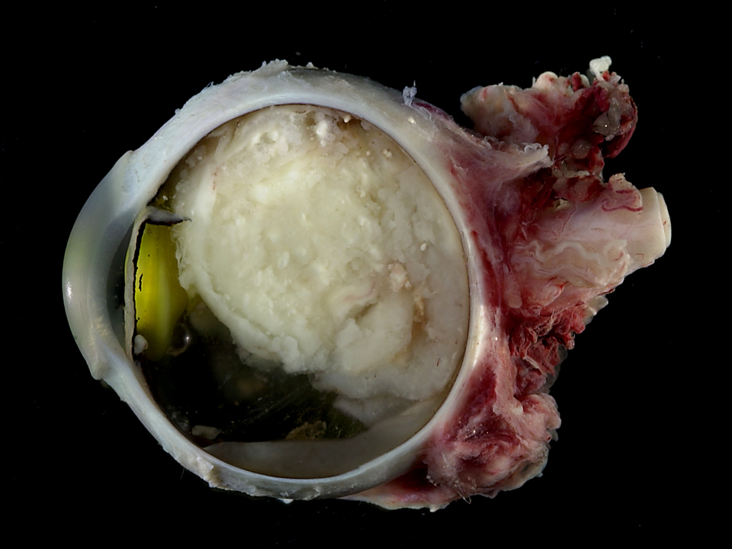
Management and Treatment
No high-risk histology
(intra-retinal)
High-risk histology
(extra-retinal)
Metastatic Workup
(Bone Scan, BM, CSF)
Observation
Examination of orbital socket
Examination of contralateral eye
Outcome: > 95% survival
NEG
POS
Adjuvant Chemotherapy
VCR/ETO/CBP x 6
(VCR/CYC/DOX)
Outcome: > 95% survival
Treatment for
Metastatic Disease

Slide 24
Retinoblastoma
Treatment
Management and Treatment
Treatment of intraocular retinoblastoma
  Ocular salvage vs. enucleation
  Treatment of unilateral retinoblastoma
  Treatment of bilateral retinoblastoma
Treatment of extraocular retinoblastoma
  Treatment of orbital disease
  Treatment of metastatic disease

Slide 25
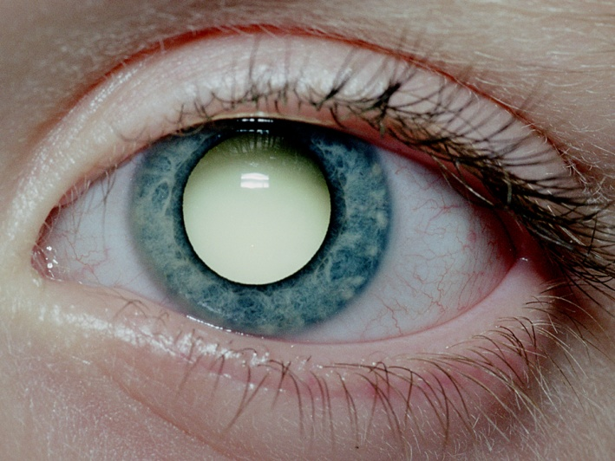
Treatment of Unilateral Retinoblastoma
Management and Treatment
Usually presents with advanced intraocular disease
  Leukocoria → tumor affects 2/3^{rds} of the eye globe
Options:
  Upfront enucleation and risk-adapted adjuvant therapy
    No risk pathology (75-80%): Enucleation + Observation
    Risk pathology (20-25%): Enucleation + Adjuvant chemotherapy
  Ocular salvage treatments indicated for early intraocular disease (A, B, C, some D)
    Intra-arterial or systemic chemotherapy + focal treatments
    Ocular salvage rates > 75%
  Ocular salvage not indicated for advanced intraocular disease (E, some D), and upfront enucleation is recommended

Slide 26
Treatment of Unilateral Retinoblastoma
Group A
Group B, C
Group D
Group E
Focal Treatments
Systemic or
I-A Chemotherapy
+
Focal Treatments
Consider IA
chemotherapy
Enucleation
Pathology
Progression
Progression
Progression
No risk
Risk
Systemic or IA chemotherapy
Brachytherapy
Consider
Brachytherapy
Chemotherapy
+ EBRT if extraocular disease
Observation
Enucleation
Enucleation
Histological risk-based adjuvant chemotherapy

Slide 27
Retinoblastoma
Treatment
Management and Treatment
Treatment of intraocular retinoblastoma
  Ocular salvage vs. enucleation
  Treatment of unilateral retinoblastoma
  Treatment of bilateral retinoblastoma
Treatment of extraocular retinoblastoma
  Treatment of orbital disease
  Treatment of metastatic disease

Slide 28
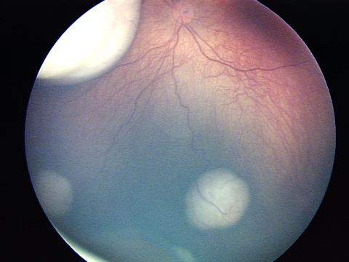
Treatment of Bilateral Retinoblastoma
Key Concepts to Consider
Management and Treatment
Multifocal disease
Dynamic process
  Tumors develop until 4-5 years of age
Treatment decisions must include (for each eye)
  Tumor burden (‘Group’)
  Potential for vision
  Status of contralateral eye
Risk factors for ocular salvage:
  Tumor size
  Vitreous seeding
  Retinal detachment/seeds

Slide 29
Treatment of Bilateral Retinoblastoma
Management and Treatment
Usually more conservative approach than for unilateral RB
Upfront intra-arterial or systemic chemotherapy + intensive focal treatments +/- intravitreal chemotherapy
Radiation therapy is very effective for poor responders BUT usually voided or delayed whenever possible
  Side effects of irradiation: bone growth delay and second malignancies
  Timing of enucleation and irradiation also depends on status of contralateral eye
Outcome
  Ocular salvage rates: 65-90%
  Survival: >90%

Slide 30
Management and Treatment
Treatment of Bilateral Retinoblastoma
Group A
both eyes
Group B
worse eye
Group C, D
worse eye
Group E
worse eye
Focal Treatments
2 or 3-drug systemic chemotherapy or
I-A chemotherapy
+
Focal Treatments
3-drug systemic
chemotherapy or
I-A chemotherapy
+
Focal Treatments
Enucleate group E eye
Treatment based on
Pathology
Group of remaining eye
Progression
Progression
Progression
Chemotherapy
Brachytherapy
EBRT*
Intravitreal chemotherapy
Enucleation
*EBRT – External-beam radiation therapy
Histological risk-based adjuvant chemotherapy

Slide 31
Retinoblastoma
Treatment
Management and Treatment
Treatment of intraocular retinoblastoma
  Ocular salvage vs. enucleation
  Treatment of unilateral retinoblastoma
  Treatment of bilateral retinoblastoma
Treatment of extraocular retinoblastoma
  Treatment of orbital disease
  Treatment of metastatic disease

Slide 32
Extraocular Retinoblastoma
Management and Treatment
Orbital disease
  Overt orbital disease, trans-scleral involvement, or + cut-end of optic nerve
  Associated with pre-auricular or cervical nodal disease
  Treatment with cisplatin-based therapy, enucleation, and radiation therapy is curative in > 70% of the cases
Extra-orbital disease
  Very rare in the US
  Metastatic sites: bone, bone marrow, liver, CNS
  Extra-CNS disease is curable (70% survival) with cisplatin-based therapy and consolidation with high-dose chemotherapy and auto HSCT
  CNS disease has a dismal prognosis

Slide 33
Long Term Effects
Management and Treatment
Chemotherapy
  Hearing loss
  Therapy-related AML (BUT, survivors of heritable RB do not have an added risk beyond chemotherapy exposure)
  Cardiotoxicity
Radiation
  Facial deformity
  Second malignant neoplasms
Ocular
  Decreased vision (tumor, treatment)
  Retinal vasculopathy (tumor, RT, I-A chemo)
  Xerophthalmia (RT)
Second malignant neoplasms

Slide 34
Second Malignancies in Retinoblastoma Survivors
Management and Treatment
Cumulative incidence 36% at 50 years*
Most are radiation-induced:
  RT exposure almost doubles the risk (20% to 40%)
  60-70% of second malignancies are in the head and neck area
  Dose-effect
  Age-effect (higher risk for < 1 yo)
Malignancies:
  Osteosarcoma (25-40%): Most common inside and outside irradiated field
  Soft tissue sarcomas (10-15%): Inside > outside irradiated field (leiomyosarcoma > fibrosarcoma > MFH > STS NOS > RMS)
  Melanoma and other skin cancers (15-20%)
  Lung cancer and other common cancers of adulthood
*Kleinerman, R. A. et al. J Clin Oncol; 23:2272-2279 2005

Slide 35
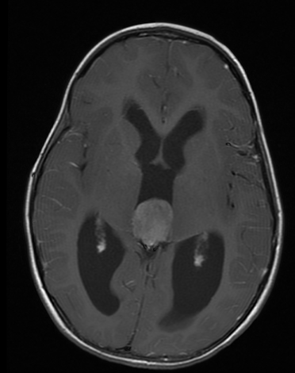
Trilateral Retinoblastoma
Management and Treatment
Bilateral RBL + asynchronous
midline intracranial tumors
  Pineoblastomas
  3-9% of bilateral RBL
  Median interval B-RBL to T-RBL: 35 m.
  Very poor prognosis
Lower vertebrates: Pineal gland is a photoreceptive organ
Screening: MRI every 6 months until 5 years of age for children with bilateral RB (although unclear impact on outcome)

