Slide 1
Germ Cell Tumors
Carlos Rodriguez-Galindo, MD
St. Jude Children’s Research Hospital

Slide 2
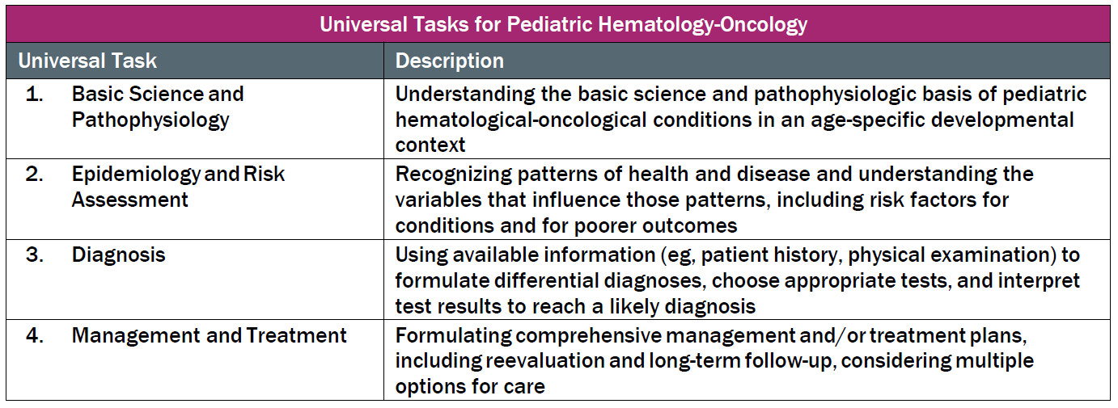
This talk will follow the topical structure suggested by the ABP:

Slide 3
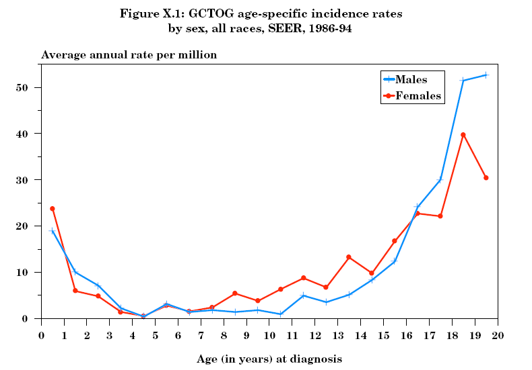
Pediatric Germ Cell Tumors
Epidemiology and Risk Factors
Annual Incidence:
  3.9 cases per million children (0-15y)
    1.5 cases / million at gonadal sites
    2.4 cases / million at extragonadal sites
~3% of all pediatric cancers
Bimodal age distribution
  Peak < 3 years
    Extragonadal
    Testicular tumors
  Peak: adolescence
    Gonadal tumors
Ries LAG, Smith MA, Gurney JG, Linet M, Tamra T, Young JL, Bunin GR (eds).
Cancer Incidence and Survival among Children and Adolescents: United States SEER Program 1975-1995, National Cancer Institute, SEER Program. NIH Pub.No.99-4649. Bethesda,MD,1999.

Slide 4
Pediatric Germ Cell Tumors
Histology
Basic Science and Pathophysiology
Diagnosis
Seminomatous (germinomatous) GCT:
  Seminoma (testes)
  Dysgerminoma (ovary)
  Germinoma (extra-gonadal)
Non-seminomatous (non-germinomatous) GCTs:
  Embryonal Carcinoma: Undifferentiated cells that histologically resemble embryonic cells from the blastocyst
  Yolk Sac Tumor: Most common malignant GCT in young children; components of embryonic and extraembryonic endoderm
  Choriocarcinoma: Very rare, represents trophoblastic differentiation
  Teratoma: disordered mixture of differentiated cell types from all three somatic cell layers. If a component acquires neuronal differentiation: immature teratoma

Slide 5
Pediatric Germ Cell Tumors
Classification
Basic Science and Pathophysiology
Type I
  Children < 4 years
  Usually present as teratoma, yolk sac tumor, or mixtures of the two
Type II
  Puberty through young adulthood
  Full range of germinomatous and non-germinomatous histologies
  Often associated with a presumptive precursor lesion known as germ cell neoplasia in situ (GNCIS, usually seen in normal tissue adjacent to tumor)

Slide 6
Pediatric Germ Cell Tumors
Biology
Basic Science and Pathophysiology
Origin
  Arise from primordial cells involved in gametogenesis at different stages of development (Type I vs. Type II)
  Aberrant caudad or cephalad migration of germ cells leads to midline extragonadal tumors.
Molecular Genetics
  Type I (young patients)
    Gain of 1q, 11q, 20q, and 22
    Loss of 1p, 6q, and 16q
    Partial loss of genomic imprinting
  Type II (older patients)
    Amplification of chromosome 12 (usually through creation of isochromosome 12p)
    Amplification of X chromosome
    Loss of genomic imprinting
  Type I and II exhibit distinct gene expression profiles
  Distinct miRNA landscape from normal gonad (serum miRNA levels under evaluation as tumor markers)

Slide 7
Pediatric Germ Cell Tumors
Risk Factors
Epidemiology and Risk Factors
Genetic syndromes
  Klinefelter Syndrome (47XXY)
  Gonadal Dysgenesis
    Swyer Syndrome (46XY)
    Turner Syndrome (47XO)
Anatomic
  Crypto-orchidism
  Genitourinary anomalies
    Hernia, hydrocele

Slide 8
Pediatric Germ Cell Tumors
Clinical Presentation
Diagnosis
Presentation:
  Ovarian: abdominal pain, palpable abdominal/adnexal mass
    Consider ovarian sex cord-stromal tumor if
      Precocious puberty: Granulosa Cell Tumor (young children)
      Amenorrhea and/or virilization: Sertoli-Leydig Tumor (adolescents)
  Testicular: Irregular, non-tender mass
  Extragonadal tumors:
    Sacrococcygeal: Constipation, urinary retention
    Mediastinal: Chest pain, respiratory distress
Diagnosis:
  CT/MRI primary
  Metastatic work-up: Bone scan, Chest CT

Slide 9
Pediatric Germ Cell Tumors
Clinical Presentation
Diagnosis
Age:
  Girls → ovarian tumors after age 3
  Boys → testicular tumors before age 4 or after age 13
  Extragonadal tumors:
    Sacro-coccyx before age 4
    Mediastinum after age 9
    80% stage III/IV
Site:
  Gonadal: 41% vs. Extragonadal: 59%.
  Children < 15 → Extragonadal > Gonadal
  Children ≥ 15 → Gonadal > Extragonadal

Slide 10
Pediatric Germ Cell Tumors
Histology and Tumor Markers
Diagnosis
Histology | Serum AFP | Serum B-HCG
Yolk sac tumor | ++++ | -
Choriocarcinoma | - | ++++
Embryonal carcinoma | +/- | +/-
Germinoma | - | -
Teratoma | - | -
Immature teratoma | +/- | -
AFP: Developmental changes in < 12 months
Dysgerminomas: May have elevated PLAP

Slide 11
Pediatric Germ Cell Tumors
Tumor Marker Kinetics
Diagnosis
Alpha-Fetoprotein
  Normal values
    Newborn > 40,000 ng/mL (> 100,000 in preterms)
    Adult levels (<10) reached by 8-12 months
  t ½ = 5-7 days (important for monitoring response to therapy)
    But: wide variability in t ½ in the first year of life
    Difficulties in interpreting absolute levels and decay during infancy
  Elevation in levels of AFP suggests active disease, BUT
    Infants may have slow rebound in AFP after completing chemotherapy
    Abrupt increase in AFP may occur after initiation of therapy (tumor lysis)
    Spurious persistence of elevated AFP may occur in alterations of liver function (viral hepatitis, cholestasis secondary to anesthesia, exposure to phenytoin)
    Other malignancies may also cause elevation of AFP (hepatoblastoma, pancreatoblastoma)
Beta-HCG
  Normal values < 5 IU/mL
  t ½ = 24-36 hours
  Elevation of levels of B-HCG suggest active disease, BUT
    Iatrogenic hypogonadism may cause elevation of Luteinizing Hormone, which has immunologic cross-reactivity with B-HCG
    Other malignancies may also cause elevation of B-HCG (multiple myeloma and other adult-type malignancies)

Slide 12
Pediatric Germ Cell Tumors
Staging
Diagnosis
Stage | Description
I | Complete resection with normalization of tumor markers within expected half-life.
II | Microscopic residual disease: persistent marker elevation; lymph nodes < 2 cms
III | Gross residual disease: lymph nodes > 2 cms (or > 1 - < 2 cm that fail to resolve within 4-6 weeks); no extra-abdominal or visceral metastases
IV | Distant metastases

Slide 13
Pediatric Germ Cell Tumors
Staging of Testicular Tumors
Diagnosis
Inguinal incision and radical orchiectomy with high ligation of cord structures
Assessment of retroperitoneal lymph nodes by CT
  LN < 1 cm: Negative
  LN 1 to <2 cm: Indeterminate → if stage I, f-u in 4-6 weeks, remain stage I if < 1 cm, if stable or increased, consider biopsy or upstage.
  LN > 2 cm: Metastatic disease
In case of scrotal orchiectomy
  May remain stage I if negative margins and appropriate decline of tumor markers
  Proximal cord structures should be resected and upstage if disease present
If scrotal biopsy was performed
  Scrotum is contaminated → stage II
  Hemiscrotectomy is not required
  Completion orchiectomy should be performed

Slide 14
Pediatric Germ Cell Tumors
Staging of Ovarian Tumors
Diagnosis
Ovarian GCT are usually large and always friable (risk of intraoperative spill)
Required components of surgical staging:
  Cytological assessment of peritoneal fluid
  Inspection and biopsy of any abnormal appearing peritoneal surfaces, lymph nodes, omentum, contralateral ovary
  Removal of the primary tumor without violation of the tumor capsule in situ
Failure to document inspection and confirmation of normal appearance of omentum, peritoneal surfaces, lymph nodes, and opposite ovary precludes eligibility for surgery only approaches

Slide 15
Pediatric Germ Cell Tumors
Treatment
Management and Treatment
Stage I gonadal tumors
  Surgery and observation are indicated in the setting of normalization of tumor markers
    Tumor markers are followed monthly to monitor normalization and anticipate recurrence
    If markers fail to normalize → stage II
    30% to 50% of patients may recur, but salvage rates are high, and survival is > 95%
All others
  Chemotherapy + surgery
  Risk-adapted regimens and intensification under evaluation
  Radiation therapy IS NOT indicated in upfront management of malignant GCT

Slide 16
Pediatric Germ Cell Tumors
Risk Assignment
Management and Treatment
Patients with stage I GCT represent a low-risk group
Patients with stage II-IV gonadal GCT appear to be an intermediate risk group
  However, post-puberal patients with gonadal tumors have a higher risk of failure
Patients with advanced extragonadal tumors represent the highest-risk group
  Older age (post-puberal) is the factor most predictive for outcome in these patients
  There is a significant interaction between age and primary site.
    Young patients – sacrococcygeal (better prognosis)
    Older patients – mediastinal (worse prognosis)

Slide 17
Pediatric Germ Cell Tumors
Treatment
Management and Treatment
Risk-Group | Stages | Treatment | Outcome (OS)
Low | Stage I immature teratoma Stage I gonadal | Surgery only | > 95%*
Intermediate | Stages II-IV gonadal Stages I-II extragonadal | Surgery + Chemotherapy | > 90%
High | Stages III-IV extragonadal | Surgery + Chemotherapy | 70%-75%
* Patients with stage I gonadal disease have a ~30%-50% risk of recurrence with surgery only; however, salvage rates with chemotherapy are excellent, thus the recommendation for surgery only and close observation with tumor markers

Slide 18
Pediatric Germ Cell Tumors
Treatment
Management and Treatment
Platinum-containing regimens
  PEb: Cisplatin + Etoposide + Bleomycin
    Adult regimen for adolescents: Weekly bleomycin (BEP)
  CEb: Carboplatin + Etoposide + Bleomycin
    Used in UK with similar results to PEB
  AGCT1531 trial: Randomization Cisplatin vs. Carboplatin
  VIP: Etoposide + Ifosfamide + Cisplatin
    Consider for mediastinal primaries
    Lower postoperative complication rates (vs. BLEO-containing regimen)
Standard approach
  Stage I gonadal: observation
  Stage I extragonadal and stage II: 4 cycles of postoperative chemotherapy
  Stages III-IV: 4 cycles, followed by surgery
    Role of postoperative chemotherapy (2 additional cycles) for residual active disease unclear, currently not recommended

Slide 19
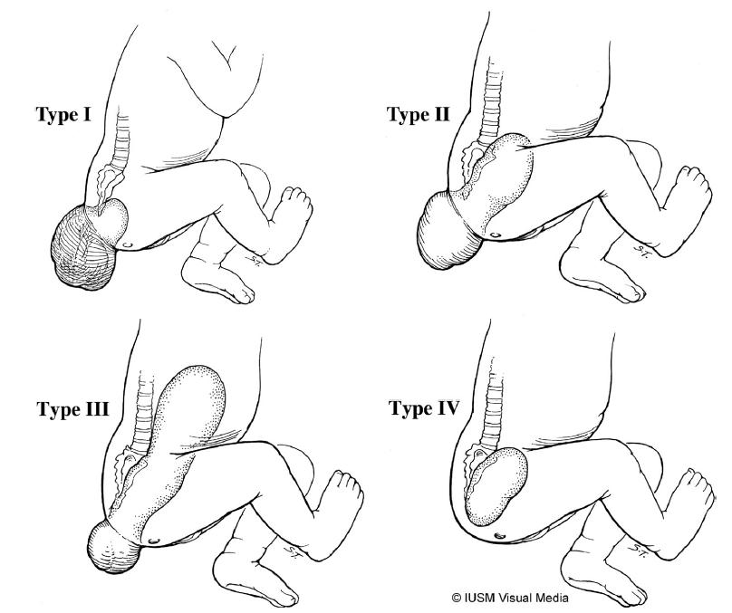
Sacrococcygeal GCT
1:35,000 live births
Two distinct clinical patterns:
  Large, predominantly external, detected prenatally or at delivery → rarely malignant (< 10%) or stage I
  Older infants, young children, less apparent → high rate of malignancy (60-90%), stages III-IV
    Abdominal pain, constipation, bladder dysfunction, neuropathy
    Large pelvic mass, lungs, bone metastases
Pathology
  Teratoma – Immature Teratoma – YST
Treatment
  Stage I: Surgery alone (+ coccyx)
  Stages II – IV: Surgery + Chemotherapy
Prognosis: Excellent (survival > 90%)
Type I: 46.7%
Type II: 34.7%
Type III: 8.8%
Type IV: 9.8%
Reprinted from Rescorla FJ, Pediatric Germ Cell Tumors, in Seminars in Pediatric Surgery 51-60, 2012, with permission from Elsevier

Slide 20
Long Term Effects
Chemotherapy
  Hearing loss
  Neuropathy
  Therapy-related AML
  Cardiotoxicity
  Renal toxicity
  Pulmonary toxicity
Bladder and bowel dysfunction in SCT

