Slide 1


Slide 2

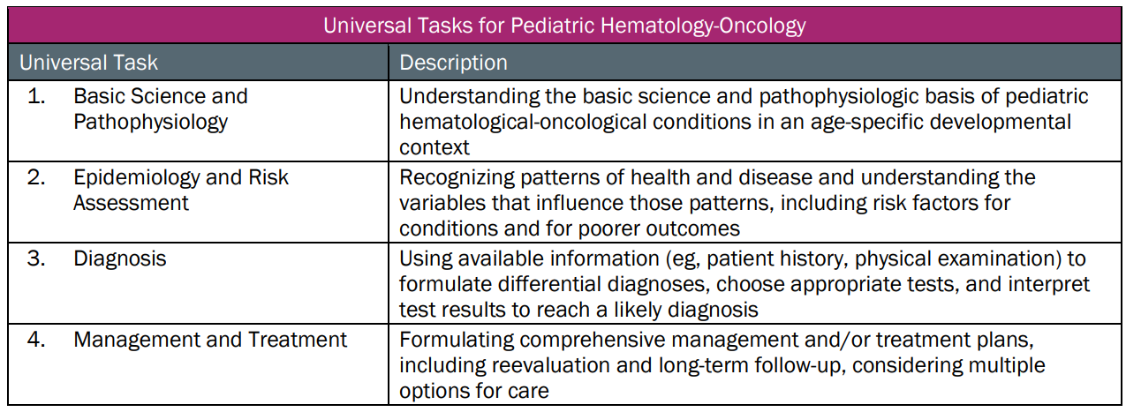
This talk will follow the topical structure suggested by the ABP:

Slide 3
[Topic of Talk]
Basic Science and Pathophysiology
Epidemiology and Risk Assessment
Diagnosis
Management and Treatment

Slide 4
[Topic of Talk]
Basic Science and Pathophysiology
Epidemiology and Risk Assessment
Diagnosis
Management and Treatment

Slide 6
[Topic of Talk]
Basic Science and Pathophysiology
Epidemiology and Risk Assessment
Diagnosis
Management and Treatment

Slide 8
[Topic of Talk]
Basic Science and Pathophysiology
Epidemiology and Risk Assessment
Diagnosis
Management and Treatment

Slide 10
[Topic of Talk]
Basic Science and Pathophysiology
Epidemiology and Risk Assessment
Diagnosis
Management and Treatment

