Slide 1
Nutritional Anemias
Jacquelyn M. Powers, MD, MS
Baylor College of Medicine
Texas Children’s Hospital

Slide 2
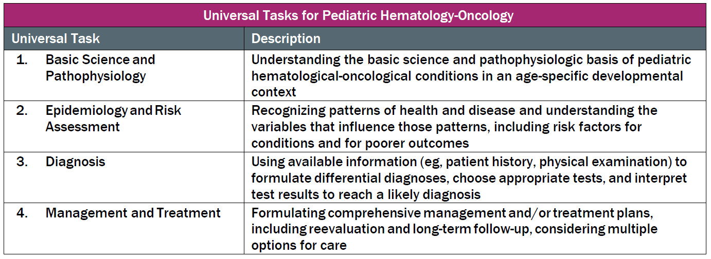
As applicable, this talk will follow the topical structure suggested by the ABP:

Slide 3
ABP Domains covered in this talk
The erythron
    Developmental changes of the erythron, normal erythrocytes, erythrocyte physiology
    Approach to anemia
Iron disorders
    Iron deficiency anemia
    Anemia of chronic disease and disorders of iron metabolism
    Transfusional and congenital iron overload
Megaloblastic anemia
    Nutritional deficiencies: folate and B12
    Metabolic disorders and drugs
Erythrocytosis (primary or secondary)

Slide 4
The erythron

Slide 5
Fetal erythropoiesis
100%
Formation in Liver
Formation in Spleen
Formation in Marrow
50%
Yolk sac
3
6
Birth
Gestational Age (Months)
Notes:
Yolk sac prior to liver (first 6 weeks)
Liver, spleen & marrow
5th to 6th week of gestation → blood formation in liver
Fetal liver site of pure erythropoiesis during 3rd to 5th months
Erythroid precursors represent approx 50% of nucleated cells
Liver is chief organ of hematopoiesis from 3rd to 6th fetal m onth
Continues thru first postnatal week
During 3rd fetal month, hematopoiesis also detected in spleen
Continues thru first postnatal week
Myeloid period of hematopoiesis commences during 4th to 5th fetal month
Becomes quantitatively important by sixth month
During last 3 months of gestation, bone marrow is chief site of blood formation
Marrow cellularity becomes maximal at ~30th week of gestation…volume of marrow occupied by hematopoietic tissue continues to increase until term

Slide 6
Erythropoiesis after birth & physiologic nadir
Increase in tissue oxygen level → decrease in EPO
Rate of hemoglobin synthesis decreases
Production reaches minimum during 2nd week of life
Subsequently increases → maximum production at approx 3 months of age
Notes:
Rate of hemoglobin synthesis and red cell production decreases dramatically during first few days after delivery
Production of red cells/hemoglobin decreases by a factor of 2 to 3 in first few days after birth
Decreases by a factor of 10 during first week of life
Decrease in red cell production due to sudden increase in tissue oxygen level, which corresponds with almost absent EPO in plasma
Rate of production reaches a minimum during 2nd week of life, increases during following months and reaches maximum at about 3 months of age (at approx 2 mL of pRBCs per day or 2% of circulating red cell mass per day)

Slide 7
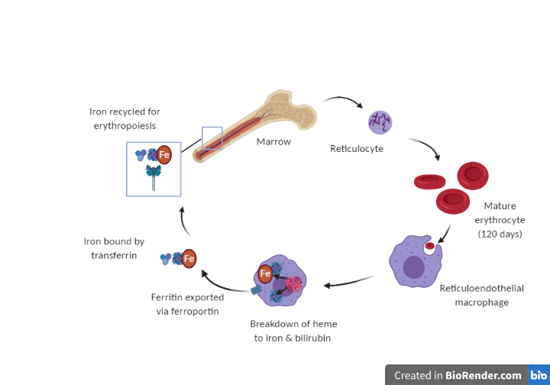
Red cell morphology
Normal, mature RBCs
  Anuclear, bi-concave, disc-shaped
  7-8 microns in diameter (similar size to nucleus of resting lymphocyte)
  Central pallor 1/3 diameter of cell
Neonatal red cells have larger volume & lower hemoglobin concentration than adults ( MCV)
  Macrocytosis more prominent in premature infants
Created with ©BioRender - biorender.com
Notes:
In adults, approx 78% of red cells appear as biconcave discs, 18% as bowl forms, approx 3% as other cell types (spherocytes, poikilocytes)
In term infants, only 43% are biconcave discs, 40% as bowl forms, up to 14% as cells with morphologic distortions
In premature infants, even more marked difference in morphology
40% discs, 30% bowls, up to 27% other morphology
High frequency of dysmorphology in hematologically normal neonates makes it difficult to diagnosis specific red cell disorders at birth
When severe, condition referred to as “infantile pyknocytosis’

Slide 8
Red blood cell life cycle
Life span significantly shorter in infants
  Term infants: 60 to 70 days
  Premature infants: 35 to 50 days
Created with ©BioRender - biorender.com

Slide 9
Approach to Anemia

Slide 10
Definition of Anemia
Reduction in red blood cell mass (Hct) or hemoglobin
  Hemoglobin >2 SD below mean for age, sex, and race
  Affected by age, sex, ethnicity, Tanner stage, altitude, heredity
Physiologic: Hgb too low to meet cellular oxygen demands
  2 mo premature infant, Hgb 7.5 → normal for age
  2 yo with cyanotic heart disease, Hgb 14 → anemic

Slide 11
Approach to Anemia
Commonly taught as either:
Pathophysiology (production, hemolysis, blood loss)
OR
Based on size (MCV): microcytic, normocytic, macrocytic
In reality, you consider both simultaneously.

Slide 12
Approach to Anemia
Reticulocyte count
(Inappropriate) Production issue
Normal / Decreased
Increased
Three critical aspects:
Clinical history
CBC/retic
Peripheral smear
(Appropriate)
MCV
Microcytic
Normocytic
Macrocytic
Hemolysis
Blood loss
Iron deficiency
Thalassemia
ACD (late)
Sideroblastic
TEC
ACD (early)
Low epo/Renal
Hypothyroid
BM Invasion
B12/Folate
Medication
BM Aplasia
Extrinsic to RBC
Immune
Non-immune
Instrinsic to RBC
Membrane, Hb
Enzyme

Slide 13
Iron Disorders
Basic Science and Pathophysiology
Epidemiology and Risk Assessment
Diagnosis
Management and Treatment

Slide 14
Iron homeostasis

Slide 15
Maternal-placental transfer of iron in pregnancy
Iron “endowment” occurs during 3rd trimester
  Even in iron-deficient mothers, placenta will continue to remove iron from mother to support fetal development
Full term infants born with adequate iron stores to last approx. 6 months
Preterm infants at greater risk for iron deficiency
  Stores depleted by 3 to 4 months of age
Notes:
Maternal iron status affects iron stores of neonates
Fetal iron stores vary linearly with maternal hemoglobin

Slide 16
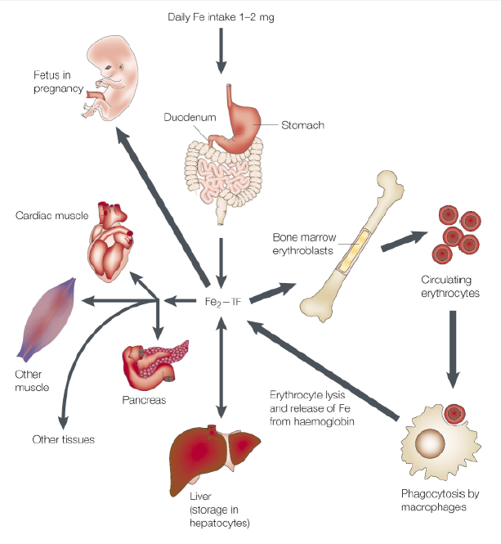
Iron distribution in body
Healthy adults approx. 3-5 grams total body iron
  Net requirement 1-2 mg
  Balanced with losses
Majority in RBC’s & bone marrow
Storage iron in liver
Circulating iron bound to transferrin (0.1% total body iron)
Children require higher amounts to support growth
Circulating
RBC’s
(1800 -2700 mg)
Bone Marrow
(300 mg)
Muscle
(Myoglobin)
(300 - 1000 mg)
From Andrews NC. Iron homeostasis: insights from genetics and animal models. Nat Rev Genet. 2000 Dec;1(3):208-17. doi: 10.1038/35042073. © 2000, Macmillan Magazines Ltd. Reprinted with permission.
Plasma
transferrin
(3 mg)
Liver
(1000 mg)
Macrophages
(600 mg)
Notes:
Distribution of iron in body. Adults have approx. 3-5 grams total. Take in 0.5 to 2 mg per day via duodenum.
Most iron is in the bone marrow & mature erythrocytes
Iron for new RBC synthesis is primarily from reticuloendothelial macrophages, which recycle iron from old RBCs
Circulating iron is bound to transferrin (only approx. 0.1% of total body iron)
Iron uptake by erythroid precursors occurs via transferrin cycle
- Other tissues are much less dependent on the transferrin cycle for iron uptake
Erythroid precursors “shed” transferrin receptors into the serum (sTfR) → sTfR is roughly a measure of erythropoietic activity
Erythropoiesis rapidly becomes iron-restricted with ↓ plasma iron
Transferrin
- 10% of non-albumin protein in serum
Binds 2 iron atoms @ 10⁻²³ M⁻¹ affinity
Carries iron throughout the circulation
Delivers it to cell transferrin receptors
Ferritin
Stores iron within cells
Polymer of 24 polypeptide subunits
Holds up to 4500 iron atoms / multimer
Oxido-reductase activity
Iron can be mobilized when needed

Slide 17
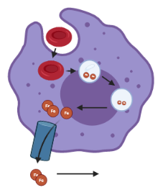
Iron recycling via macrophages
Old or damaged RBC’s engulfed by reticuloendothelial macrophages
Heme released from RBC
Heme oxygenase releases ferritin
Ferritin exported via ferroportin into the plasma
Utilized for erythropoiesis, limits need for additional iron
Ferroportin
Transferrin transports ferritin to tissues
Created with ©BioRender - biorender.com

Slide 18
Absorption of iron occurs in duodenum
Fe⁺³
Fe⁺²
Mucosal Surface
Ferrireductase
DMT1
Ferritin
Ferroportin
Basolateral Surface
Fe⁺²
Hephaestin
Transferrin - bound iron in plasma (Fe⁺³)
From Powers JM and O’Brien SH. How I Approach Iron Deficiency and out Anemia. Pediatr Blood Cancer. 2018;e27544. © 2018 Wiley Periodicals, Inc. Reprinted with permission.
Notes:
Powers JM and O’Brien SH. How I Approach Iron Deficiency with and without Anemia. Pediatr Blood Cancer. 2018;e27544.

Slide 19
Hepcidin regulates iron absorption
Iron homeostasis regulated by:
Erythropoietic demand
Hypoxia
Total body iron
Fe⁺³
Fe⁺²
Mucosal Surface
Ferrireductase
Duodenal enterocyte
DMT1
ferritin sloughed
Ferritin
Ferroportin
iron sufficient, iron-load, inflammation
Basolateral Surface
From Powers JM and O’Brien SH. How I Approach Iron Deficiency and out Anemia. Pediatr Blood Cancer. 2018;e27544. © 2018 Wiley Periodicals, Inc. Reprinted with permission.
HEPCIDIN
limits iron absorption

Slide 20
Iron balance is a paradox
Too little is bad (iron deficiency)
Anemia
Non-hematologic effects of iron depletion
Preventive mechanisms:
Iron loss minimized (no active excretion of iron from the body)
Iron absorption enhanced when iron deficient
Too much is bad (iron overload)
Generates free radicals
Oxidant injury to cells
Preventive mechanisms:
Iron absorption tightly regulated / minimized when sufficient iron
Iron in cells/plasma tightly bound to proteins (transferrin, ferritin, Hgb)

Slide 21
Few mechanisms for iron imbalance to occur
There is no mechanism to actively excrete iron from body!
Iron deficiency
Increased iron demands (rapid growth)
Insufficient iron intake
Excessive iron losses
Iron overload
Unregulated iron absorption (hereditary hemochromatosis)
Iron loading (transfusions)

Slide 22
Iron deficiency anemia

Slide 23
Iron deficiency anemia – Risk factors
Patient population | Prevalence | Primary etiology | Other risk factors
Infants, young children, 0 to 4 years | 2-3% Higher in Latino ethnicity, Asian race | Diet (excessive cow milk, breastfeeding) | Prematurity GI symptoms
School age children, 5 to 10 years | Low (<1%) | Gastrointestinal blood loss | Diet
Adolescent males, 10-18 years | Low (<1%) | Gastrointestinal blood loss | Diet Blood donation
Adolescent females, 10 to 18 years) | 9-16% Higher in Latino ethnicity, Black race | Menstrual blood loss | Diet GI symptoms Blood donation

Slide 24
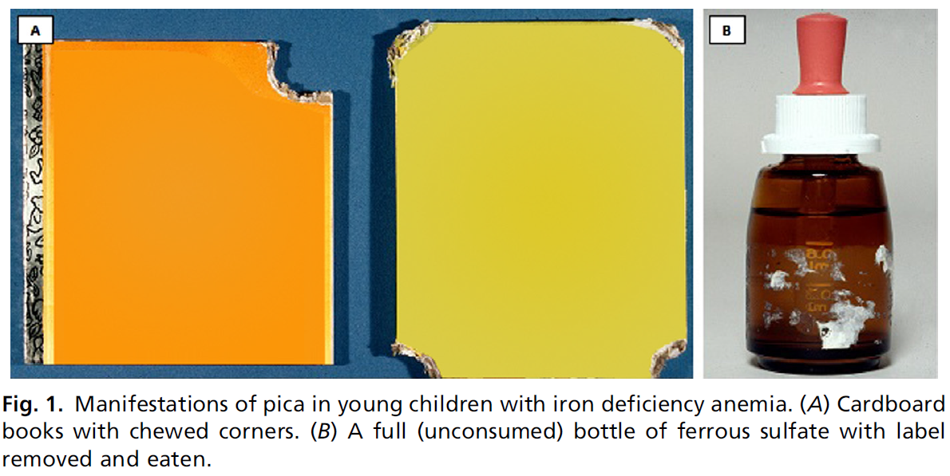
Pica: compulsive eating of non-food items
Pica seen in patients with:
Iron deficiency
Sickle cell disease
Neurodevelopmental d/o
Ice, dirt, drywall, cardboard, paper, wipes, erasers, cornstarch, soap, laundry detergent
Photos courtesy of George R. Buchanan
From Powers JM, Buchanan GR. Disorders of Iron Metabolism: New Diagnostic and Treatment Approaches to Iron Deficiency. Hematol Oncol Clin North Am. 2019 Jun;33(3):393-408. doi: 10.1016/j.hoc.2019.01.006. © 2019 Elsevier Inc. Used with permission. All rights reserved.
Notes:
Powers and Buchanan. Disorders of Iron. Pediatric Hematology/Oncology Clinics, 2020. Pg. 397

Slide 25
Laboratory values consistent with IDA
Iron Compartment | Conventional Test | Value suggestive of IDA
Storage | Serum ferritin | < 15 mg/L
Plasma | Serum iron (Fe) | < 40 mg/dL
 | Total iron binding capacity (TIBC) | > 400-425 mg/dL
 | Transferrin saturation (Fe/TIBC) | < 15%
 | Soluble transferrin receptor (sTfr) | > 35 nmol/L
RBC’s | Hemoglobin concentration (Hgb) | < 11 g/dL (increases with age)
 | Mean corpuscular volume (MCV) | < 70 fl (increases with age)
 | Red cell distribution width (RDW) | > 16%
 | Reticulocyte hemoglobin equivalent (Ret-He) or content (CHr) | < 26 pg (also low in thalassemia trait)
Other | Hepcidin (serum or urine) | Reduced
Ferritin is most important iron parameter
Anemia is the final stage of iron deficiency

Slide 26
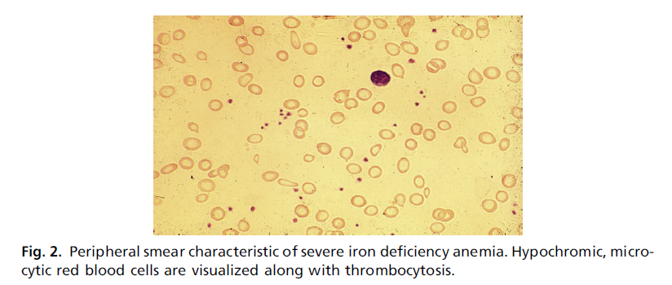
Iron deficiency anemia – Peripheral smear
Hallmarks of IDA
Hypochromia
Microcytosis
Thrombocytosis
From Powers JM, Buchanan GR. Disorders of Iron Metabolism: New Diagnostic and Treatment Approaches to Iron Deficiency. Hematol Oncol Clin North Am. 2019 Jun;33(3):393-408. doi: 10.1016/j.hoc.2019.01.006. © 2019 Elsevier Inc. Used with permission. All rights reserved.
Notes:
Powers and Buchanan. Disorders of Iron. Pediatric Hematology/Oncology Clinics, 2020. Pg. 397

Slide 27
Reasons for “persistent” IDA
Incorrect diagnosis
Persistence of etiology (low iron diet, ongoing blood loss)
Insufficient iron dose (dosing incorrect, duration too short)
Non-adherence
Malabsorption
  Rarely primary etiology
  Inflammation/underlying GI condition
  Very rare genetic condition (Iron Refractory Iron Deficiency Anemia)

Slide 28
Iron deficiency anemia – Correct etiology
Iron-rich diet
  Meat, liver, beans (black beans or lentils)
  Avoidance of tannins (tea), limitation of milk products
Minimize blood loss
  Hormonal therapy for menstrual blood loss
  Treatment of underlying GI disease

Slide 29
Iron deficiency anemia - Oral iron is standard of care
Iron therapy/supplementation
  Ferrous sulfate (iron salt)
  Once daily dosing; Specific dose variable – studies lacking
  Minimum 3 months of therapy
Standard time points for assessment
  Baseline (diagnosis, initiation of therapy)
  1 week (severe patients only, assess initial response - reticulocytosis)
  1 month (assess hemoglobin increment: CBC +/- retic, ideally anemia resolved)
  3 months (potentially assess if able to stop therapy: CBC/retic, ferritin)
  Anemia corrects prior to changes in iron parameters

Slide 30
Iron Refractory Iron Deficiency Anemia (IRIDA)
AR mutations in the TMPRSS6 gene, extremely rare
  Upregulation of hepcidin
Key clinical features
  Persistent moderate IDA, congenital onset
  Severe microcytosis (MCV 50-60 fL)
  Poor oral iron absorption → not responsive to oral iron tx
  “Fail” oral iron challenge
  Blunted response to IV iron (may be overcome by high doses)

Slide 31
Hepcidin regulates iron absorption
Fe⁺³
Fe⁺²
Mucosal Surface
Ferrireductase
Duodenal enterocyte
DMT1
ferritin sloughed
TMPRSS6 Mutations (IRIDA)
Ferritin
Ferroportin
iron sufficient, iron-load, inflammation
Basolateral Surface
From Powers JM and O’Brien SH. How I Approach Iron Deficiency and out Anemia. Pediatr Blood Cancer. 2018;e27544. © 2018 Wiley Periodicals, Inc. Used with permission.
HEPCIDIN
limits iron absorption

Slide 32
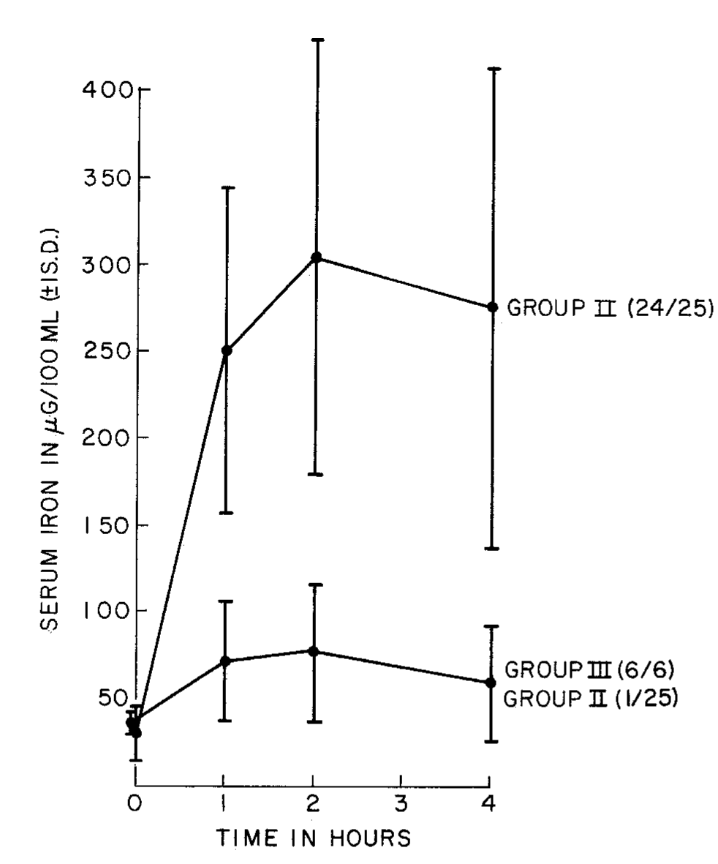
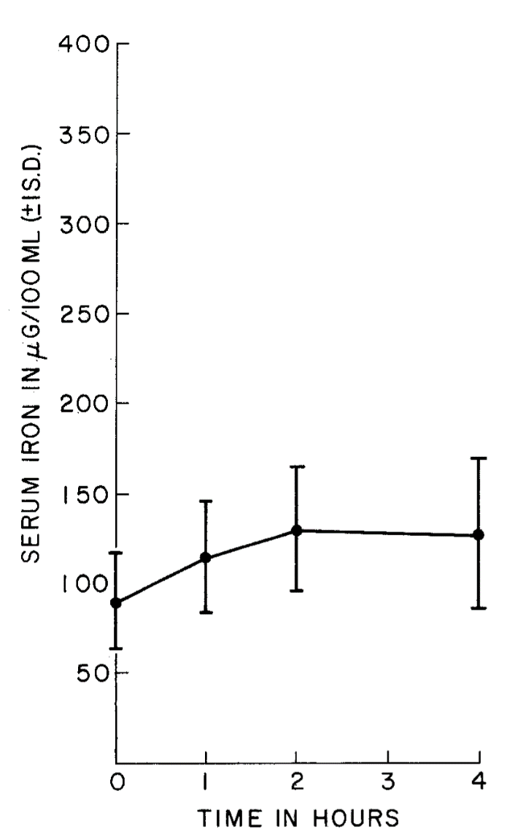
Oral Iron Challenge Test
Iron Deficient
Normal
Reprinted from Journal of Pediatrics, 88/5, Gross SJ et. al, Malabsorption of iron in children with iron deficiency, 795-9, 1976, with permission from Elsevier.
Notes:
Gross et al. J Pediatr 1976; 88:796-9
FIGURE 1 and FIGURE 2
Inability to absorb oral iron is believed to be an extremely rare cause of therapeutic failure in the
treatment of iron deficiency anemia. Six patients who had failed to respond to oral iron therapy were
studied by a simple oral absorption test and contrasted with 25 patients with untreated iron deficiency
anemia and JO normal subjects. All six of the patients who were therapeutic failures demonstrated
impaired iron absorption in the absence of other clinical evidence of gastrointestinal disease. In the 25
newly diagnosed patients with iron deficiency, 24 demonstrated elevated iron absorptions while 10 iron replete
normal subjects had minimal elevations in their serum iron values following the administration
of the test dose of 1 mg of elemental iron per kilogram. When the therapeutic failures were treated with
parenteral iron, all had a therapeutic response. In addition, after treatment the impaired absorption
of iron improved transiently. All children who absorbed iron readily responded to oral iron therapy.

Slide 33
Indications for intravenous iron therapy
Not considered SOC for majority of our patients
Approved for use in patients with:
  CKD
  “intolerance to oral iron” (often off-label)
  Concomitant IDA and anemia of inflammation
  Confirmed IRIDA
Dosing of intravenous iron by product-labeling or Ganzoni formula (calculation of iron deficit)

Slide 34
Intravenous iron preparations
Generic Name | Ferric gluconate | Iron sucrose | LMW Iron Dextran | Ferumoxytol | Ferric carboxymaltose | Ferric derisomaltose
FDA Indication | CKD on dialysis + ESAs | CKD | Oral iron administration is unsatisfactory or impossible | CKD | Intolerance or unsatisfactory response to oral iron; NDDCKD | Intolerance or unsatisfactory response to oral iron; NDDCKD
TDI (Y/N) | No | No | Yes (Europe) | Yes | Yes (Europe) | Yes
Maximum Dose | 125 mg | 200 – 300 mg | 100 mg (1000 mg off-label) | 510 mg | 750 mg (1000 mg Europe) | 1000 mg (20 mg/kg)
Infusion Time (min) | 60 minutes | 2-5 minutes (Typically 60) | 60 minutes | 15-60 minutes | 15 minutes | 20 minutes
Test Dose | No | No | Yes | No | No | No
Black Box | No | No | Yes | Yes | No | No
Distinguishing properties: Strength of carbohydrate shell that binds iron, immunogenic properties

Slide 35
Anemia of inflammation
(Iron-restricted erythropoiesis)

Slide 36
Anemia of inflammation
A form of iron-restricted erythropoiesis
Result of excessive hepcidin production
Iron is (typically) present in the body but not available for utilization
Limited absorption of oral iron from GI tract

Slide 37
Regulation of iron absorption by hepcidin
Fe⁺³
Fe⁺²
Mucosal Surface
Ferrireductase
DMT1
Ferritin Sloughed
Ferritin
Ferroportin
From Powers JM and O’Brien SH. How I Approach Iron Deficiency and out Anemia. Pediatr Blood Cancer. 2018;e27544. © 2018 Wiley Periodicals, Inc. Used with permission.
Basolateral Surface
Inflammation
HEPCIDIN
limits iron absorption

Slide 38
Hepcidin regulates iron export
During states of inflammation, hepcidin acts at ferroportin to prevent iron release into plasma
Immuno-protective mechanism to minimize iron availability to pathogens
Ferritin retained in macrophage
Ferroportin
HEPCIDIN
Transferrin transports ferritin to tissues
Created with ©BioRender - biorender.com
Andrews, NC. Nature Reviews Genetics. 2000.

Slide 39
Anemia of inflammation: Diagnosis & management
Laboratory diagnosis
Initial / early course → normocytic anemia
Prolonged inflammation / late course → microcytic anemia
Iron parameters distinct from IDA; Inflammatory markers elevated
Management
Treat underlying cause of inflammation
If severe/prolonged, assess for iron deficiency; treat with IV iron, if needed

Slide 40
Differential diagnosis for microcytic anemia
Diagnosis | Clinical history | Laboratory measurements | Distinguishing features
IDA | Low-iron diet Blood loss | Elevated RDW Low serum ferritin or TSAT | Improvement with oral iron Smear
Thalassemia trait | Not c/w IDA Ethnicity Family history | Normal iron panel +Hgb Barts on NBS (alpha) Elevated Hgb A2 on Hgb analysis (beta) | Minimal to no change with oral iron Smear
Anemia of inflammation or chronic disease | Recent acute and/or chronic illness Inflammation Tissue injury | MCV - normal or low Serum ferritin – normal or high Transferrin/TIBC may be low sTfR/log₁₀ferritin index low | Improves as inflammation decreases May benefit from IV iron

Slide 41
Differential diagnosis for normocytic anemia
Clinical history to assess for inflammation, hypothyroidism, renal disease
  Review history of recent or recurrent infections/inflammation
  Growth charts
  Other non-specific symptoms
Evaluation:
  CBC, retic, smear
  CRP
  BUN, creatinine
  TSH, Free T4
If anemia is mild and work-up is negative, presumptive diagnosis: statistical anemia (2.5% of population will fall below normal Hgb values).
+/- periodic follow-up (annual) with PCP or hematology to ensure stable.
No long-term heme follow-up needed.

Slide 42
Iron overload

Slide 43
Iron overload / Iron excess states
Increased intestinal iron absorption
  Hereditary hemochromatosis
  Ineffective erythropoiesis (e.g. thalassemia)
Chronic transfusions

Slide 44
Hemochromatosis → Increased iron absorption
Fe⁺³
Fe⁺²
Mucosal Surface
Ferrireductase
DMT1
Ferritin
HFE Mutation
Ferroportin
From Powers JM and O’Brien SH. How I Approach Iron Deficiency and out Anemia. Pediatr Blood Cancer. 2018;e27544. © 2018 Wiley Periodicals, Inc. Used with permission.
Basolateral Surface
X
Hepcidin
limits iron absorption
Increased iron absorption

Slide 45
Iron absorption in Hereditary Hemochromatosis
 | Normal* | Hemochromatosis
Daily iron loss | 1 mg | 1 mg
Daily dietary iron intake | 10 mg | 10 mg
Absorption (%) | 10% | 40%
Amount absorbed daily | 1 mg | 4 mg
Net daily iron gain | 0 mg | 3 mg
Net annual iron gain | 0 | 1,100 mg
Net iron gain over 20 yr | 0 | 22 gm (7 to 10-fold increase)
* Except during periods of rapid growth

Slide 46
Iron overload – Pathophysiology
Iron stores increase
Capacity of transferrin exceeded
The longer that NTBI is present, the more damage that occurs
Non-transferrin bound iron (NTBI) accumulates and is toxic
Iron accumulates in organs
Free radicals and
reactive oxygen species
Hepatic, Cardiac, Endocrine, and Joint damage
Peroxidation of membrane
lipids and cellular injury
Notes:
As iron stores increase, the capacity of transferrin will be exceeded, and unbound iron will accumulated.
This free iron accumulates in organs, forms free radicals and reactive oxygen species, which damage membrane lipids and cellular contents, leading to organ toxicity.

Slide 47
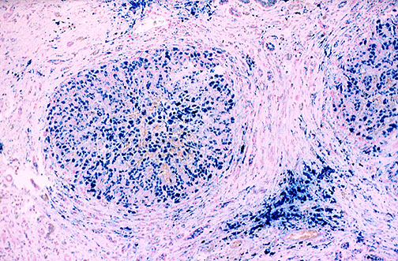
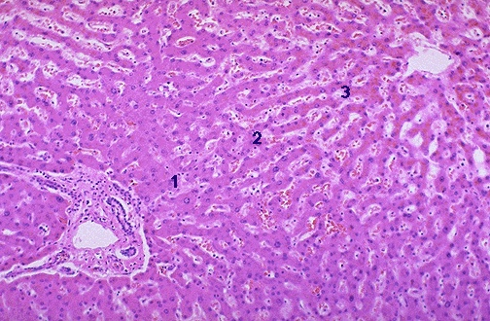
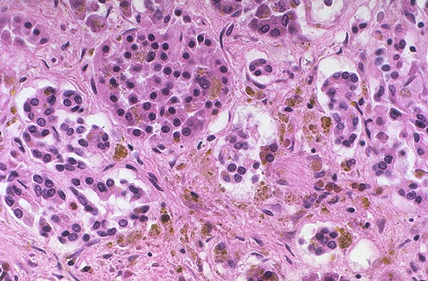
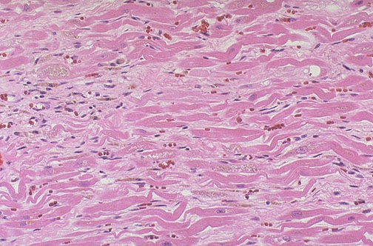
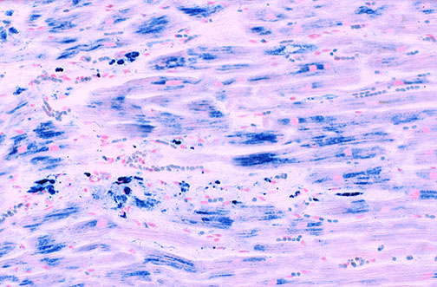
Clinical manifestations of iron overload
Liver | Cirrhosis, liver failure, hepatocellular carcinoma
Pancreas | Diabetes mellitus; Other endocrine effects (hypo-gonadism, hypothyroidism)
Heart | Heart failure, dysrhythmias, sudden death
Images courtesy of George Buchanan

Slide 48
Hereditary hemochromatosis
Other rare disorders (AR) resulting in absent hepcidin production
  Hemojuvelin (HJV) - juvenile
  HAMP (hepcidin gene) - juvenile
  Transferrin receptor 2 (TFR2) - adults
Ferroportin mutation (FPN1)
  Autosomal dominant
  Presents in adulthood
Neonatal hemochromatosis
Extremely rare

Slide 49
Hereditary hemochromatosis due to HFE mutation
HFE C282Y most common mutation
Autosomal recessive
Mutations in the HFE (hemochromatosis) gene
  High prevalence of genetic mutations
    Heterozygote: 1 in 8
    Homozygote: 1 in 250
  Low penetrance of clinical disease
    Uncommon in adults
    Very rare in children and adolescents
Notes:
Strong founder effect – Northern European Caucasians
Most commonly due to homozygosity of C282Y mutation
High prevalence 1 in 400 homozygous, 1 in 10 heterozygous
Low penetrance ~25% C282Y homozygotes develop disease
Rarely symptomatic in children but many queries about it because of affected relatives.
Testing: Molecular – HFE gene analysis; Biochemical – Transferrin saturation, serum ferritin
Management of C282Y/C282Y homozygote
Monitoring iron studies, low iron diet, abstain from alcohol.
Treatment – therapeutic phlebotomy

Slide 50
Hereditary hemochromatosis - Diagnosis
Ideally, determine HFE genotype of index case (affected relative)
  Test both of child’s parents to determine genotype
  Unless both parents have an HFE mutation the child’s risk is negligible and further studies are unnecessary
Both parents with mutation → determine genotype of child
If child homozygote (C282Y / C282Y):
  At risk of HH (but not definitive due to variable clinical presentation)
  Monitor iron markers every 1-2 years

Slide 51
Transfusion-related iron overload
Every time you give a transfusion, you give iron
  1 ml of pure RBCs contains ~0.5 to 1 mg of iron
  One unit of pRBCs per month will provide up to 3-4 g/yr
  After 1 year, expect ferritin ~ 1000 ng/mL
Most data from hematology patients
Variable iron loading depending on underlying disease
Notes:
Iron loading in patients on chronic transfusion varies by underlying disease
Patients with thalassemia, sickle cell disease and Diamond-Blackfan anemia receiving chronic transfusion therapy load iron at different rates
Multifactorial
Variability in erythropoeitic activity
Variability in iron parameters and hepcidin
Data sparse in oncology patients

Slide 52
Transfusion-related iron overload - Diagnosis
Comprehensive transfusion history ideal
Screening ferritin, if >1000 ng/mL → further evaluation:
Full iron panel (assess transferrin saturation)
MRI liver, typically in lieu of liver bx
  LIC (Liver Iron Content), Normal <1.8 mg Fe / g dry weight
Cardiac MRI (identifies patients at risk for decrease in LVEF)
  Assess if severe liver iron overload (LIC>15), evidence of pancreatic iron on MR Abd
  Consider in patients with cardiotoxicity (b/c potentially modifiable)

Slide 53
Iron overload: Management
Therapeutic phlebotomy
  Iron overload in the setting of HH
  Transfusion-related iron overload, no longer transfusion dependent
Chelation therapy
  Iron overload in the setting of ongoing transfusion therapy

Slide 54
Megaloblastic Anemia

Slide 55
Megaloblastic Anemia
Basic Science and Pathophysiology
Epidemiology and Risk Assessment
Diagnosis
Management and Treatment

Slide 56
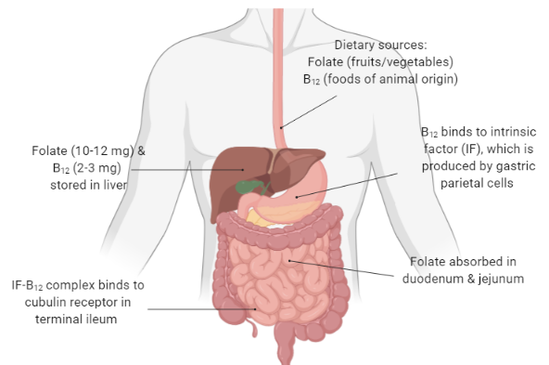
Vitamin B₁₂ and folate physiology
Created with ©BioRender - biorender.com

Slide 57
Anemia due to vitamin B₁₂ or folate deficiency
Both vitamins required for DNA synthesis
Deficiency → reduced DNA replication → megaloblastic anemia
Similar peripheral blood and marrow morphology
Impaired nuclear maturation but abundant cytoplasm
  Large marrow progenitors
  “Nuclear-cytoplasmic dysynchrony”
Notes:
Folate:
Facilitates biochemical reactions involving one carbon transfers
Facilitates purine biosynthesis
Vitamin B₁₂
Methionine synthesis
Formation of succinyl coenzyme A from methylmalonyl coenzyme A
Bottom line: Required for DNA synthesis and regulation

Slide 58
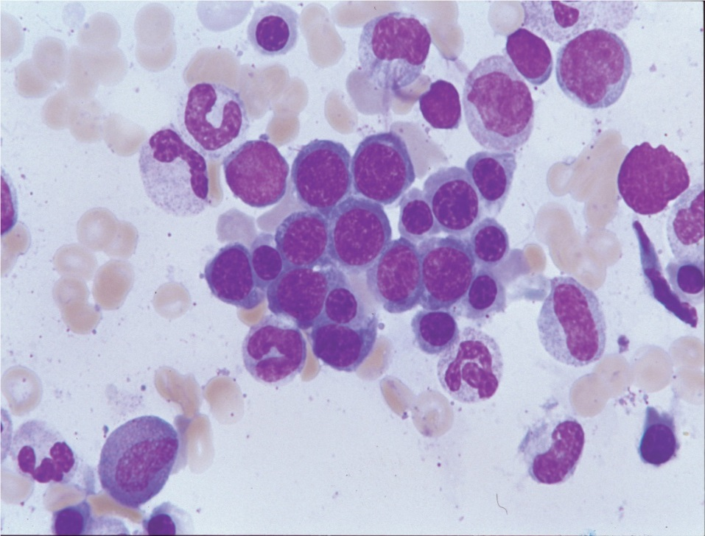
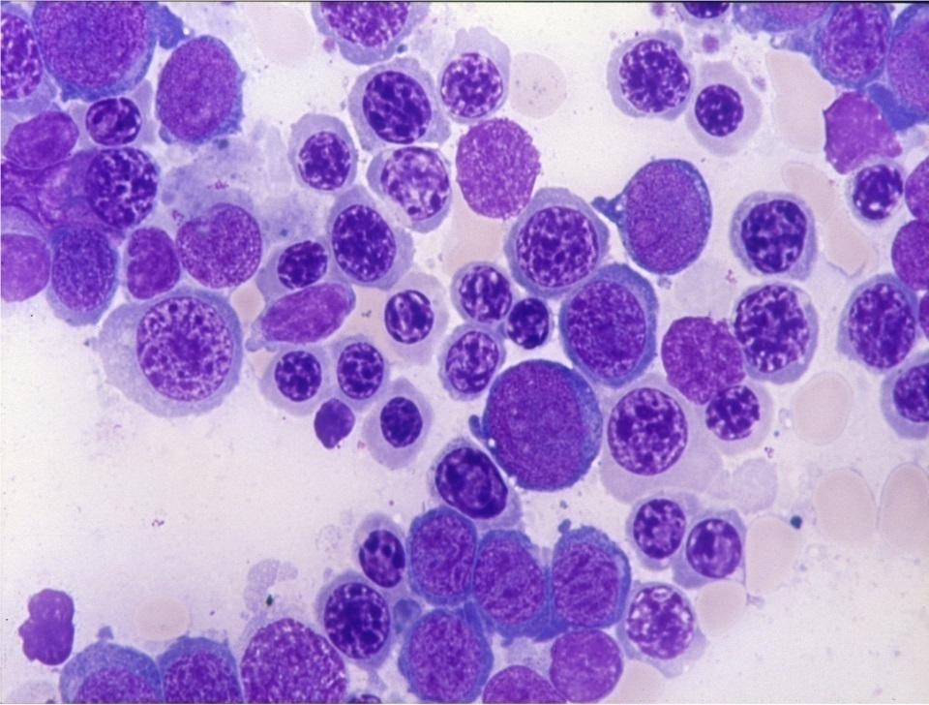
Megaloblastic bone marrow
Normoblastic
Megaloblastic
“Nuclear-cytoplasmic dysynchrony”
Image courtesy of Mark D. Fleming
Notes:
Images from 2019 ASPHO presentation – courtesty of Mark D. Fleming, MD, DPhil

Slide 59
Megaloblastic anemia – Ineffective erythropoiesis
Defective DNA synthesis
Megaloblastic maturation
Bone marrow lysis
→ ↑ LDH
↓
↑ Heme catabolism
→ ↑ Bilirubin (Icterus)
Image courtesy of Mark D. Fleming
Notes:
From 2019 ASPHO talk - Mark D. Fleming, MD, DPhil

Slide 60
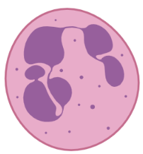
Megaloblastic anemia – Peripheral smear
Macrocytic is NOT the same as Megaloblastic
Smear: hypersegmented neutrophils, macrocytosis with marked variation in RBCs, occasionally pancytopenia
↓
Hemolysis/Reticulocytosis
Marrow Hypo/Aplasia
Liver Disease
Drugs/toxins
Generally MCV <105fL
↓
Folate deficiency
Vitamin B₁₂ deficiency
Inherited metabolic disease
Drugs /toxins
Generally MCV >110fL
Defective DNA Synthesis

Slide 61
Differential diagnosis - Macrocytosis
Normal newborn infant
Trisomy 21
Brisk reticulocytosis
Marrow failure
Medications (anti-epileptic drugs)
Hypothyroidism, liver disease
Megaloblastic anemia (B₁₂, folate deficiency)

Slide 62
Megaloblastic anemia – Clinical findings
Non-specific signs and symptoms of anemia
Jaundice due to ineffective erythropoiesis
Neurological findings (B₁₂ deficiency only)
  Due to degeneration of the posterior columns of the spinal cord
  Proprioceptive and fine motor deficits, ataxia, psychomotor retardation, seizures, depression, psychosis
  Folate supplementation may correct hematologic findings but will NOT treat neurologic findings in B₁₂ deficiency

Slide 63
Vitamin B12 & folate – Laboratory findings
Methylmalonyl mutase
B₁₂
↑ Methylmalonic acid
Methylmalonyl-CoA
X
Succinyl-CoA
Methylated product
Lipids, myelin, DNA, etc…
↑Homocysteine
Methylation
cycle
Methionine
X
X
X
Methyl
Tetrahydrofolate
(mTHF)
Methionine synthase
B₁₂
Tetrahydrofolate
Image courtesy of Mark D. Fleming
Notes:
Mark D. Fleming, MD, DPhil

Slide 64
Vitamin B₁₂ & folate deficiency: Laboratory findings
 | Folate deficiency | B12 deficiency
Serum folate | ↓ | Nml to ↑
RBC folate | ↓ | Nml to ↓
Serum B12 | Nml to ↓ | ↓
Methylmalonic acid (MMA) | Nml | ↑
Homocysteine | ↑ | ↑
64
Notes:
Laboratory Findings
Macrocytosis, relatively low reticulocyte count
Mild thrombocytopenia and/or neutropenia
Hypersegmentation of neutrophils
Megaloblastic changes in marrow

Slide 65
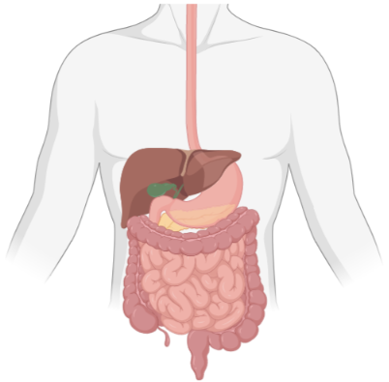
Vitamin B₁₂ & folate deficiency - Etiologies
Nutritional (1 mg)
• Strict vegetarians
• Breastfed infants of vegan mothers
Nutritional (100 mg)
• Malnutrition
• Increased demand
- hemolytic anemias
  “IF deficiency”
  • Gastrectomy
  • Autoimmune gastritis
  (Pernicious anemia)
  Competition
  • Fish tapeworm
  • Intestinal blind loop
Malabsorption
• Gluten-sensitive enteropathy
• Tropical sprue
• Jejunal resection
• Severe Crohn’s disease
• Intestinal failure (short gut syndrome)
• Sulfasalazine
  “Receptor deficiency”
  • Ileal resection
  • Crohn’s disease
  • Imerslund-Gräsbeck
  syndrome
Other
• Anti-folate drugs (methotrexate)
• Alcohol
Other
• Transcobalamin II deficiency
• Nitric oxide
Created with ©BioRender - biorender.com

Slide 66
Vitamin B₁₂ (cobalamin) deficiency
Humans completely dependent on dietary sources of B12
Extensive stores, so develops gradually over long period of time
Clinical history significant for:
  Poor diet (breastfed infant of vegan mother)
  Abnormal absorption (pernicious anemia)
Diagnosis:
  B12 level (variable, less reliable unless quite low)
  Send homocysteine and methylmalonic acid (MMA) – both HIGH
Treatment with IM/PO (critical for neurologic effects)
Notes:
Present in all meat and dairy products
Intrinsic factor (IF) required for absorption
IF produced by gastric parietal cells
IF-B₁₂ complex binds to cubulin receptors in terminal ileum and absorbed
Transported by transcobalamin (TC-I and TC-II) in plasma
Transcobalamin II (TC-II) required for entry into cells
Abundant B₁₂ stores in liver and other tissues (2-5 year supply)

Slide 67
Vitamin B₁₂ deficiency - Pernicious anemia
Adult
Juvenile
Acquired, rare during childhood
Reduced/absent production of intrinsic factor (IF) by parietal cells due to autoantibodies
A/W other autoimmune disorders (thyroid, diabetes, etc.)
Treatment: IM B₁₂
AR, rare
Mutation(s) in the gastric IF gene
  Low serum B12 level,
  Abnormal Schilling test, corrected by IF
Not A/W autoimmune disorders
Treatment: IM B₁₂
67
Notes:
Lab evaluation – Adult Pernicious anemia
Autoantibodies
Against intrinsic factor (IF) are specific but not sensitive
50% of patients with pernicious anemia
Rare in normal individuals
Against gastric parietal cells are sensitive but not specific
85% of patients with pernicious anemia
But also 3-10% of normal individuals
Schilling test (of historical interest)
Oral administration of radiolabeled B₁₂, with or without intrinsic factor; “chase” dose of IV B₁₂; measure B₁₂ absorption indirectly by urinary excretion
Distinguishes IF deficiency from malabsorption

Slide 68
Vitamin B₁₂ deficiency – Autosomal recessive forms
Imerslund-Gräsbeck Syndrome
Transcobalamin II Deficiency
AR, rare, early infancy
Mutations in cubilin or amnionless genes
Malabsorption of B₁₂ due to inability of IF/B₁₂ to bind in terminal ileum
Abnormal Schilling test, not corrected by IF
Associated proteinuria
  AR, early infancy
  Pancytopenia, diarrhea, FTT
  Normal plasma cobalamin and folate levels
  Marrow floridly megaloblastic
  Low or absent TC-II levels in serum

Slide 69
Folate deficiency
Rare, much less common than cobalamin (B12) deficiency
Clinical history significant for:
  Poor diet (infant/child drinking goat’s milk)
  Impaired absorption (Crohn disease, celiac)
Heme effects indistinguishable from B12 but no neuro effects
Diagnosis:
  Serum folate (less reliable unless very low or very high), RBC folate
  Check homocysteine (HIGH) and MMA (normal)
Treat with oral supplementation
Notes:
Dietary sources
Fresh fruits and leafy vegetables
Meat
Cow and human milk
Cereals and bread (fortified)
Chemical forms
Folic acid
Tetrahydrofolate monoglutamate (plasma) and polyglutamates (tissues)
Absorption in proximal jejunum
Daily requirement: 3 μg/kg
Decreased intake (rare due to supplementation of packaged foods)
Severe malnutrition
Sick premature infant
Unpasteurized goat milk
Intestinal malabsorption (celiac disease, inflammatory bowel disease, anticonvulsants)
Increased requirements
Pregnancy
Chronic hemolytic anemia (rare)
Hereditary folate malabsorption (autosomal recessive) or other inborn errors
Neural tube defects (spina bifida, anencephaly)
Dx/Management
Consistent history
Absence of neurologic manifestations of B₁₂ deficiency
Reduced serum folate (reflects current status)
Reduced red cell folate (reflects tissue levels)
Megaloblastic changes in CBC ± marrow
Complete response to therapy with physiologic doses of folate (200-400 μg/day)

Slide 70
Megaloblastic anemia – Additional causes
Thiamine (Vitamin B1) Responsive Megaloblastic Anemia (TRMA)
Hereditary orotic aciduria
Congenital dyserythropoietic anemia
Myelodysplasia, M6 AML

Slide 71
Megaloblastic anemia – Response to therapy
Reticulocytosis in 5-8 days
Recovery from anemia in 2-4 weeks
Normalization of MCV within 1-2 months
Neurologic recovery (B₁₂ deficiency ONLY)
  Within weeks, unless irreversible disease

Slide 72
Erythrocytosis

Slide 73
Erythrocytosis
Basic Science and Pathophysiology
Diagnosis
Management and Treatment

Slide 74
Erythrocytosis (polycythemia) = Increased RBC mass
Appropriate (in response to hypoxia)
  Chronic arterial hypoxemia (right to left shunt, high altitude)
  Hemoglobin mutation with high oxygen affinity
Inappropriate (no hypoxia)
  Elevated EPO – tumor or inherited disorder of oxygen sensing (Chuvash polycythemia, von Hippel-Lindau or HIF gene mutations)
  Low erythropoietin – MPD (JAK2 mutation) or Epo receptor mutation

Slide 75
Oxygen Sensing and RBC mass
Red cell mass
O₂ carrying capacity
Erythropoiesis
Renal O₂ sensing
Epo synthesis
Plasma Epo
Notes:
75

Slide 76
Hemoglobin oxygen binding
Allosteric cooperativity: oxygen affinity of Hgb is proportional to quantity of oxygen bound at a given time
As hemoglobin travels from the lungs to the tissues,
    ↓ pH (↑[H+])
    ↑ pCO₂
    Leading to Hb ↓ O2 affinity, therefore releasing oxygen into the tissues
Results in the sigmoidal shape of the oxygen-dissociation curve

Slide 77
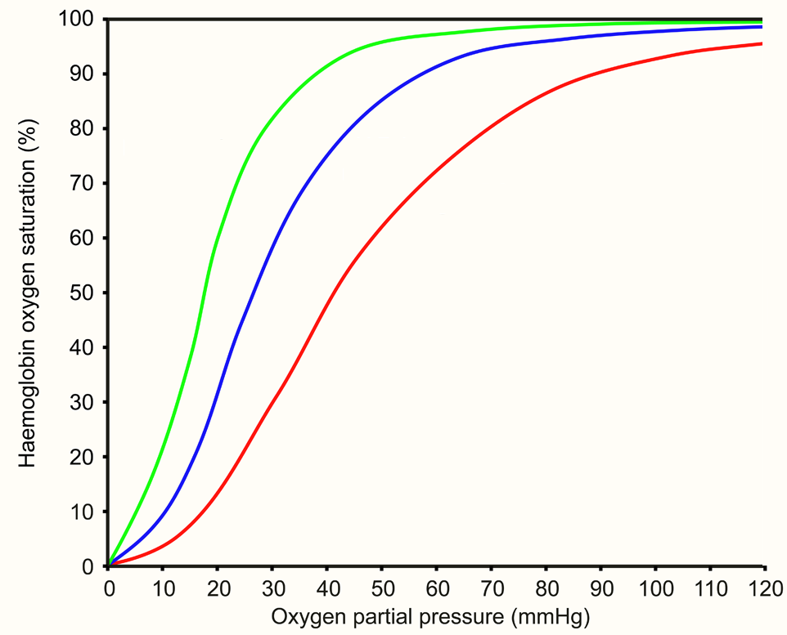
Oxyhemoglobin dissociation curve
 | Right shift ↓ O₂ affinity | Left shift ↑ O₂ affinity
Temperature | high | low
2,3-DPG | high | low
p(CO₂) | high | low
pH (Bohr effect) | low (acidosis) | high (alkalosis)
Hemoglobin | Hb A | Hb F
Left Shift
(↑ affinity)
↓ Temp
↓ 2,3-DPG
↓ pCO₂
↓[H⁺]
Right Shift
(↓ affinity)
↑ Temp
↑ 2,3-DPG
↑ pCO₂
↑[H⁺]
2,3-DPG: 2,3 di-phosphoglycerate is abundant in the erythrocyte.
2,3-DPG binds to and stabilizes the deoxy form of Hgb, results in ↓ O₂ affinity. This is an adaptive response, requiring several days (e.g. high altitude).
Notes:
https://commons.wikimedia.org/wiki/File:Oxygen-Haemoglobin_dissociation_curves.svg

Slide 78
Measure of oxygen affinity (P50)
Describes affinity of a given Hgb for oxygen
P50 is the PO2 at which Hgb is 50% saturated with O2
As P50 ↓, O2 affinity ↑
  Hgb A 26.5 mmHg
  Hgb F 20 mmHg
  Hgb S 34 mmHg
Adapted from https://commons.wikimedia.org/wiki/File:Oxygen-Haemoglobin_dissociation_curves.svg
Notes:
https://commons.wikimedia.org/wiki/File:Oxygen-Haemoglobin_dissociation_curves.svg

Slide 79
Neonatal erythrocytosis (Hct >65%)
Etiologies:
  Diabetic mother, IUGR, delayed cord clamping
  Maternal-fetal transfusion, twin-twin transfusion
  Trisomy 21
Laboratory features: Thrombocytopenia, jaundice, hypoglycemia
Clinical manifestations: Plethora, tachypnea, seizures
Therapy: Partial exchange (isovolemic) to ↓Hct < 55%

Slide 80
Approach to Erythrocytosis
Absent
Hypoxia
Present
Inappropriate
Appropriate, 2º
(EPO level elevated)
Critical aspects:
Hypoxia
Erythropoietin level
Congenital vs Acquired
EPO level
Congenital
Acquired
Low
(1º Erythrocytosis)
Elevated
(2º Erthrocytosis)
  High affinity Hb, or aberrant 2,3 DPG synthesis
  Methemoglobinemia
      R→L shunt, OSA, pulmonary disease
      CO poisoning / smoking (CarboxyHb)
      Renovascular disease
      Drugs (NO), Toxins
Congenital (Epo receptor mutation/truncation)
Acquired (Clonal / myeloproliferative disorders)
Congenital (Altered O2 sensing, HIF mutations)
Acquired
  Chuvash polycythemia (homozygous C958T in VHL)
  PHD2 erythrocytosis (AD)
  HIF2α erythrocytosis (AD, pulm HTN)
  Hydronephrosis / Renal Cysts
  Epo-secreting Tumor (e.g. renal, adrenal, hepaticposterior fossa)
  Performance-enhancing drugs (exogenous Epo, anabolic steroids)

Slide 81
Erythrocytosis (polycythemia) - Evaluation
History (including family history) and physical examination
Careful examination of CBC
Measurement of oxygen saturation
Serum erythropoietin level
O₂-hemoglobin dissociation curve (p50)
Imaging studies (renal, posterior fossa)

Slide 82
Erythrocytosis (polycythemia) - Management
Largely dependent on underlying etiology / primary disorder
Therapeutic phlebotomy indicated for non-specific signs and symptoms of hyperviscosity
  Plethora, fatigue
Thrombosis risk
82

Slide 83
Thank you for your attention - Best of luck!
Jacquelyn M. Powers, MD, MS
Assistant Professor of Pediatrics
Team Lead, General Hematology
Director, Iron Disorders & Nutritional Anemias Program
Director, Young Women’s Bleeding Disorders Program
832-824-7330
jmpowers@txch.org
83

