Slide 1
Clinical Pharmacology and Targeted Therapies
Elizabeth Fox, MD
St Jude Children’s Research Hospital

Slide 2
Disclosures
none

Slide 3
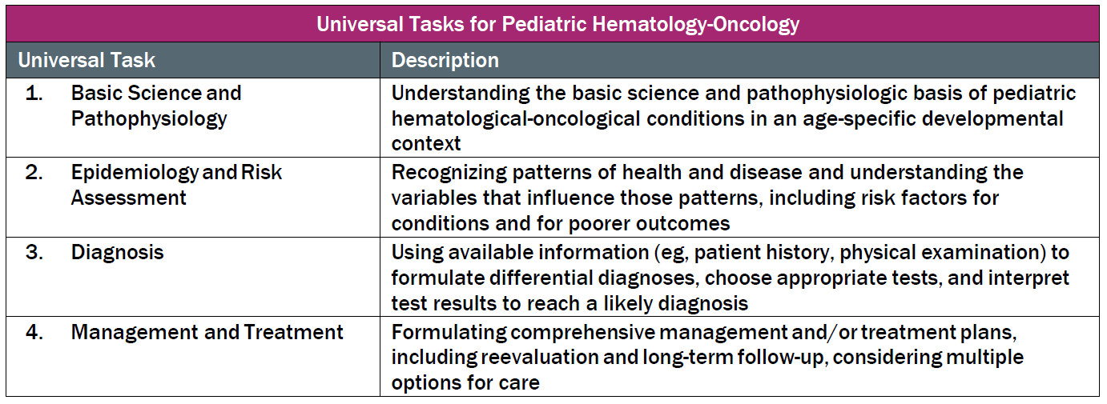
This talk will follow the topical structure suggested by the ABP:

Slide 4
Principles of Treatment of Pediatric Oncology
Basic Science and Pathophysiology: Principles of Multimodality Therapy
Epidemiology and Risk Assessment: Basic Pharmacology
Diagnosis: Mechanism of Action of Drug Classes
Management and Treatment: Toxicity and Amelioration

Slide 5
Outline
General Principles of Multimodality Therapy for Childhood Cancer
  Local Control: Emphasis on Principles of Radiation Therapy
  Systemic Therapy: Emphasis on Principles of Chemotherapy
Basic Pharmacology for Pediatric Oncologists
  Define Basic Pharmacology Terms
  Central Nervous System Pharmacology
3. Cytotoxic Chemotherapy
  Alkylating Agents
  Antimetabolites
  Topoisomerase Inhibitors
  Tubulin Binding Agents
  Miscellaneous

Slide 6
Multimodality Therapy for Cancer in Children
Dramatic improvement in outcome and cures for some cancers in children have been achieved by:
  Multimodality Therapy
    Systemic Therapies (cytotoxic and targeted chemotherapy, stem cell transplant, cellular therapy)
    Local Control (radiation , surgery)
  Improved Diagnostic Techniques and Supportive Care (growth factors)
  Improved understanding of the genomics and oncogenic pathways relevant to cancer
Risk-stratified, multimodality therapy is based on patient age and gender, site of disease, extent of disease, histology, molecular characteristics of the cancer cells, and response to therapy.
Although curative in 80% of children, the life altering late effects of these therapeutic approach are substantial.

Slide 7
Principles of Radiation Oncology
Production and targeted delivery of ionizing radiation to a patient to cause a biologic effect.
Dependent on the principles and accuracy of radiation physics.
Goal to deliver prescribed dose to target volume of tumor while sparing normal tissue

Slide 8
Radiation: Mechanism of Therapeutic Action
Radiation interacts with intracellular components
Direct vs Indirect Effects
  Direct effects on DNA (25-75% of cell kill)
  Indirect effects by ionizing water creating free hydroxyl radicals that damage
Lethal vs Sub-lethal Damage
  Lethal damage from accumulation of double strand breaks (DSB) in DNA
  Sub-lethal damage from limited DSB, single stand breaks, cross-links, or base damage

Slide 9
Factors Affecting Radiation Sensitivity
1. Cellular:
Cell Type
Growth and replicative activity
Cell cycle phase at the time of exposure
Genetic mutations in oncogenes and tumor suppressor genes
2. Microenvironment
Vascularity
Oxygenation
Necrosis
3. Underlying Radiation hypersensitivity
Ataxia Telangiectasia
Nijmegen breakage syndrome
Concomitant Medications (Radiation Sensitizers):
Doxorubicin, dactinomycin, gemcitabine

Slide 10
Time: Dose Relationship
Total dose measured in Gray (SI unit= Gy)
  Amount of radiation depositing 1 joule of energy in 1 kilogram.
  1 Gy= 100 rad
  1 rad= 0.01 Gy or 1 centiGray (cGy)
Total time determined by number of fractions to deliver dose
  Typical total dose is 10.8-65 Gy delivered in 1.5- 2 Gy fractions
  Fractionation balances tumor lethality and normal tissue injury
    Exploits cell cycle of cancer cell
    Normal cell capable of cellular repair in 24 hours compared to cancer cells

Slide 11
External Beam Radiotherapy
Electromagnetic radiation
  Photon Therapy: High energy X-Ray generated from linear accelerator, high energy beam can maximize internal tissue dose while limiting skin dose (skin sparing)
  Gamma Rays: Emitted from radioactive cobalt-60 (CNS, vascular malformations)
High Energy Particulate Radiation:
  Electron Therapy: Absorbed superficially, increased absorption in bone (scalp lesions)
  Proton Therapy: Plateau dose distribution- deposit 90-100% of dose at the point they stop in tissue (Bragg peak); avoids exit dose.
  Neutron Therapy: Unfavorable depth-dose characteristics
  Heavy Charged Iron or Carbon-12 Therapy: Similar to protons

Slide 12
IMRT: Intensity Modulated Radiation Therapy | PBRT: Proton Beam Radiation Therapy | SBRT: Stereotactic Body Radiation Therapy | Stereotactic Radiation Therapy | TBI: Total Body Irradiation
Photons or Protons | Proton | Usually Photons | Gamma | Photon
7-9 beams altered in time and space to avoid normal tissue 3D dose distributions Requires complex planning, dose calculations | Spares normal tissue because no exit dose Bragg peak is point where 90-100% dose is delivered to tissue Spread of Bragg Peak (SOBP): multiple Bragg peaks at different depths | May deliver delivery single high dose radiation treatment or a few fractionated radiation treatments Specialized equipment positions the patient | Specialize equipment to position the patient to deliver RT precisely to tumor Cyberknife Gamma Knife | 12-15Gy in 8-12 fractions Eliminate residual cancer cells Make space in bone marrow compartment Immune suppression
Suitable for high dose radiation | Brain tumors and other solid tumors | Body | Brain Tumors Vascular malformations | Transplant conditioning regimen
Late effects depend on site and dose | Potential fewer late effects | Potential fewer late effects | More precision | Significant late effects, growth, endocrine

Slide 13
Tumor Volume Definitions for Radiation Therapy
Gross Tumor Volume (GTV)
  Volume occupied by tumor at diagnosis
  Same for photons, protons and brachytherapy
Clinical Target Volume (CTV)
  Includes GTV and sites of suspected occult disease and involved adjacent lymph nodes
  Same for photons, protons and brachytherapy
Planning Target Volume (PTV)
  Includes CTV including surrounding geometric area accounting for variability in set up, breathing and motion during treatment
  PTV is not the same as photons for protons
  PTV is same as CTV for brachytherapy

Slide 14
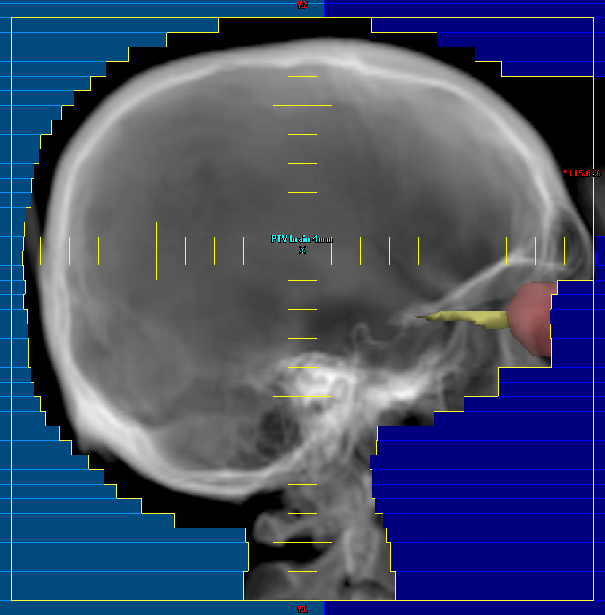
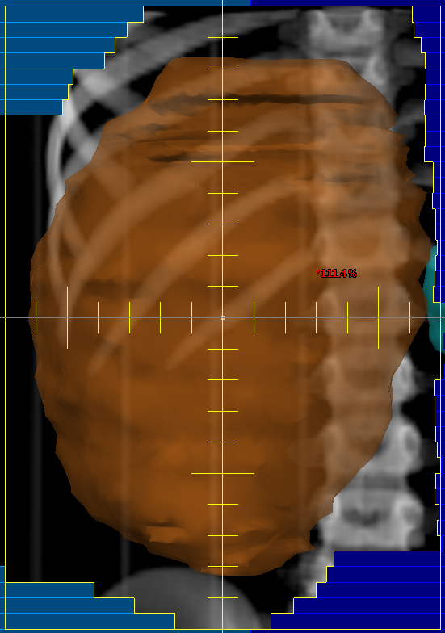
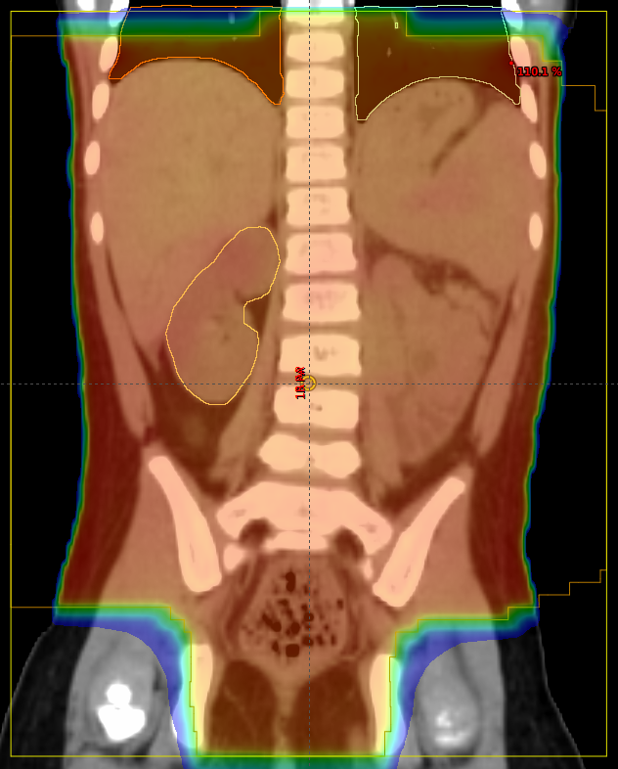
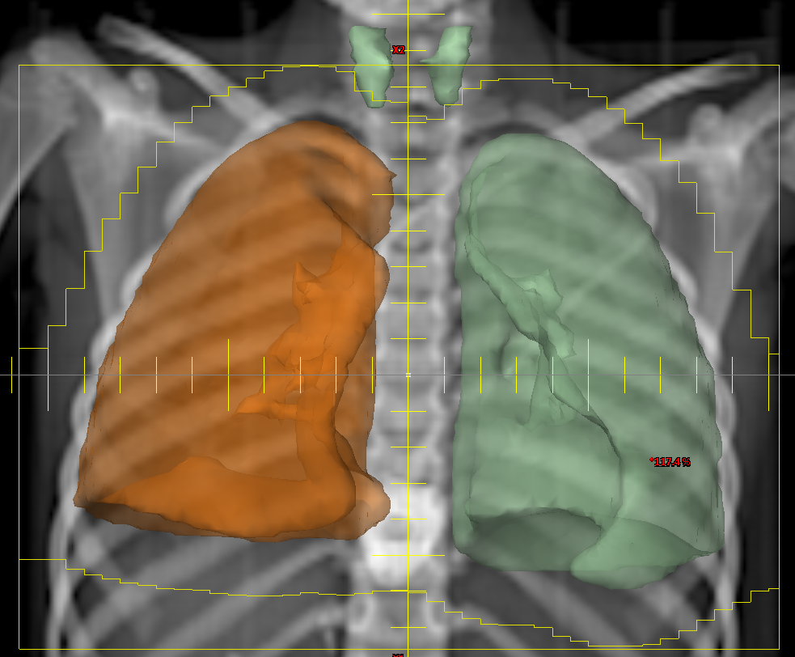
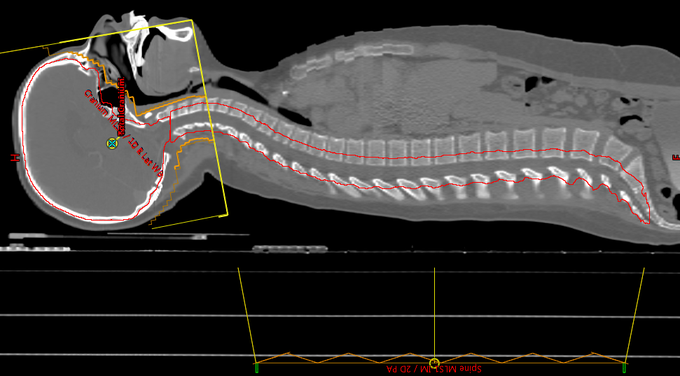
1
2
3
4
5
Cranial irradiation for ALL includes posterior half of eye and C2
Flank irradiation for Wilms Tumor includes whole vertebral body
Irradiation for tumor spillage and peritoneal metastases includes
pelvis
4. Whole lung irradiation may not be able to avoid thyroid gland
Spinal irradiation includes thecal sac and extends to S3
Images courtesy Dr. Kenneth Wong, CHLA/USC

Slide 15
Other Types of Radiation
Internal Brachytherapy – source of radiation is implanted in the body
  Short energy emission range such as iodine-125, cesium-131
Systemic Delivery (IV) Radiotherapy (Radiopharmaceuticals)
  Radio-Iodine (RAI, ¹³¹Iodine) Gamma and Beta particles, Thyroid cancer
  ¹³¹I-Meta-iodobenylguanidine (¹³¹I-MIBG): delivers beta particles via neuroendocrine transporter to Neuroblastoma or Pheochormocytoma
  ¹⁷⁷Lu- DOTO-TATE: Beta emitting, somatostatin receptor positive GI neuroendocrine tumors (Peptide Receptor Radiouclotide Therapy, PRRT)
  ¹⁵³Samarium-DOTMP Beta emitting linked to phosphonic acid chelator to target osteoblastic bone metastasis (growth plate toxicity)

Slide 16
Organ Risk: COG Radiation Oncology Recommendations
Organ | Volume | Dose (Gy)
Bladder | 100% | 45
Esophagus | 50% | 40
Heart | 100% | 30
Liver | 100%/50% | 23.4/30
Optic chiasm/Optic Nerve | 100% | 54
Rectum | 100% | 45
Small Bowel | 75% | 45
Spinal Cord | Any volume | 50.4
Kidney | 100%/50% | 14.4/24
Lung | 100%/<36% | 15/20
Eye | 100% | 45
Lens | 100% | 6
Cochlea | 100% | 40

Slide 17
Central Nervous System: Threshold Radiation Dose
Condition | Dose (Gy)
Brain necrosis | 60
IQ deficits | 12-18
Growth hormone deficiency | 18-25
Precocious puberty | 20
TRH/TSH deficiency | 40
LH/FSH deficiency | 40
ACTH deficiency | 40
Hyperprolactinemia | 40

Slide 18
Principles of Clinical Pharmacology
Process | Factors Influencing | Parameter/Units | Definition
Absorption- getting the drug into the body if taken orally | Adherence, gastric acidity and emptying, small intestine surface area, transporters, food interactions | Bioavailability (F) [%] | Rate and extent of absorption (F = fraction of the dose that is absorbed)
Distribution- delivery of drug to site of action | Chemical properties of the drug, blood flow to the tissue, plasma protein binding | Volume of Distribution* (V_{d}) [L] or [L/kg] | Volume of fluid into which the dose of drug would have to be diluted to yield the measured plasma concentration
Metabolism- 1.Activate/inactivate 2.make water soluble | Phase 1:non-synthetic alterations (CYP) Phase 2: conjugation (glucuronidation) | Clearance* (CL) [ml/min] | The volume of plasma from which drug is removed in a specified period of time
Excretion- removal from the body | Renal, biliary

Slide 19
Variability in Drug Metabolism
Cytochrome P450 is super family of drug metabolizing enzymes
  phase 1 reactions ie oxidation and demethylation that can activate or deactivate drugs
  Responsible for 70- 80 % of all phase 1 drug metabolism
    CYP3A responsible for 50% of phase 1 drug metabolism
      Loss of function mutation inn CYP3A4 are rare
      Drug interactions based on inhibition of CYP3A4 include fluconazole and vincrisitine
Phase 2 drug metabolizing enzymes have clinically significant polymorphisms
  Thiopurine Methyl Transferase (TPMT)- catabolism of mercaptopurine
    1/300 people is deficient in TPMT activity and have increased toxicity (Neutropenia) from mercaptopurine
    NUDIT-15 polymorphisms are also associated with thiopurine intolerance
  UDP-glucuronosyl-transferase 1A1 (Gilberts Disease) and Irinotecan metabolism
    Polymorphism in promoter of UGT1A1 are associated with increased neutropenia in adults receiving bolus doses of irinotecan (effect on diarrhea in protracted dosing in children is unclear)

Slide 20
Pharmacokinetic Parameters
Area Under Concentration Time Curve (AUC) | Measures Exposure (linear trapezoidal method = sum of the average concentration at 2 time points on the concentration time curve / difference of the corresponding time points)
Average concentration (C_{ave}) | AUC / dosing interval
Bioavailability (F) | AUC_{oral} / AUC_{IV}
Clearance (CL) | Dose / AUC
Half-life (T_{1/2}) | Time it takes for plasma drug concentration to decrease by 50%
Volume of distribution (V_{d}) | Dose / C_{time 0}

Slide 21
Blood Brain Barrier and CNS Pharmacology
Tissue capillary endothelium
Brain capillary endothelium
Strategies to Circumvent the Blood Brain Barrier
High-dose chemotherapy
  Methotrexate, cytarabine
Identifying drugs which penetrate the BBB based on lipophilicity, molecular weight, degree of ionization, plasma concentration of free drug (protein binding)
nitrosoureas, thiotepa, topotecan
Disruption of the blood-brain barrier
  Osmotic, radiation, vasoactive compounds,
Regional Chemotherapy
  Intra-carotid chemotherapy (cisplatin, methotrexate)
  Intrathecal injection (methotrexate, cytarabine)
  Intra-tumoral (carmustine)
  Convection Enhanced Delivery
Intercellular cleft passage
Mitochondria
Transporter
Efflux pump
(e.g., P-gp)
Fenestration
Tight junction
Pinocytosis
Lumen
Tissue
Brain

Slide 22
CNS Volume and Intrathecal Chemotherapy
CNS is a fixed volume that reaches 80% of adult volume by age 3 years,
  Intrathecal (IT) chemotherapy dose is based on age
  IT MTX dosing based on BSA, children < 18 months had higher rate of isolated CNS relapse Bleyer et al Cancer Treatment Reports, 1977 61: 1419-25; Bleyer et al , 1983, JCO 1:317-25.
Cerebrospinal Fluid
  Volume is 135 -150 mL
  Produced in choroid plexus and ependyma of ventricles at rate of 0.35-0.4 mL/min
  Flow via pulsatile motion synchronized with cardiac systole
Age (years) | Methotrexate (mg) | Cytarabine (mg)
< 1 | 6 | 15
1 | 8 | 30
2 | 10 | 50
≥ 3 | 12 | 70

Slide 23
Cytotoxic vs Targeted Chemotherapy
Chemotherapy: drugs that are administered to treat cancer
Cytotoxic Therapy refers to ability to directly kill cancer cells through non-specific mechanisms of action such as induction of DNA damage and apoptosis that result in cell death
  Non-selective: both cancer and rapidly dividing normal cells are affected
  Usually myelosuppressive (except for vincristine)
  Ability to target cytotoxic drugs to cell surface antigens : Antibody Drug Conjugates
Molecularly Targeted Therapy refers to drugs that interfere with pathways critical to oncogenic phenotype of cancer cells
  Greater selectivity for cancer cells alters side effect profile (class effect toxicities)
  Non- myelosuppressive or minimally myelosuppressive

Slide 24
Principles of Chemotherapy
Goal of curative therapy is to eradicate malignant cells and precursors
Goldie-Coldman Hypothesis
  Cancer cells mutate and become resistance to therapy at a rate that depends on the cancer’s inherent genetic instability
  Probability that a cancer contains a resistant clone is dependent on the mutation rate and size of the tumor
  Even when tumor burden is low there is likely to be at least one drug resistant clone
Three Basic Principles of Chemotherapy for Cancer in Children
  Combination Therapy
  Adjuvant Chemotherapy
  Dose Intensity

Slide 25
Principle 1: Combination Chemotherapy Regimens
Concurrent administration of multiple anticancer drugs with non-overlapping mechanism of action and non-overlapping toxicity profiles
  Overcome resistance to individual drugs in newly diagnosed cancer and prevent development of resistance during therapy (Goldie Coldman Hypothesis)
  Acute Lymphoblastic Leukemia: transient response rates of 60% with single agents (MTX, MP, Prednisone, VCR, Dauno, or L-ASP); 3-4 drug combination induction regimens produce durable response rate of 95%
Selection of Combination Agents
  Activity in advanced disease (phase II)
  Non-cross-resistant
  Additive or synergistic mechanism of action
  Non-overlapping toxicity spectra

Slide 26
Principle 2: Adjuvant Therapy
Adjuvant Setting: Administration of chemotherapy when disease burden is minimal but risk of recurrence is high (Goldie-Coldman Hypothesis)
  Continuation of system therapy after local control in localized cancer
    Osteosarcoma: Improved 3 y EFS when chemotherapy administered after complete resection of localized tumor (20% surgery alone vs 65% surgery + chemotherapy) Eilber et al J Clin Oncol 1987;5:21-6
  Maintenance Therapy
    ALL: Methotrexate, 6-Mercopatopurine
    RMS: vinorelbine + cyclophosphamide. (Bisogno G et al , Lancet Oncology 2019, 20:1566-75)
Neoadjuvant Setting: Administration of systemic chemotherapy prior to definitive local control
  Reduce tumor burden at the primary site prior to definitive local therapy (surgery/radiation)
  Control disease not amenable to local therapy (metastases)
  Assess the sensitivity of the tumor to chemotherapy by measuring tumor response

Slide 27
Principle 3: Dose Intensity
Maximize the Dose Rate of chemotherapy
Highest possible dose at the shortest tolerable interval
Calculated by normalizing the dose rate (mg/m²/week) for a drug and comparing to the dose rate of a reference drug or prior regimen.
Examples:
  Interval Compression improved EFS in localized EWS (Womer et al JCO 2012: 30:4148-54)
  Dose intensity of 4 drug induction in NBL correlates with response and survival (Cheung et al JCO 1991, 9:1050-1058).
  Children with ALL have improved survival with standard dose vs half dose MTX and MP in maintenance. (Pinkle et.al Cancer 1971, 27:247-256.)

Slide 28

Mechanism of Action
Classification
Alkylating Agents
Classical
Non-classical
Antimetabolites
Folate
Purine
Pyrimidine
Topoisomerase Inhibitors
Anthracyclines
Epipodophyllotoxins
Camptothecins
Other: Dactinomycin
Tubulin Inhibitors
Vinca Alkaloids
Taxanes
Miscellaneous
Corticosteroids
Asparaginase
Bleomycin
Etoposide
Teniposide
Topotecan
Irinotecan
Actinomycin-D
Doxorubicin
Daunomycin
Idarubicin
Mitoxantrone
Ara-C
Intercalators
Doxorubicin
Daunomycin
Idarubicin
Bleomycin
CMP
dCMP
Topo Inhibitors
Free Radical Damage
DNA
5-FU
dTMP
FH₂
Nelarabine
Cladrabine
Alkylator
Mechlorethamine
Cyclophosphamide
Ifosfamide
Melphalan
Carboplatin
Cisplatin
Oxaliplatin
Nitrosureas
Busulfan
Dacarbazine
Procarbazine
Temozolomide
dUMP
MP, TG
FH₄
Purines
MTX
RNA
De novo Synthesis
Salvage Pathway
Protein
Asparaginase
Tubulin
Vincristine
Vinblastine
Paclitaxel
Courtesy of Peter Adamson, MD- modified

Slide 29
Overview of Side Effects of Cytotoxic Chemotherapy
Common Toxicities | Unique Toxicities
Myelosuppression Nausea and vomiting Alopecia Oro-intestinal mucositis Hepatotoxicity Allergic reactions Cutaneous reactions Local tissue damage | Cardiotoxicity (anthracyclines) Hemorrhagic cystitis (cyclophos, ifos) Peripheral neuropathy (alkaloids, cisplatin) Coagulopathy (asparaginase) Ototoxicity (cisplatin) Nephrotoxicity (methotrexate, cisplatin) Leucoencephalopathy (methotrexate)

Slide 30
Attenuating Toxicity
Toxicity | Rescue
Myelosuppression | Cytokines (G-CSF) Marrow, stem cell re-infusion Individualized dosing
Nausea & vomiting | Antiemetics
Hemorrhagic cystitis (cyclophosphamide, ifosfamide) | Mesna
Nephrotoxicity (cisplatin) | Hypertonic saline (chloruresis)
Cardiotoxicity (anthracyclines) | Dexrazoxane
Myelosuppression/mucositis (methotrexate) | Leucovorin, carboxypeptidase

Slide 31
Vesicants and Irritants
Vesicant Potential
High | Low | Irritant
Daunomycin | Cisplatin | Bleomycin
Doxorubicin | Dacarbazine | Carboplatin
Idarubicin | Docetaxel | Cyclophosphamide
Dactinomycin | Etoposide | Carmustine
Meclorethamine | Mitoxantrone | Gemcitabine
Mitomycin C | Oxaliplatin | Ifosfamide
Vinblastine | Paclitaxel | Irinotecan
Vincristine |  | Melphalan
Vinorelbine |  | Topotecan

Slide 32
Alkylating Agents: Mechanism of Action
Damage to the DNA template (alkyl adducts) induces apoptosis
For bifunctional alkylators (nitrogen mustards), damage results from the formation of crosslinks (inter-strand, intra-strand, DNA-protein)
Mutations (G-C to A-T) with methylation (temozolomide, dacarbazine)
Effects are schedule-independent = cell cycle independent (effect related to AUC)
Steep (log-linear) dose-response curves, narrow therapeutic index
In Vitro Cytotoxicity
Vincristine
cell cycle dependent
Fraction of Cells Surviving
Melphalan
cell cycle
independent
Drug Conc. (multiple of IC₉₀)

Slide 33
Alkylating Agents
Type | Chemical Class | Drugs
Classical Alkylating Agents | Nitrogen mustards | mechlorethamine, bendamustine, melphalan
 | Oxazaphosphorines | Ifosfamide, cyclophosphamide
 | Ethylenimines | thiotepa
 | Nitrosoureas | carmustine, lomustine
 | Alkyl sulfonates | busulfan
Non-Classical Alkylating Agents | Triazenes | dacarbazine, temozolomide
 | Platinums | cisplatin, carboplatin, oxaliplatin

Slide 34
Some Alkylating Agents are Prodrugs
Drug | Active Metabolite | Pathway
Cyclophosphamide | 4-OH-CP | CYP2B6, 3A4, 2C9
Ifosfamide | 4-OH-Ifos | CYP3A4, 2A6
Dacarbazine | MTIC | CYP1A2
Temozolomide | MTIC | Spontaneous
*
Notes:
Oxazaphosphorines are hydroxylated at the 4-position on the ring.
Dacarbazine is N-demethylated

Slide 35
Alkylating Agents: Toxicity
 | Myelo-suppression | N&V | Alopecia | Hyper-sensitivity | GI/Mucositis | Renal | Cystitis | Hepatic | Cardiac | Pulmonary | Neuropathy | CNS
Cyclophosphamide | DLT | • | • |  |  | • | • |  | HD
Ifosfamide | DLT | • | • |  |  | • | • |  | HD |  |  | •
Melphalan | DLT | • | • |  | HD |  |  |  |  | •
Carmustine (BCNU) | DLT | • | • |  |  | • |  | HD | HD | • |  | HD
Lomustine (CCNU) | DLT | • | • |  |  | • |  | HD |  | • |  | HD
Thiotepa | DLT | • | • |  | HD |  |  | HD |  |  |  | HD
Busulfan | • | HD | • |  | HD |  |  | HD |  | • |  | HD
Dacarbazine | mild | DLT |  |  |  |  |  | •
Temozolomide | DLT | • |  |  |  |  |  | mild
Cisplatin | mild | • | • | • |  | • |  |  |  |  | •
Carboplatin | DLT | • | • | • |  | HD |  | mild |  |  | HD
DLT=dose limiting toxicity; HD= high dose/transplant conditioning

Slide 36
Platinum Analog Toxicity
Toxicity | Cisplatin | Carboplatin | Oxaliplatin
Peripheral neuropathy | DLT | +/- | DLT (Pharyngo-laryngeal dysesthesia; Raynaud Symptoms)
Nausea & vomiting | +++ | + | +++
Nephrotoxicity | +++ | +/- | +/-
Ototoxicity | +++ | - | -
Myelosuppression | +/- | DLT (platelets) | ++
Hepatotoxicity | +/- | +/- | ++
Hypersensitivity | + | ++ | +
DLT = dose limiting toxicity

Slide 37
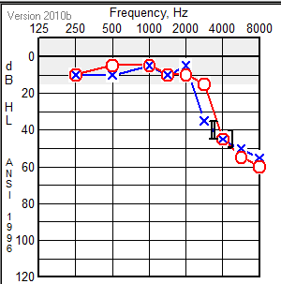
Cisplatin Ototoxicity
Audiogram Demonstrates Cisplatin Related Bilateral High Frequency (Hz > 4000) hearing loss (dB)
Sodium Thiosulfate may ameliorate ototoxicity in some treatment regimens and patient groups. (Freyer et al Lancet Oncology 2017, 18:63-74)
Notes:
Sensorineural hearing loss from damage to cochlear hair cells
Dose and schedule dependent
Cumulative and irreversible
Effects high frequencies (4 to 8 kHz) first
Cochlear hair cells express OCT2

Slide 38
Oxazaphosphorine Toxicity
Cyclophophamide Nephrotoxicity | Water retention, hyponatremia from a direct reversible tubular effect (not ADH mediated)
Ifosfamide* Nephrotoxicity Young age, high cumulative dose (70-80 g/m²) are risk factors | Proximal tubular damage (Fanconi-like) with glucosuria, phosphaturia, amino aciduria, Ricketts in younger children
 | Decreased GFR
 | Distal tubular damage with RTA, concentrating defects
Cyclophosphamide and Ifosfamide | Hemorrhagic cystitis is cause by irritation of bladder lining by the metabolite acrolein, MESNA chelates acrolein in bladder
Ifosfamide | Associated with increased neurotoxicity/mental status changes particularly when used in combination with aprepitant, Methylene Blue can be used to ameliorate neurotoxicity for ifosfamide

Slide 39
Alkylating Agents: Prominent Late Effects
Gonadal atrophy and loss of reproductive function (nitrogen mustards, ovarian failure from high dose busulfan)
Pulmonary fibrosis (nitrogen mustards, busulfan, nitrosoureas – Carmustine (BCNU) O’Driscoll et al. N Engl J Med 1990; 323:378-82
Renal dysfunction (cisplatin, nitrosoureas, ifosfamide)
Ototoxicity (cisplatin)
Carcinogenic (second cancers)
Details in Survivorship Lecture

Slide 40
Antimetabolites: Mechanism of Action
Inhibition of synthesis of nucleic acids or their building blocks
  Methotrexate inhibits Dihydrofolate Reductase
Incorporation into DNA or RNA, resulting in defective product
Inhibition of enzymes required for DNA or RNA synthesis
Effects are cell-cycle and S-phase specific
Effects are schedule-dependent (effect related to prolonged exposure above threshold concentration)

Slide 41
Antimetabolites: Chemical Classes
Antimetabolites are False Substrates in DNA/RNA Synthesis
Folate analogs | Methotrexate
Purine analogs Adenine, Guanine, Hypoxanthine, Xanthine | Thiopurines: Mercaptopurine, thioguanine Deoxyadenosine analogs: Fludarabine, cladribine, clofarabine Deoxyguanosine analogs: Nelarabine (Ara-G)
Pyrimidine analogs Cytosine, Thymine, Uracil, Orotic Acid | Cytarabine (Ara-C), gemcitabine, fluorouracil

Slide 42
All Antimetabolites are Prodrugs
Drug | Active Metabolite | Pathway
Methotrexate | MTX-polyglutamates | FPGS: folypolyglutamyl synthase
Mercaptopurine Thioguanine | Thioguanine monophosphate | Three step process One step process
Fludarabine Cladribine Clofarabine | F-ara-ATP Triphosphate forms | Dephosphorylation Deoxycytidine kinase
Cytarabine | Ara-CTP | Kinases
Gemcitabine | Gemcitabine-triphosphate | Deoxycytidine kinase
Fluorouracil | fdUMP | Thymidine kinase

Slide 43
Antimetabolites: Toxicity
Most frequent toxicities:
  Myelosuppression, hepatoxicity, mucositis, nausea, vomiting
  Neurotoxicity, rash, dermatitis, pulmonary toxicity
Drug-specific effects include:
  Nephrotoxicity: High Dose MTX. (HDMTX > 1 g/m²)
  Radiation recall: Gemcitabine
  Veno-occulsive disease/ Sinusoid Obstructive Syndrome: Thioguanine
  Immunosuppression: Fludarabine, cladribine
  Flu-like symptoms: Cytarabine, gemcitabine

Slide 44
Antimetabolites: Toxicity
 | Myelosuppression | Immunosuppr. | N&V | Alopecia | Hypersensitivity | GI/Mucositis | Renal | Hepatic | Cardiac | Pulmonary | Neuropathy | CNS | Rash, Dermatitis
Methotrexate | DLT |  | • |  | • | • | HD | • |  | • |  | • | •
Mercaptopurine | DLT |  |  |  |  | • |  | •
Thioguanine | DLT |  | • | • |  | • |  | SOS
Fludarabine | DLT | DLT | • | • |  |  |  |  |  | • |  | HD
Cladribine | DLT | DLT
Clofarabine | • |  | • |  |  | • |  | DLT |  |  |  |  | DLT
Nelarabine | • |  |  |  |  |  |  |  |  |  | DLT | DLT
Cytarabine | DLT |  | DLT | • |  | DLT |  | • |  | • |  | • | •
Gemcitabine | DLT |  | DLT | • |  | DLT |  | DLT |  | • |  | • | •
Fluorouracil | Bolus |  | • | • |  | CIVI | • |  | • |  | • | • | •
DLT=dose limiting toxicity; HD= high dose;
SOS= Sinusoidal Obstructive Syndrome; CIVI= continuous IV infusion

Slide 45
Antimetabolite Related Neurotoxicity
Drug | Route | Toxicity | Resolution
Methotrexate | Intra-venous (high dose) Intrathecal | Acute encephaolpathy: Headache, Nausea/Vomiting, altered Mental Status, hemiparesis, aphasia, seizure Onset 5-14 days IV HDMTX (Osteosarcoma), 5% leukemia/lymphoma (0.8%) Chronic encephalopathy | Acute: 1-7 days 10-50% Recur Chronic: Permanent
Cytarabine | Intra-venous (high dose) | Acute Cerebellar Syndrome: nystagmus, ataxia, dysmetria, dysarthria onset day 3-8 | Typically ≈ 1 wk 30% patients have residual cerebellar deficit
Nelarabine | Intrvenous | CNS: somnolence, seizures Peripheral: “Guillan-Barre Like” weakness, parasthesia LE>UE | Gradually reversible (not transient)
Fludarabine | Intra-venous (high dose) | Progressive Leukoencephalopathy Dose ≥ 100 mg/m² daily Delayed onset demyelination | Can be fatal

Slide 46
Leucovorin Administration
Maximum infusion/exposure duration for MTX is 42 hrs
  Leucovorin rescue should start no later than 42 hour from the start of the MTX infusion
Leucovorin rescue should NOT be delayed if the MTX is not completed within the planned duration
Adjust the leucovorin dose for elevated plasma MTX concentration
Leucovorin doses greater than approx 25 mg/m² should be administered IV

Slide 47
High Dose Methotrexate (HDMTX) Nephrotoxicity
HDMTX-induced nephrotoxicity is a medical emergency
  Development is unpredictable (prior cisplatin, inadequate alkalinizaton, other renal insults ie drop BP, meds)
  Decreased MTX excretion results in prolonged exposure to high concentrations of MTX
  Enhanced MTX toxicity (myelosuppression, mucositis, dermal, hepatic)
Incidence of nephrotoxicity (Grade2+) with osteosarcoma regimen is 1.5%, can be fatal
High output Acute Renal Failure (monitor creatinine daily)
Emergency measures
  Hydration and alkalinization (Improve solubility of MTX)
  Adjust (increase) leucovorin dose and administer on more frequently
  Dialysis (slow and inefficient)
  Glucarpidase (fast and effective)
Notes:
1.5 % is 57 out of 3,779 patients.
7% mortality rate in patients who develop renal dysfunction after 12 gm/m2 HDMTX
Hemodialysis, charcoal hemofiltration and charcoal hemoperfusion, peritoneal dialysis (ineffective)
One method of dialysis removes <50% and there is usually rebound
Two methods of dialysis can remove up to 75% but it takes up to 6 days

Slide 48
Glucarpidase (CPDG₂): Mechanism of Action
  Enzyme that rapidly cleaves circulating methotrexate into less active metabolite (DAMPA) and Glutamic Acid
  DAMPA cross reacts with standard MTX assays
  Consider Using if:
  Plasma MTX ≥10 µM 42 h or more after the start of MTX or
  Serum creatinine ≥ 1.5 x ULN and plasma MTX ≥ 2 SD above the mean
  Treatment Regimen:
  High-dose LV per institutional guidelines
  Glucarpidase (CPDG₂) 50 units/kg IV x 1-3 doses
FDA Approval : Jan 17, 2012

Slide 49
Antimetabolites: Drug Interactions
Mercaptopurine: The bioavailability of mercaptopurine is limited by the extensive first-pass metabolism of the drug by xanthine oxidase in the liver and intestinal mucosa.
  Allopurinol
    Inhibitor of xanthine oxidase, an enzyme responsible for catabolism of MP
    Five-fold ↑ in bioavailability of oral MP (NOT IV)
    Inhibition of first-pass metabolism of oral MP
    Management: Reduction of oral MP dose by 75%
Methotrexate
  Competitors for renal tubular secretion: Salicylates, penicillin, NSAID, ciprofloxacin (decreased MTX excretion)
  Pharmacodynamic Interaction with sulfa drugs (bactrim)
  L-asparaginase: depletes leukemia cell of essential amino acid
    In vitro: co-exposure of L-asp + MTX decreased cytotoxicity
    In vitro Pre-Tx with L-asp totally abrogated MTX cytotoxicity
    Dr. Capizzi: MTX prior to L-asparaginase results in synergistic cytotoxicity (Biochem Pharmacol (1974) 23: S151-S161)

Slide 50
Role of Topoisomerases
Topoisomerases orchestrate the topology of DNA and are Required for replication, transcription, recombination, repair
Create and religate DNA strand breaks to allow uncoiling or strand passage
  Single strand breaks- topoismomerase I
  Double strand breaks- topoisomerase II
Inhibitors block religation leading to strand breaks

Slide 51
Topoisomerase Inhibitors: Chemical Classes
Chemical Class | Drug | Inhibited Topoisomerase
Anthracyclines | Doxorubicin, daunomycin, idarubicin | Topo II
Epipodophyllotoxins | Etoposide, teniposide | Topo II
Anthracenedione | mitxantrone | Topo II
Phenoxazone | dactinomycin | Topo II
Camptothecins | Topotecan, irinotecan | Topo I

Slide 52
Topoisomerase Inhibitors: Natural Products
Group | Chemical Class | Source | Comment
Anti-tumor Antibiotic | Anthracyclines | Streptomyces | Red
 | Dactinomycin | Streptomyces | Yellow
 | Mitoxantrone | Synthetic | Deep Blue
Plant Products | Epipodophyllotoxins | Mandrake | Witch’s Herb
 | Camptothecins | Chinese Tree

Slide 53
Topoisomerase Inhibitors: Toxicity
 | Myelosuppression | N&V | Alopecia | Mucositis | Diarrhea | Cardiac | Hepatic | Vesicant | XRT sensitizer | Infusion reactions | Hypersensitivity | Peripheral neuro
Doxorubicin | DLT | • | • | • | • | CDLT |  | • | •
Daunomycin | DLT | • | • | • | • | CDLT |  | • | •
Idarubicin | DLT | • | • | • | • | CDLT |  | • | •
Etoposide | DLT | • | • | • | oral |  | • | mild |  | • | • | mild
Teniposide | DLT | • | • | • |  |  | • | mild |  | • | • | mild
Topotecan | DLT | • | • | • |  |  | •
Irinotecan | DLT | • | • |  | DLT |  | •
Mitoxantrone | DLT | • | • | • | • | ? |  | mild
Dactinomycin | DLT | • | • | DLT |  |  | SOS | • | •
XRT= Radiation therapy, DLT Dose Limiting Toxicity; CDLT Cumulative DLT;
SOS= Sinusoidal Obstructive Syndrome

Slide 54
Irinotecan Associated Diarrhea
Irinotecan is a prodrug that is metabolized to SN-38 which is more 1000x more cytotoxic
SN-38 is glucuronidated (increase water solubility) by UGT1A1 for biliary excretion via the GI tract
Glucuronidases are enzymes produced by normal gut bacteria that cleave glucuronide from SN-38 causing diarrhea
 | Timing | Mechanism | Intervention
Hyper-Acute | Within hours (<8 hr) | Cholinergic | Atropine
Acute | >8 h | SN-28 | Loperimide Octreotide
Prophylaxis |  | SN-38 | Cefixime or similar to decrease glucuronidase producing bacteria in gut

Slide 55
Tubulin Binding Agents: Mechanism of Cytotoxicity
Microtubules function by having a dynamic equilibrium between polymerization and depolymerization
Inhibition of microtubule function by
  Inhibiting tubulin polymerization
  Inhibiting depolymerization = Stabilizing tubulin
Impacts mitosis, cell structure, intracellular transport, membrane signaling, nuclear transport of p53
Inhibition of mitotic spindle formation resulting in metaphase arrest
Effects are schedule-dependent (cell cycle dependent)

Slide 56
Tubulin Binding Agents: Chemical Classes
Mechanism of Tubulin Inhibition | Chemical Class | Drugs
Inhibit Polymerization | Vinca Alkaloids | Vincristine Vinblastine Vinorelbine
Inhibit Depolymerization (Stabilize) | Taxanes | Paclitaxel Docetaxel
Both |  | Eribulin

Slide 57
Toxicity
 | Myelosuppression | N&V | Alopecia | Hypersensitivity | GI/Mucositis | Dermatologic | Cardiac | Neuropathy | CNS | Fatigue | Edema
Vincristine |  |  | • |  |  | • |  | • | •
Vinblastine | • |  | • |  | • |  |  | •
Vinorelbine | • |  | • |  |  |  |  | •
Paclitaxel | • | • | • | • | • | • | • | • | • | •
Docetaxel | • | • | • | • | • | • |  | • |  | • | •
Eribulin | • |  | • |  | • |  |  | • |  | •
Notes:
Overview of toxicity
Neuropathy is associated with all these agents

Slide 58
Vinca Alkaloid Toxicity
Toxicity | Vincristine | Vinblastine | Vinorelbine
Peripheral neuropathy | DLT | ++ | +
Constipation | ++ | + | +++
Alopecia | + | + | +/-
Blood Pressure | low | high | -
Myelosuppression | No (increase platelets) | DLT | DLT
SIADH | + | + | +
Mucositis | - | ++ | -
Vesicant | + | + | +

Slide 59
Vincristine Neurotoxicity
Peripheral neuropathy
  Sensory (numbness, paraesthesia, pain)
  Motor (fine motor, loss of Deep Tendon Reflexes)
Cranial nerve involvement
  Diplopia, ptosis, hoarseness
Autonomic neuropathy
  Constipation, abdominal pain, paralytic ileus
  Orthostatic hypotension
  Urinary retention
SIADH
Moore et al Pediatr Blood Cancer 53:1180-1187, 2009
Notes:
59
ACCL0731 COG Caancer Control and Late Effects study of glutamic acid for VCR neurotoxicity
Randomized Placebo Controlled Double Blind study requiring 208 subjects with endpoint clinical neurotoxicity at 5 and 10 weeks.
L glutamic acid 250 mg TID for greater than 1 m2, 250 mg PO BID for <1 m2

Slide 60
Toxicity of Tubulin Stabilizing Agents
Toxicity | Paclitaxel | Docetaxel
Myelosuppression | DLT | DLT
Hypersensitivity Rxn | +++ | ++
Cardiac | ++ | -
Peripheral neuropathy | ++ | ++
Mucositis | + | -
Dermatological | + | +++
Fatigue | ++ | +++
Myalgias | + | ++
Fluid Retention | - | +++

Slide 61
Hypersensitivity
Drug | Vehicle | Pre treatment/ Treatment
Paclitaxel | Cremaphor EL + EtOH | Corticosteroids, H₁ and H₂ blockers Prolong infusion
Docetaxel | Polysorbate 80 + EtOH | Corticosteroids, H₁ and H₂ blockers Prolong infusion

Slide 62
Tubulin Binding Agents: CYP450 Interactions
CYP3A4 inhibitors reduce the clearance of Vinca Alkaloids and Taxanes
  Imidazole anti-fungals: fluconazole, itraconazole, voriconazole
  Antibiotics: ciprofloxacin, norfloxacin, erythromycin, clarithromycin
  Anti-retrovirals: indinavir, nelfinavir, ritonovir
  Misc: cimetadine, amiodarone,diltiazem, verapamil, grapefruit juice (bergamottin)
  Others….
CYP3A4 inducers enhance clearance of Vinca Alkaloids and Taxanes
  Anticonvulsants: Phenobarbital, phenytoin, carbamazepine
  Anti-retrovirals: nevarapine
  Antibiotics: rifabutin, rifampin
  Misc: St Johns Wort,
  Others…
Pharmacogenetic polymorphisms in CYP3A5

Slide 63
Miscellaneous Agents: Corticosteroids
Glucocorticoids bind intracellular glucocorticoid receptors, complexes are translocated to the nucleus, dimerize and bind DNA response elements and modulate gene expression inducing apoptosis.
Prednisone, Prednisolone, Dexamethasone
  Near complete oral absorption (>80%)
  Prednisone is prodrug, requiring hepatic activation to prednisolone but not impacted by hepatic dysfunction
  Dexamethasone is not bound to transcortin, prednisolone is tightly bound to transcortin, may contribute to lower rate of meningeal relpase in children with ALL treated with dexamethasone
Toxicity: centripedal obesity, growth failure, immunosuppression, myopathy, avascular necrosis of bone, gastric ulcers, pancreatitis, diabetes, psychiatric disorders, hypertension, impaired wound healing

Slide 64
Miscellaneous Agents: Asparginase
Asparagine is a non-essential amino acid
Childhood leukemic blasts are deficient in asparagine synthase and sensitive to asparagine depletion, depletion of asparagine is associated with improved survival in children with ALL
Asparaginase (bacterial) enzyme that depletes extracellular asparagine
Drug | Dose/Schedule | Half-life | Comment | Toxicity
Native E Coli Asparaginase | IV/IM 6000-25,000 IU/m² 3x week | 24-36 hours | No longer produced in the US (2012) | Hypersensitivity (incidence varies by type), coagulopathy, pancreatitis, hepatic/ hyperbilirubinemia, neurotoxicity
PEG-asparaginase (E. coli) | IV/IM 2500 IU/m² every 1-4 weeks | 5-7 days | polyethylene-glycol (PEG) prolongs half life and decreases immunogenicity
E chrysanthemi Asparaginase (Erwinia Asp) | IV/IM 25,000 IU/m² 3x week | 10-15 hours | Used after hypersensitivity reactions or neutralizing antibody

Slide 65
Miscellaneous Agents: Bleomycin
Mixture of low molecular weight glycopeptides
Chelates divalent transition metals such as iron, copper, zinc, nickel
Bleomycin-Iron complexes are the active form and bind DNA producing double and single strand breaks
Toxicity includes
  Interstitial pneumonitis
  Linear hyperpigmentation of skin and nails
  Alopecia
  Hypersensitivity reactions
  Raynaud phenomenon
  Not myelosupprssive

Slide 66
Summary: Principles of Radiation and Cytotoxic Chemotherapy
Overall survival of all types of childhood cancer is 80%
    Multimodality therapy, Combination cytotoxic therapy
    Clinical Trials
    Supportive Care
    Improved imaging, staging, risk stratification
    Improved understanding of genomic drivers of childhood cancer
Acute Toxicities of Chemotherapy
  Recognize and ameliorate acute common side effects of chemotherapy
  Know unique, agent specific side effects
  Transient, Dose-related, Idiopathic, Cumulative
  Recognize rare but serious side effects and current management strategies
Late Effects of therapy for childhood cancer are substantial
  Survivorship Specialty Clinical Services
  Childhood Cancer Survivor Study (CCSS)
  Development of new agents

Slide 67
Targeted Therapies

Slide 68
Reminder of the topical structure suggested by the ABP:

Slide 69
Outline
General Principles of Molecularly Targeted Therapy
  Clinical Trials
  RACE for Children Act
Pathways, Targets, and Agents
  Differentiating Agents
  Small Molecule Inhibitors of Oncogenic Pathways
  Antiangiogenic Agents and Multitargeted Tyrosine Kinase Inhibitors
  Epigenetic Modifiers
  Immune Checkpoint Inhibitors
  Antibodies and Antibody Drug Conjugates

Slide 70
Clinical Trials
Traditional Clinical Trial Paradigm for Drug Development
Phase | Objective | Endpoint | Subjects | Duration
1 | Dose Toxicity profile Pharmacology | Toxicity (graded) PK/PD parameters | Relapsed cancer (<25) | 12-24 mos
2 | Activity | Response | Relapsed cancer (10 to 20 per tumor) | 24 mos
3 | Efficacy (benefit) | Survival | Untreated cancer 100s to >1,000 | 5-10 yrs

Slide 71
Cytotoxic vs. Molecularly Targeted Drugs
Cytotoxic Anticancer Drugs
Molecularly Targeted Drugs
Damage DNA
  Irreversible (cytotoxic)
  Non-selective
  Toxic (dose-limiting)
Pulse/cyclical (IV)
Selected by histology
Cure the cancer
Inhibit cell signaling
  Reversible (cytostatic)
  Selective
  Drug-specific toxicity
Continuous (oral)
Selected by biology
Control the cancer

Slide 72
Research to Accelerate Cures and Equity for Children Act
(RACE Act, FDARA Sec 504: enacted August 2018, statutory requirement August 18, 2020)
Requirement to evaluate molecularly targeted oncology products in children, if the target is relevant to cancer in children
Removes histology-based orphan exception for pediatric studies in cancer by closing the loophole in Pediatric Research Equity Act (PREA, Sec 505B of FD&C Act)
Focus on accelerating appropriate initial pediatric evaluations early in drug development
Impact of the RACE for Children Act
Pre-Clinical | Clinical Trials | Cancer Control Survivorship
No preclinical data is required if substantial data exists > 230 molecular entities on the relevant target list = need for high throughput screening More pediatric specific models needed Most Pharma do not have pediatric relevant models | Not intended to increase number of trials Plan (iPSP) required prior to NDA filing No prioritization for multiple agents in class Histology-agnostic development Small study populations require innovative study design Global collaboration essential | Improve outcome through timely assessment of appropriate novel drugs Assessment of late effects of targeted and immune based therapies Assessment of chronic dosing on growth, physical and neurocognitive development

Slide 73
Differentiating Agents: Arsenic Trioxide (ATO, As₂O₃) and All-trans Retinoic Acid (ATRA)
In adults with standard risk Acute Promyelocytic Leukemia (APL) t(15;17)= PML-RARA treated with ATO and ATRA, EFS 97.3% and OS 99.2%.
In children with new diagnosis APL, 2 cycles of IV ATO + oral ATRA in first consolidation reduced anthracycline use and had comparable survival to prior regimens.
 | ATO | ATRA
Route of administration | IV | Oral
Mechanism | Apoptosis and differentiation of PML-RARalpha | Bind transcription factor (Retinoic Acid Receptor (RAR)
Toxicity | Prolonged QTc Leukocytosis, APL Differentiation syndrome Elevated hepatic transaminases Dermatitis Low Mg, Ca, hyperglycemia | Retinoid Acid (APL differentiation) Syndrome (25%) Chelitis, Headache, pseudotumor cerebri Bone and joint pain Hypertrigliceridemia, Venous thrombosis
APL differentiation syndrome is treated with dexamethasone

Slide 74
13-cis Retinoic Acid (Isotretinoin) in Neuroblastoma
  Mechanism of Action: Can induce the differentiation of neuroblastoma cell lines and decrease cell proliferation
  Indication: Neuroblastoma
  Route: oral
  Contraindication: pregnancy(REMS program)
  Side Effect/Monitoring:
    Common: dermatologic changes (dry skin, chelitis, photosensitivity), headache, hypertriglyceridemia, Hypercalcemia.
    Severe: epiphyseal changes, pseudotumor cerebri, visual change, psychiatric effects

Slide 75
BCR-ABL Inhibitors
Chronic Myeloid Leukemia (CML):
2-3% of leukemia in children (0.6-1.2/ million children/yr in US)
10% present in advance phase
>90% carry reciprocal translocation BCR-ABL1 t(9;22)(q34;q11)
Imatinib | Dasatinib | Nolatinib
Chronic Phase: First Line 96% CR, 69% CCYR/12mo Accelerated Phase/ Blast Crisis: Screen for BMT and mutation status | Blast Crisis BCR-ABL1 Y253H, E255K/V, F359 V/C/I | Blast Crisis BCR-ABL1 V299L, T315A, F317L/V/I/C
T3151 mutation: BMT/investigational | T3151: BMT/investigational | T3151 : BMT/investigational
Toxicity: nausea, vomiting, fatigue, diarrhea, elevated hepatic transaminases; hemorrhagic pleural effusions | Diarrhea, headache, hypokalemia, bone growth, (adults pleural and pericardial effusion) | nausea, rash, headache, fatigue, pruritus, vomiting, diarrhea, cough, constipation, arthralgia, nasopharyngitis, pyrexia
Fuentes et al Br J Hematology 2014, 167, 33-47
Hijiya N et al Blood 2019, 133: 2374-2384
Notes:
16% with suboptimal response to imatinib harbor mutation
Non-Adherence (target > 1000ng/mL)
Toxicity similar to adults
-consider bone growth and cardiotoxicity
27% discontinue for suboptimal response or intolerance
90 mutations only subset are assoicates with TKI failure
BCR-ABL1 kinase domain mutations are not induced but arise independnetly and are selected by TKIs

Slide 76
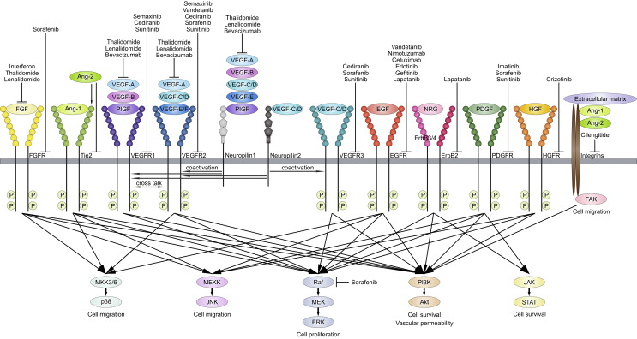
Anti-angiogenic Agents and Multi-Kinase Inhibitors
Reprinted from Critical Reviews in Oncology/Hematology, 89, 3, Sie, et al, Anti-angiogenic therapy in pediatric brain tumors: An effective strategy?,418-432, Copyright 2014, with permission from Elsevier

Slide 77
Multi-targeted Tyrosine Kinase Inhibitors
 | Axitinib | Cabozantinib | Pazopanib | Regorafenib | Sorafenib | Sunitinib | Vandetanib
Target | VEGF, PDGF, c-KIT | VEGF1/2/3, c-KIT, FLT3 | VEGF, PDGF, c-KIT | VEGF, PDGF, c-KIT | VEGF1/2/3, PDGF, c-KIT, RAF, FLT3 | VEGF, PDGF, c-KIT | VEGF, EGFR, RET
FDA approval | Renal Cell Carcinoma (RCC) | Medullary Thyroid Cancer (MTC), Hepatocellular Carcinoma | RCC, soft tissue sarcoma | Metastatic colorectal cancer | RCC, hepatocellular carcinoma | RCC, GIST | MTC
Study in Children | Phase 1 | Phase 1, 2 | Phase 1 | Phase 1 | Phase 1, 2, Phase3 (AML) | Phase 1 | MTC
Toxicity | Hypertension, diarrhea, fatigue, rash, nausea | Hypertension, fatigue, wound healing,nausea pneumothorax Amylase/lipase | Hypertension diarrhea, elevated liver function | Rash, low platelets, hepatic, fatigue, nausea | Rash, hypertensiondiarrhea, bleeding | Cardiac dysfunction, hypertension, diarrhea, mucositis, rash | Prolong QTc, hypertension, diarrhea, rash
For Bevacizumab see Monoclonal Antibody

Slide 78
Toxicity Profile of Tyrosine Kinase Inhibitors (TKIs)
Toxicity | Drugs
Skin rash | EGFR, MEK, PI3K/mTOR inhibitors
Diarrhea | EGFR, VEGFR, MEK, PI3K inhibitors
Hypertension | VEGFR inhibitors
Hypothyroidism | VEGFR inhibitors
Proteinuria | VEGFR inhibitors
Skin/hair depigmentation | PDGFR, RET inhibitors
Hemorrhage | VEGFR inhibitors
Thromboembolism (clots) | VEGFR inhibitors
Hepatic | Common to many
Hyperglycemia | PI3K/mTOR inhibitors

Slide 79
Anaplastic Lymphoma Kinases (ALK) Inhibitors
Adults: ALK Inhibitors are FDA approved for Non-Small Cell Lung Cancer harboring ALK-EML4 .
Children:
Large Cell Anaplastic Lymphoma t(2,15) NPM-ALK-
  crizotinib results in rapid durable objective responses in 67% of children with Relapsed ALCL
Inflammatory Myofibroblastic Tumors- over expression of ALK
Neuroblastoma- gain of function ALK mutations R1275, F1174, F1245 or ALK amplification
  Tolerable doses of crizotinib in children with NBL (280 mg/m²/dose BID) are tolerated and needed for activity based on pre-clinical models
  Phase 3 Trial ANBL1531 incorporates ALK inhibitor with standard multimodality therapy in patients with tumors ALK mutations at diagnosis
Drugs: Crizotinib, Lorlatinib, Ceritinib
Toxicity: Mild neutropenia, hepatotoxicity, acute kidney injury
ALK inhibitors with CNS penetration (lorlatinib) are associated with mental status changes,seizures, and neurocognitive dysfunction

Slide 80
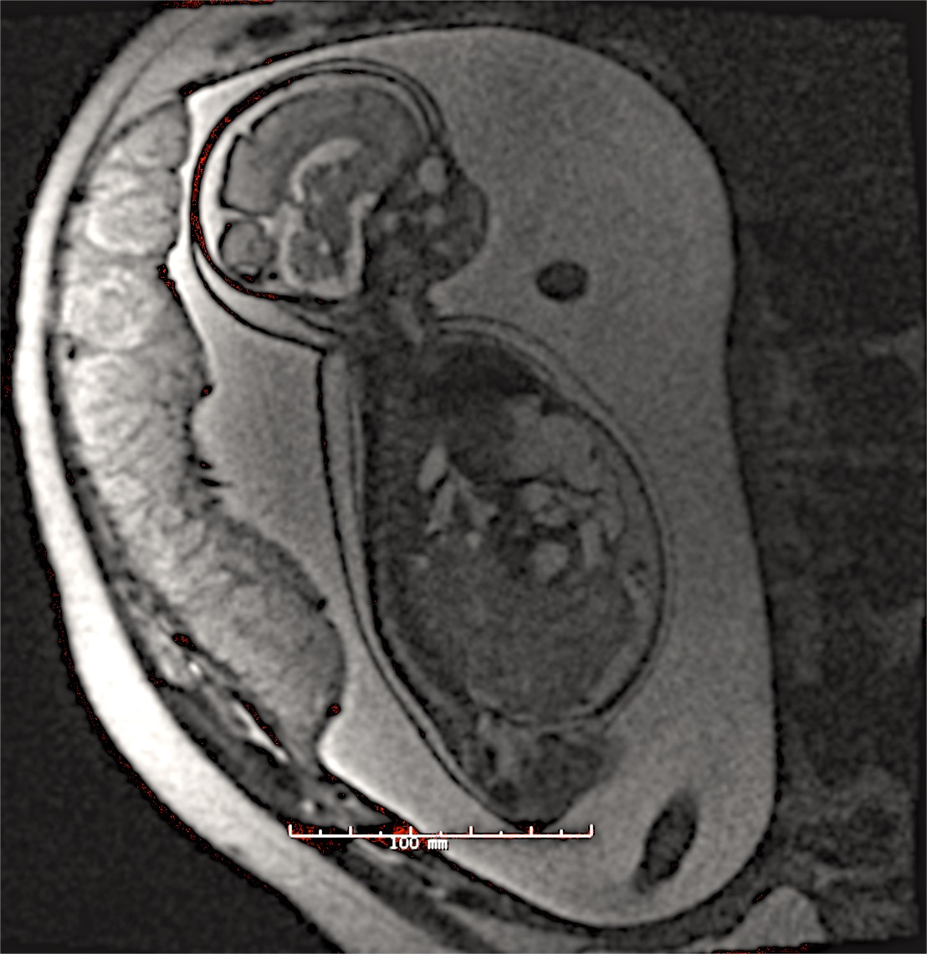
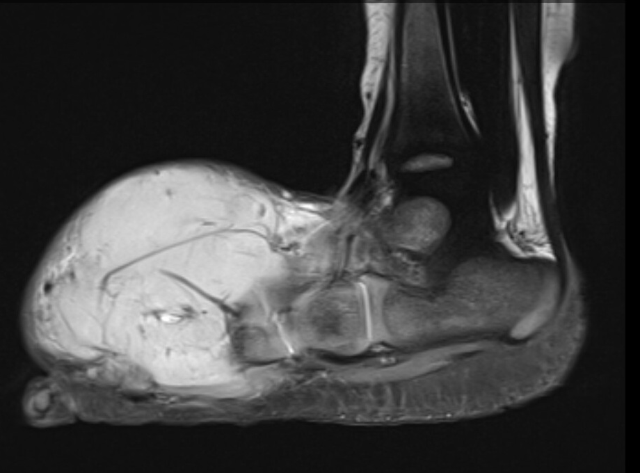
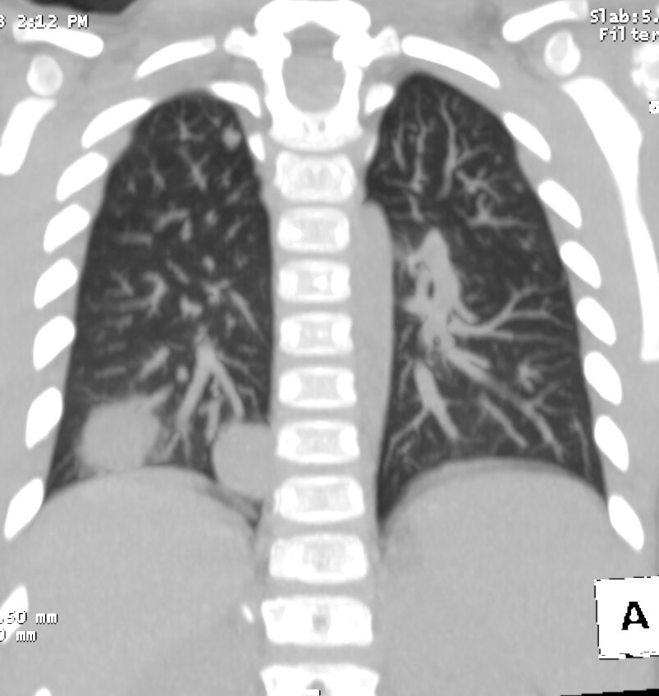
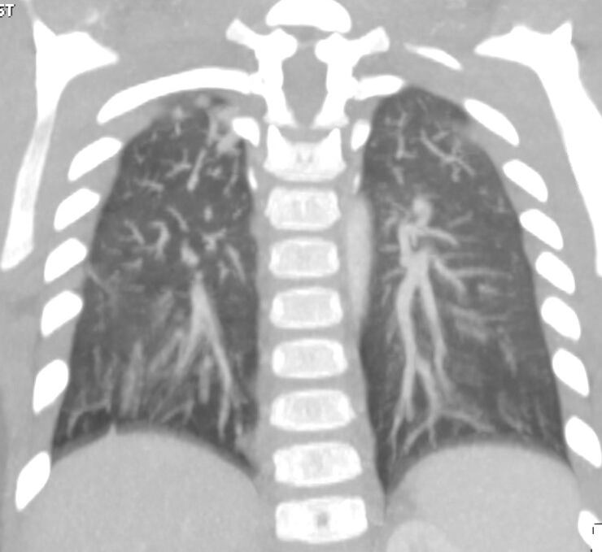
NTRK Inhibitors for Rare Tumors
Neurotropic Receptor Kinase
NTRK fusion oncoproteins (NTRK-ETV6 and other fusion partners)
  Occur rarely (<5%) in common cancers (adenocarcinoma, soft tissue sarcoma, leukemia)
  Occur occasionally (5-25%) papillary thyroid cancer, some gliomas, GIST
  Occur frequently (>90%) in rare tumors (congenital mesoblastic nephroma, infantile fibrosarcoma, secretory breast carcinoma)
Congenital Mesoplastic Nephroma
Infantile Fibrosarcoma
Initial Presentation
Recurrence
Larotrectinib x 6 months
Notes:
This demonstrates that the phenominal success when the drug is a potent inhibiotr of the target and the target is an oncofusion protein irrespective of the histology of the tumor

Slide 81
NTRK Inhibitors
 | Larotrectinib | Entrectinib
Reference | Laetsch et al Lancet Oncology 2018 | Desai et al ASCO 2018; Robinson et al ASCO 2019
Population | Adults and Children Biomarker enriched/selected | Children and Adolescents Solid tumor Dose Escalation; biomarker expansion
Dose Limiting Toxicities | increased ALT | pulmonary edema, fatigue, dysguesia, elevated creatinine; weight gain, ataxia, bone fractures
MTD | No | Yes
Pediatric RP2D | 100 mg/m² BID (max 100 mg/dose) | 550 mg/m² Daily
Adult RP2D | 100 mg BID | 600 mg/day (˜350 mg/m²)
Objective Response | 14/15 patients with fusion positive tumors | 8/11 patients with fusion positive tumors
Formulations | 25 or 100 mg capsules; 20 mg/mL oral solution | 100 and 200 mg capsules
FDA Approval | Age and Histology Agnostic Approval (NTRK fusion positive solid tumors) | Histology Agnostic Approval for patients > 12 years (NTRK fusion positive solid tumors)
Notes:
These studies and the approval and authorization of NTRK inhibitors in children and adults demonstrate clear success, however the work is not complete.
The Chldren’s Oncology Group has just launched a Phase 2 trial of larotrectinib in children with newly diagnosed NTRK fusion solid tumors to determine if neoadjuvant therapy with larotrectinib can decrease surgical morbidity and determine how best to use larotrectinib in the adjuvant setting and assess potential neurocognitive impact of NTRK inhibition.

Slide 82
Inhibition of DNA Methylation
Azacitidine: pyrimidine nucleoside analogue of cytidine.
incorporates into DNA reversibly inhibiting DNA methyltransferase blocks DNA methylation.
Hypomethylation of DNA activates tumor suppressor genes silenced by hypermethylation
incorporated into RNA and disrupts normal RNA function and impairing tRNA cytosine-5-methyltransferase activity.
deoxy derivative, decitabine (5-aza-2′-deoxycytidine)
Toxicity: nausea, vomiting, fevers, diarrhea, bruising, petechiae, rigors, weakness, hypokalemia, constipation
Tazometostat: Activating enhancer of zeste homolog 2 (EZH2) mutations or aberrations of the switch/sucrose non-fermentable (SWI/SNF) complex (eg, mutations or deletions of the subunits INI1 or SMARCA4) can lead to aberrant histone methylation
Toxicity: anorexia, muscle spasms, nausea, vomiting,

Slide 83
Histone Deacetylase (HDAC) Inhibitors
Valproic- Anti- anticonvulsant found to have HDAC inhibitory and histone hyperacetylation.
Toxicity: somnolence, intratumor hemorrhage, pandreatitis (Su et al Clin Can Res 2011 Feb 1;17(3):589-97.)
Vorinostat- oral pan-HDACi targeting a broad range of HDACs including HDAC1, HDAC2, and HDAC3 (Class I) and HDAC6 (Class IIb)
Toxicity: thrombocytopenia, fatigue, nausea, diarrhea, anemia, and vomiting (vanTilburg et al Clinical Epigenetics, 2019 11: 188-200)
Etinostat an oral small molecule inhibitor of class I HDACs (HDACs 1, 2, 3, and 11).
Fatigue, vomiting, diarrhea, thrombocytopenia, neutropenia
Condensed (Deacetylated) Chromatin
(transcriptional gene repression)
Histone Deacetylase
(HDAC)
Histone Acetyl Transferase (HAT)
Decondensed (Acetylated)Chromatin
(transcriptional gene activation)

Slide 84
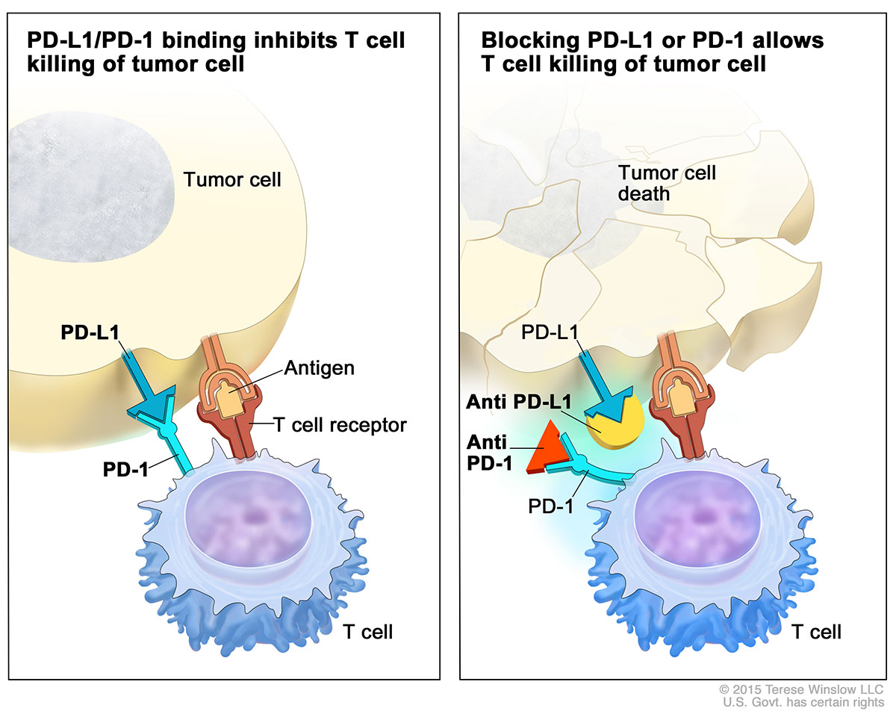
Immune Checkpoint Inhibitors (ICI)
Credit: National Cancer Institute / Terese Winslow; https://www.cancer.gov/news-events/cancer-currents-blog/2015/gulley-checkpoint

Slide 85
Immune Checkpoint Inhibition in Childhood Cancer
 | Atezolizumab | Nivolumab | Pembrolizumab
 | Geoerger et al Lancet Onc 2020, 21:134-44 | Davis et al Lancet Onc 2020, 21:541-50 | Geoerger et al Lancet Onc 2020, 21:134-44
N | 115 screened/90 enrolled | 85 enrolled/75 evaluable toxicity | 863 screened/155 eligible/ 154 enrolled
Age (years) | 14y IQR(10-17) | 14y IQR(8-17) | 13y IQR(8-15)
PD-1/PDL-1 selection | No | No | Yes
Common Toxicity | Anemia, Fever, Fatigue | Anemia, Fatigue | Anemia, Hepatic function
Serious Adverse Events | Fever, infection | Pleural effusion | Fever, pleural effusion, pneumonitis
Objective Response Rate | ORR= 5% 2/9 Hodgkin Lymphoma; 1/11 EWS 1 malig rhabdoid tumor | ORR=5% 3/10 Hodgkin Lymphoma 1/10 NHL | ORR=10% 9/15 Hodgkin Lymphoma; 2 ACC; 1 malig rhabdoid tumor, 4 other rare tumors

Slide 86
Immune Related Adverse Effects (irAEs) of ICI
Fatal toxic effects associated with ICIs occur at a rate of 0.3-1.3%
irAEs are more frequent for Anti-CTLA-4 alone or in combination with PD-1/PD-L1 therapy
Occur “early” in the course of therapy and result in rapid deterioration
  Anti- PD-1/PDL-1 onset 40 days
  Anti CTLA 4 onset 40 days
  Combination Anti-PD-1+ Anti-CTLA4 14 days
Immune related events that resulted in fatalities in adults include: Colitis, pneumonitis , hepatitis, myocarditis, neurologic, nephritis, multiorgan failure
Myocarditis has the highest fatality rate with 40% of reported cases of myocarditis resulting in death
Effective management depends on early recognition and prompt intervention with immune suppression (methylprednisolone) and/or immunomodulatory strategies.
Wang et al Jama Oncology 2018;4(12):1721-1728.

Slide 87
Antibodies
Drug | Type | Target | Mechanism of Action | Tumors | Toxicity
Bevacizumab | humanized | VEGF 1/2/3 | Blocks angiogenesis | Brain tumors in children | Hypertension, rash, proteinuria, Growth plate changes, fatigue
Rituximab | chimeric | CD-20 | Depletes normal B-cells and antibody | B cell lymphoma, post transplant lymphoprolifer-ative disorder | Infusion reactions (fever, chills, flu-like symptoms) bronchospasm, hypotension, angioedema Lymphopenia (recovery 9-12 mo) Hypogammaglobulinemia/opportunistic infections
Dinutuximab Dinutuximab ß | Chimeric Cloned in cell lines | GD2 | Antibody dependent cell mediated cytotoxicity (ADCC) | Neuroblastoma | Neuropathic pain, capillary leak, hypersensitivity, rare transverse myelitis

Slide 88
Antibody Drug Conjugates
Drug | Type | Target | Payload | Mechanism of Action | Tumors | Toxicity
Gemtuzumab Ozogamicin | humanized | CD-33 | N- acetyl calicheamicin | Calicheamicin is internalized and binds DNA creating double strand breaks | AML | Infusion related reactions, myelosuppression, serious infections
Inotuzumab Ozogamicin | humanized | CD-22 | Ozogamicin (calicheamicin) | Ozogamicin is internalized and binds DNA creating double strand breaks | B-cell malignancies | Infusion reaction, Myelosuppression, infection, hepatotoxicity, post transplant SOS
Brentuximab Vendotin | chimeric | CD-30 | Monomethyl auristatin E (MMAE) | Tubulin binding agent | Hodgkin Lymphoma, ALCL | Neutropenia,, neuropathy, fatigue, fever, anorexia, nausea, vomiting Infusion reaction, rare leukoencephalopathy

Slide 89
Summary Targeted Therapies
For many children, current therapies are curative
Goal of developing new agents for childhood cancer is to improve overall survival and reduce acute and late effects of therapy
Targeted therapies have class specific toxicity profiles that differ from cytotoxic therapies
New endpoints and trial designs will be required for dose-finding trials of less toxic molecularly-targeted anticancer drugs
RACE for children act endeavors to increase evaluation and accelerate drug development for children with cancer.

